Slide 1
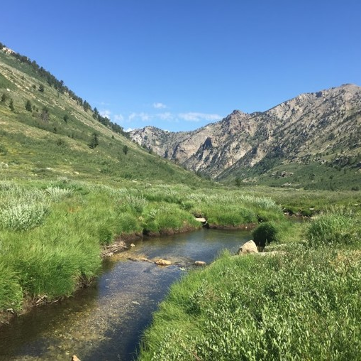
Home Means Nevada
Exploring Nevada Habitats

Slide 2
“Home means __________,
Home means the __________,
Home means the ________ and the ________.
Out by the Truckee’s silvery ________,
Out where the ________ always shines.”
Do you know the words to Nevada’s state song?

Slide 3
Do you know the words to Nevada’s state song?
“Home means Nevada,
Home means the hills,
Home means the sage and the pine.
Out by the Truckee’s silvery rills,
Out where the sun always shines.”

Slide 4

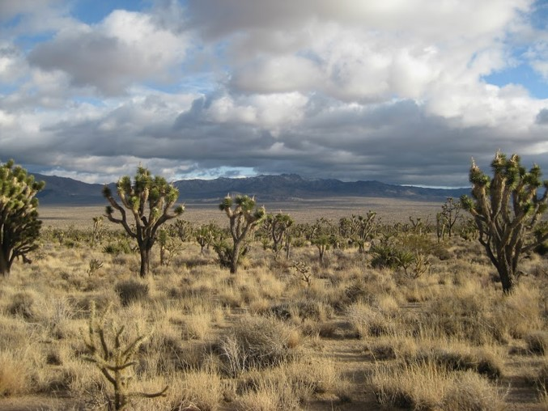
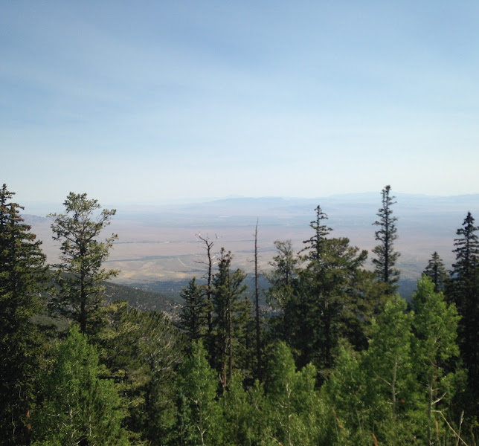
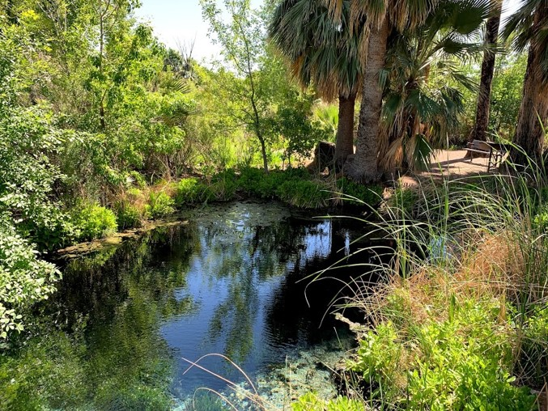
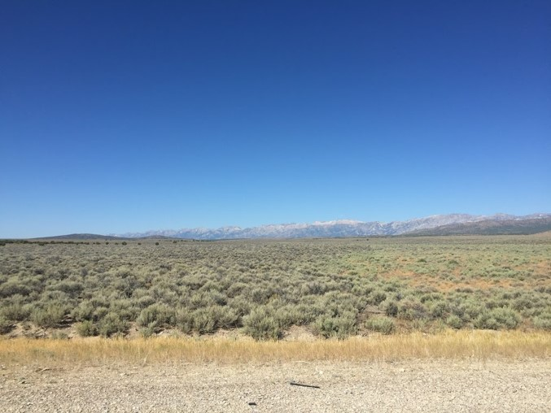
Sage? Pine? RILLS?
If you live in the Las Vegas valley, the Nevada described in our state song may not seem very familiar to you. Here in Southern Nevada, we live in the Mojave Desert. If you travel north, you’ll get to a colder desert called the Great Basin Desert. In the mountains, where it’s wetter and cooler, you’ll find forests. And where there’s lots of water, you’ll find a habitat called a wetland.
All of these places are habitats for Nevada’s animals.

Slide 5
What is a habitat?

Slide 6
What is a habitat?
A habitat is a place where a plant or animal lives in nature.
Can you think of some things that animals need to have in their habitats? Hint: What things do YOU need to survive?

Slide 7
Habitats need to have . . .

Slide 8
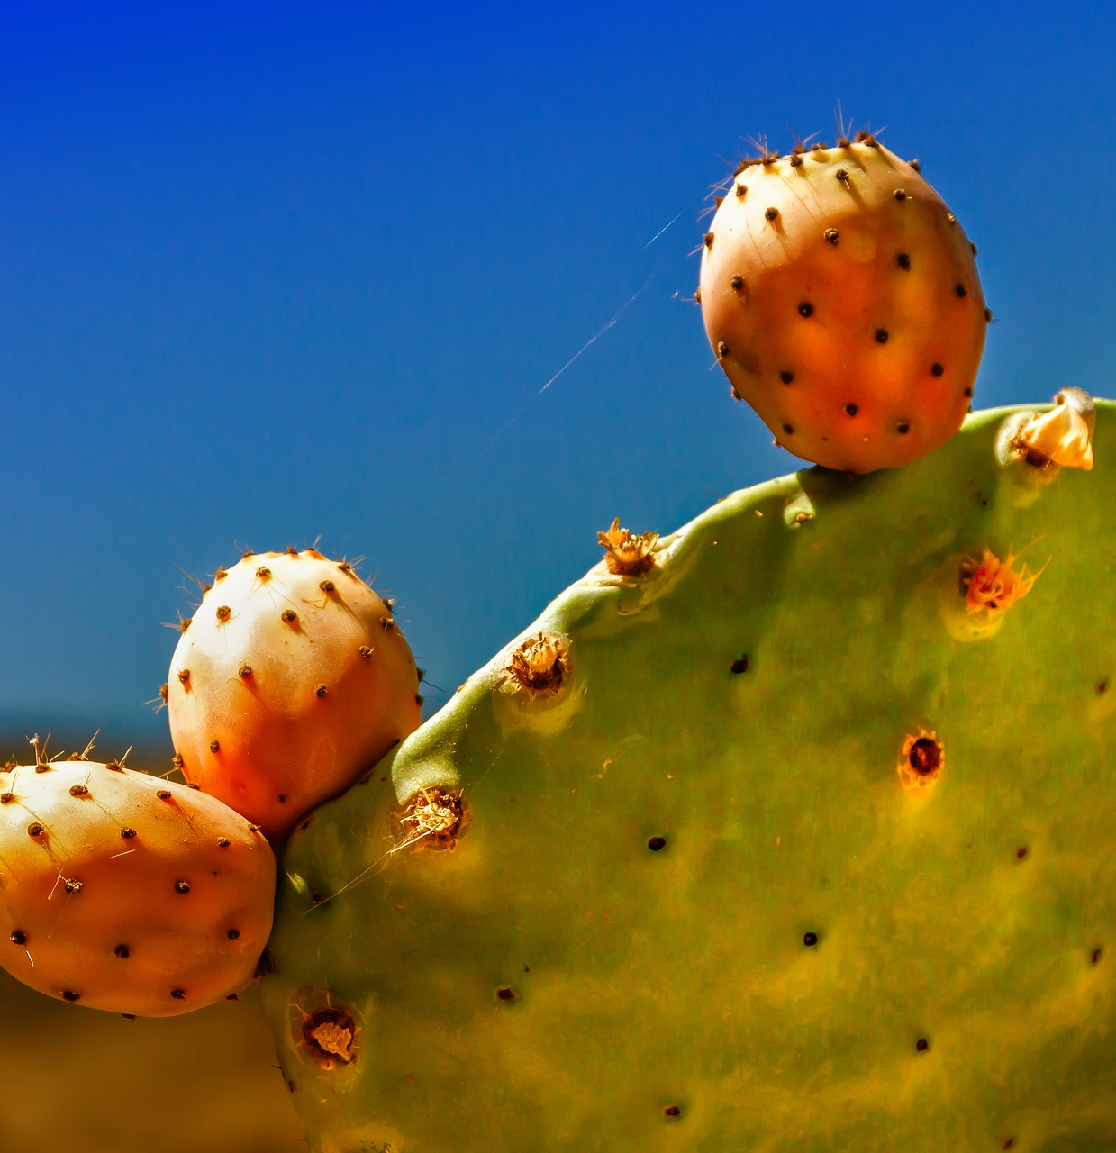
Habitats need to have . . .
food

Slide 9

Habitats need to have . . .
food
water

Slide 10
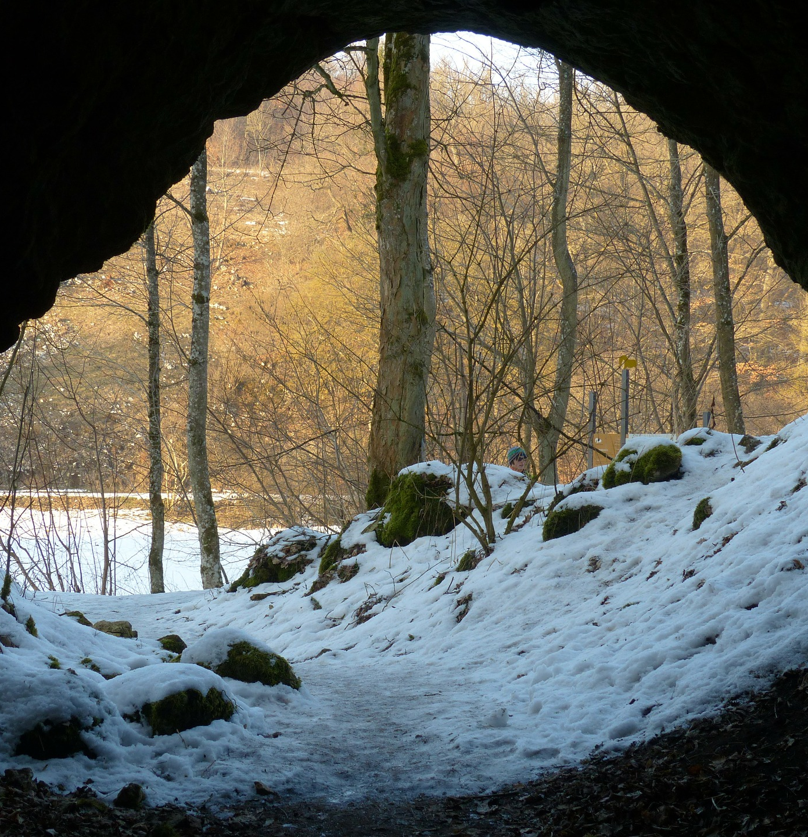
Habitats need to have . . .
food
water
shelter

Slide 11
What is an adaptation?

Slide 12
What is an adaptation?
An adaptation is something an animal has or does to help it survive.
While you’re learning about different kinds of habitats, think about the different adaptations animals have to live in those habitats.

Slide 13
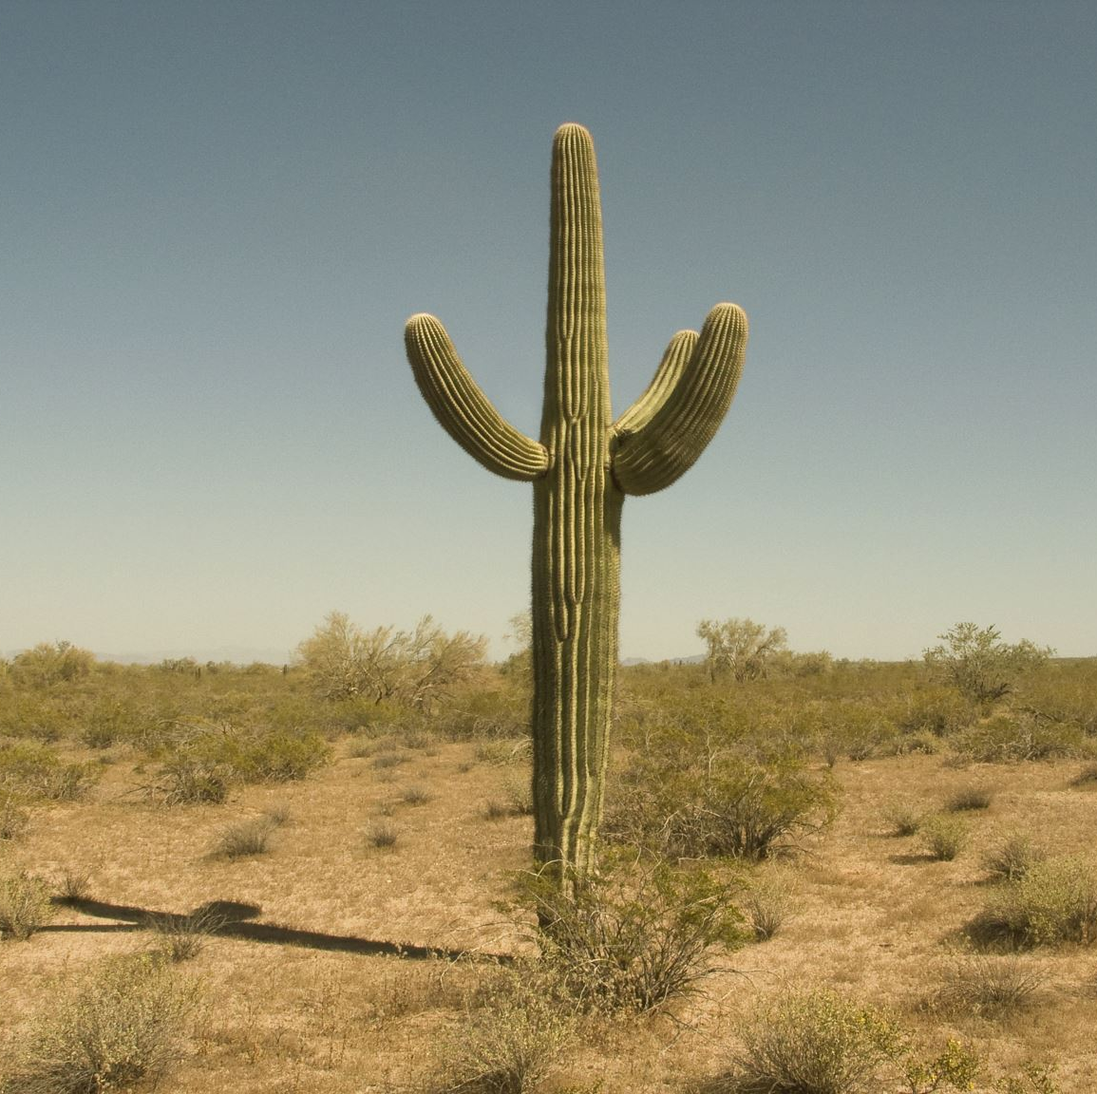
DESERT
A desert is a place that gets very little rain.
Deserts can be hot or cold, but they are always dry.
There are two deserts in Nevada – the Mojave Desert and the Great Basin Desert.

Slide 14
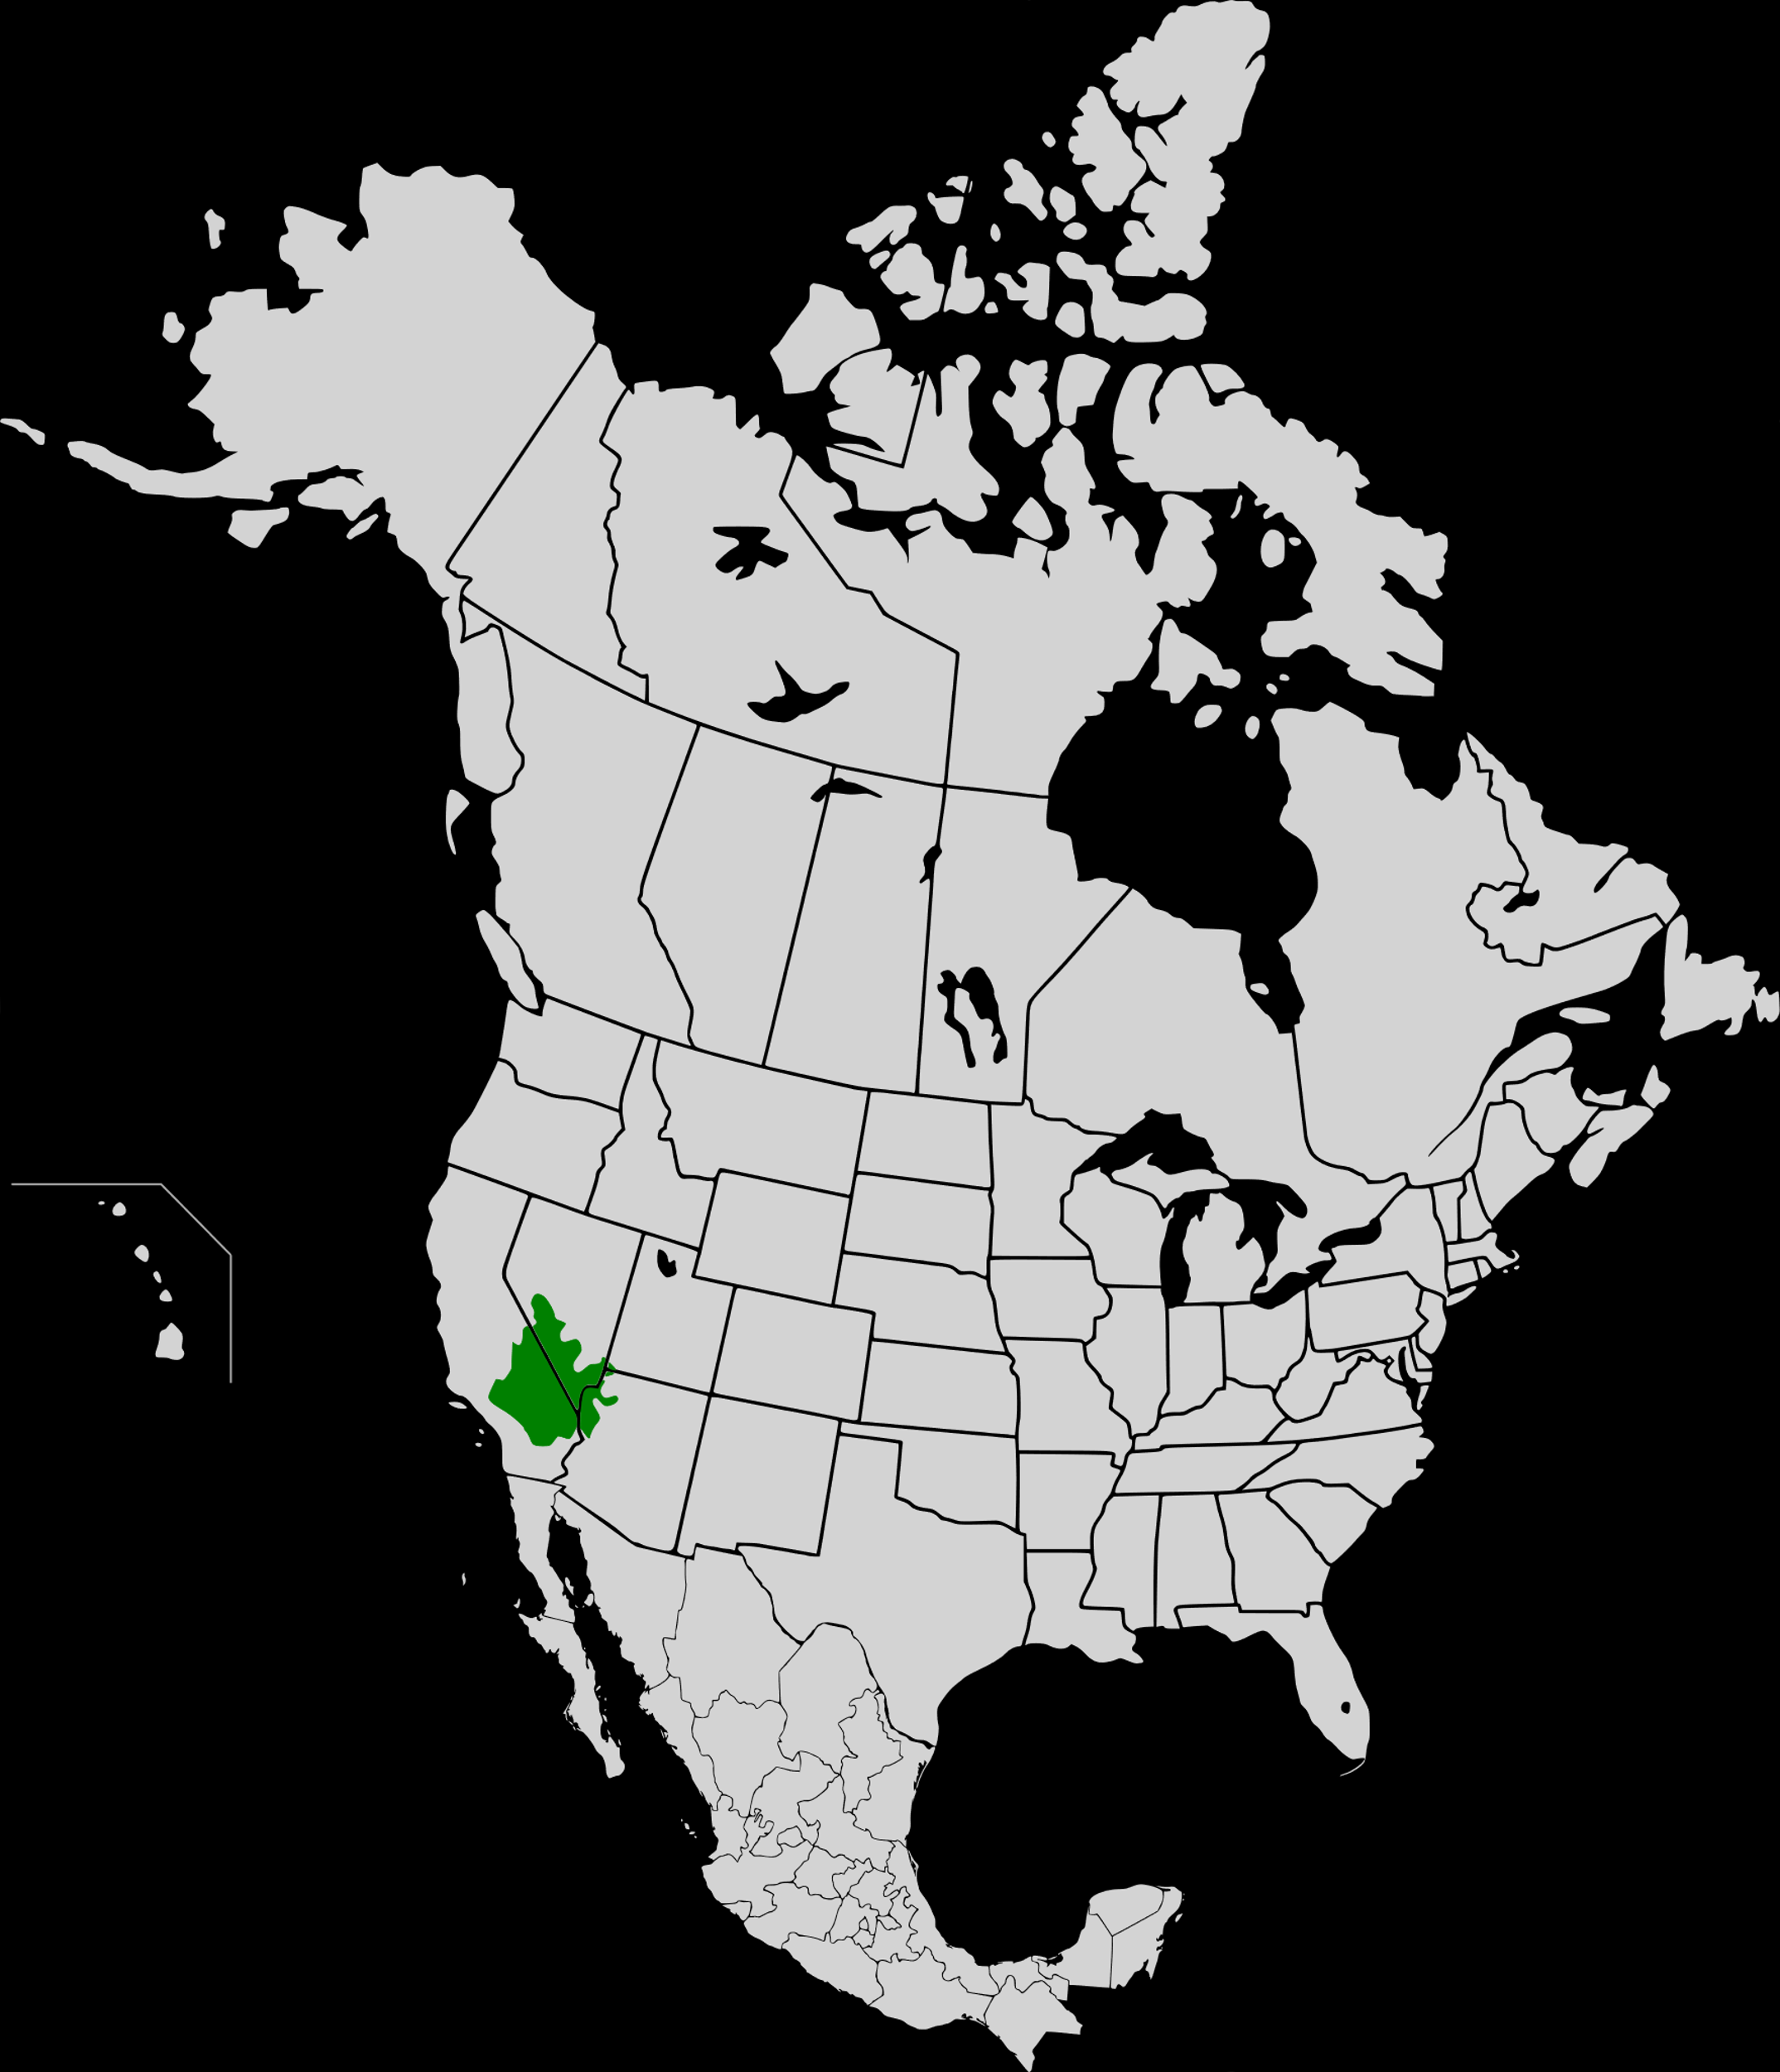
Mojave Desert
A dry and hot desert.
The hottest temperature ever recorded, 134 degrees Fahrenheit, was recorded in the Mojave Desert.
Windy days are common.
Las Vegas is the largest city in the Mojave Desert.
By Cephas (talk · contribs) - North America second level political division 2.svgTerrestrial ecoregions of North America : a conservation assessment. Taylor H Ricketts; et al. Washington, D.C. : Island Press, ©1999. xxiv, 485 p. : ill. (some col.), maps (some col.) ; 28 cm. (ISBN 9781559637220), CC BY-SA 3.0, https://commons.wikimedia.org/w/index.php?curid=12369094

Slide 15
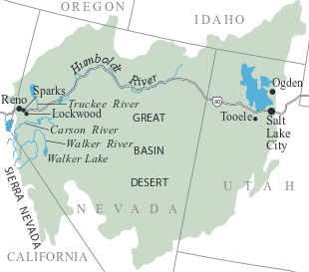
Great Basin Desert
SAGE!
The Great Basin Desert covers most of Nevada.
Unlike the Mojave Desert, the Great Basin Desert gets lots of snow in the winter.
A shrub called sagebrush is common. Sagebrush flowers are the official Nevada state flower!

Slide 16
What are some animals that live in the desert?
What adaptations do they have?

Slide 17
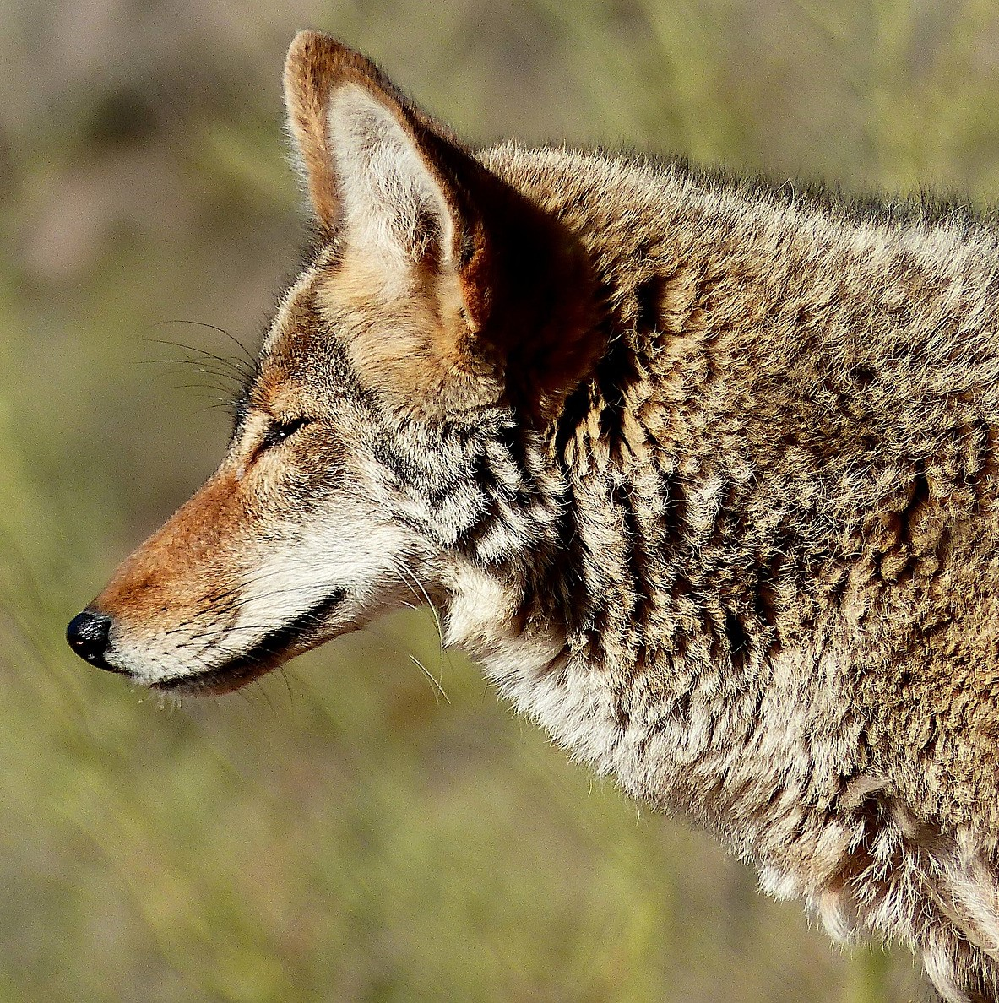
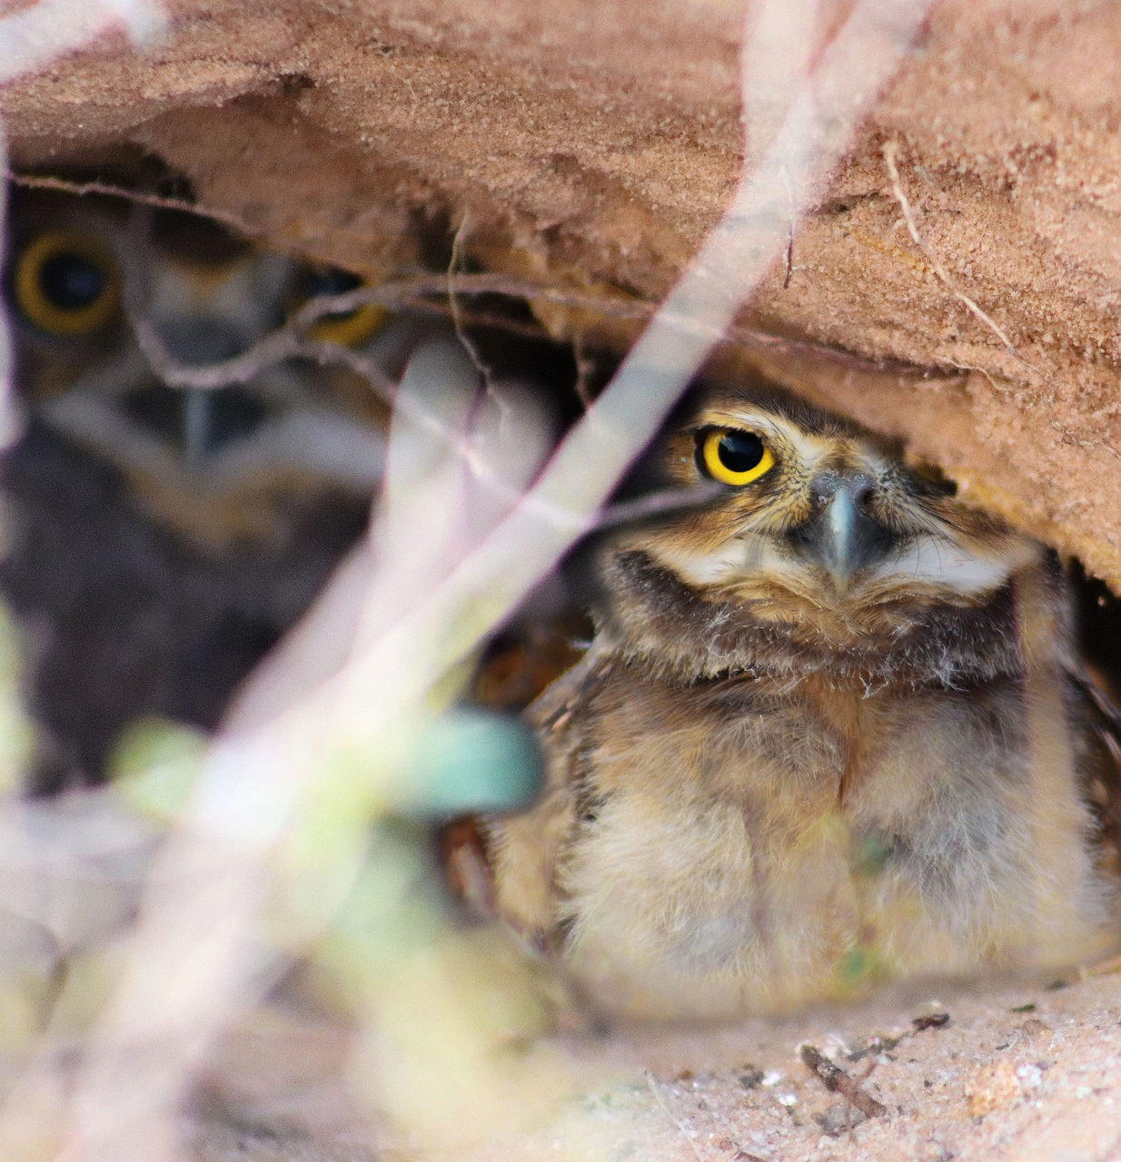
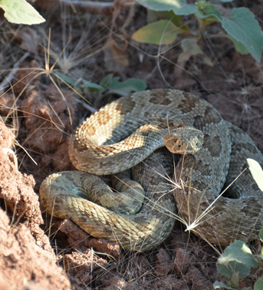
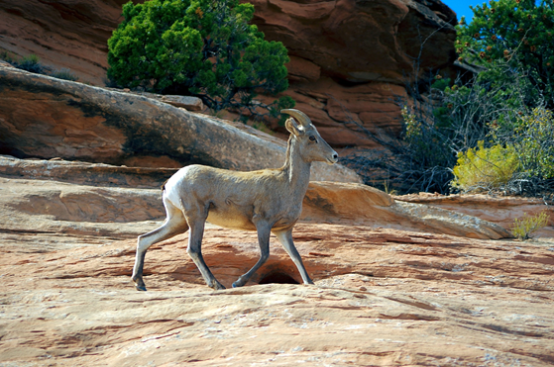
What are some animals that live in the desert?
What adaptations do they have?

Slide 18
Have you ever explored a desert habitat?
Here are some places you can explore the desert near Las Vegas . . .

Slide 19
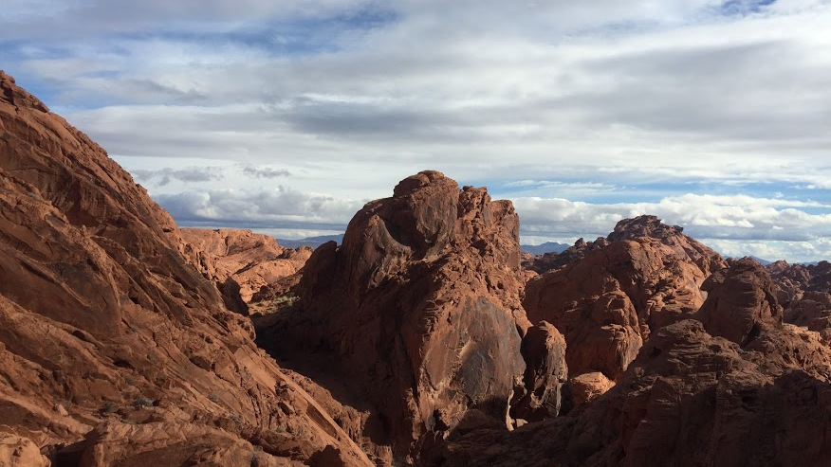
Valley of Fire State Park

Slide 20
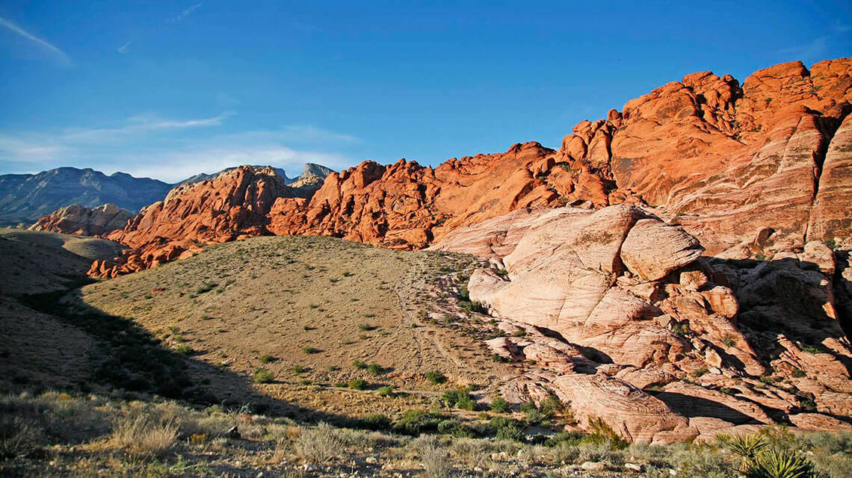
Red Rock Canyon National Conservation Area

Slide 21
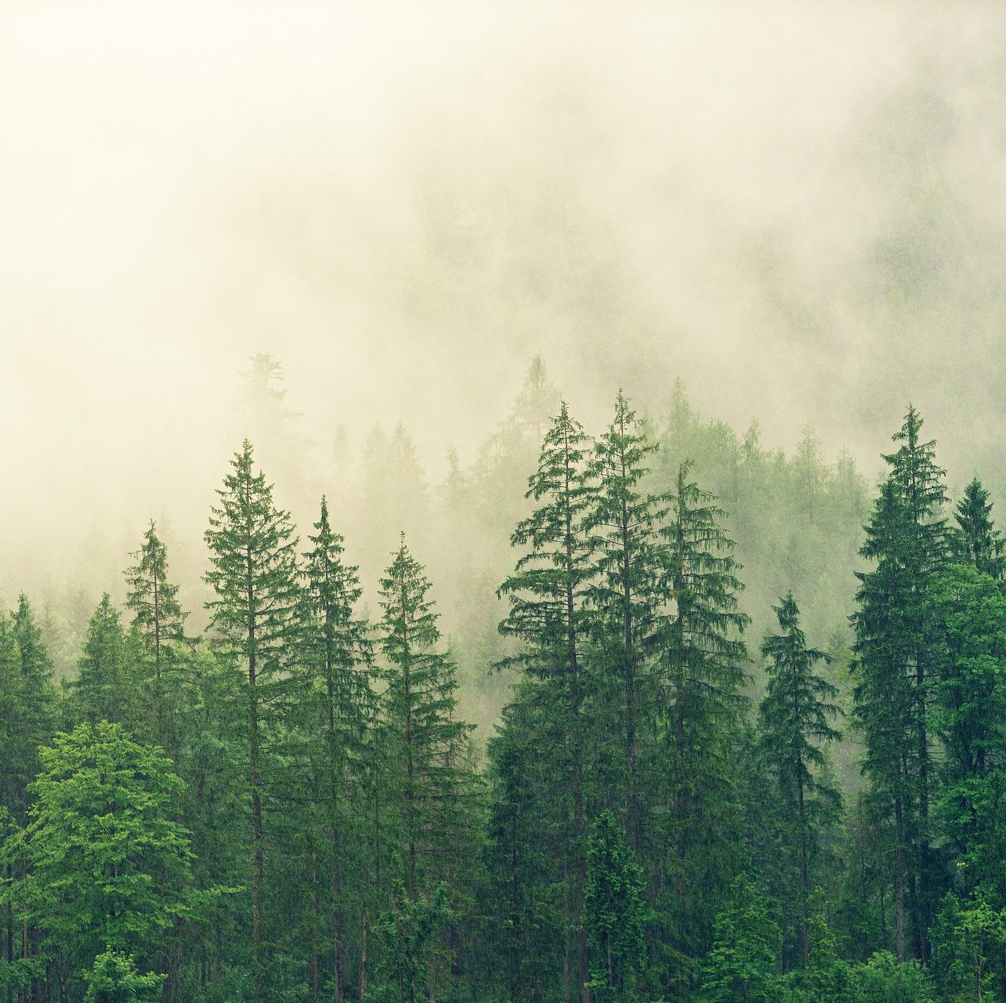
FOREST
PINES!
A forest is a type of habitat covered with trees.
Trees in a forest can be deciduous (lose their leaves in winter) or evergreen (keep their leaves in winter).
In Nevada, forests are found high in the mountains. Even though Nevada is known as a desert state, we have more mountain ranges than any other state!

Slide 22
What are some animals that live in the forest?
What adaptations do they have?

Slide 23
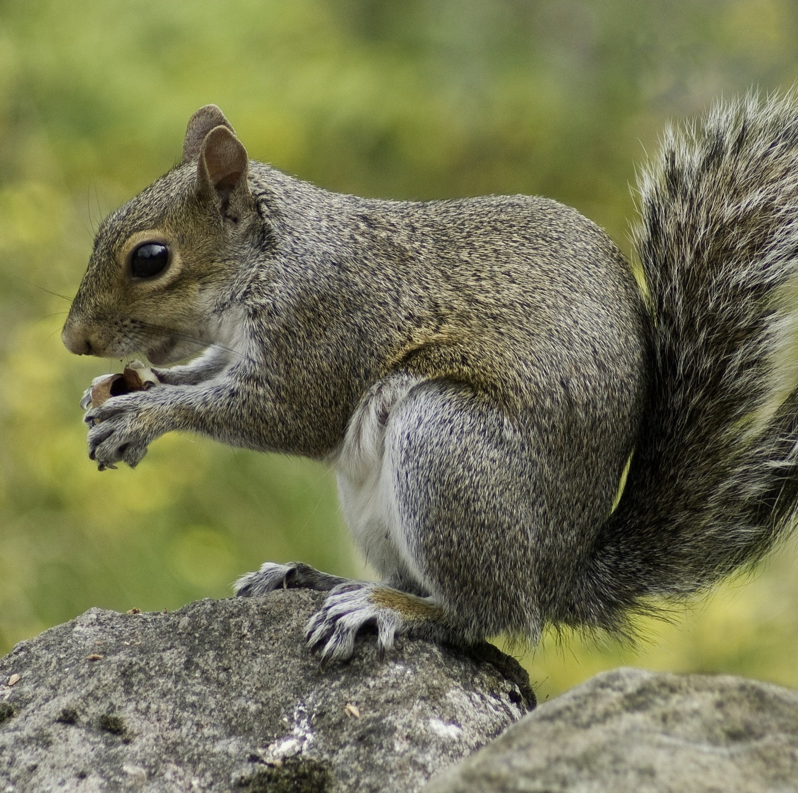
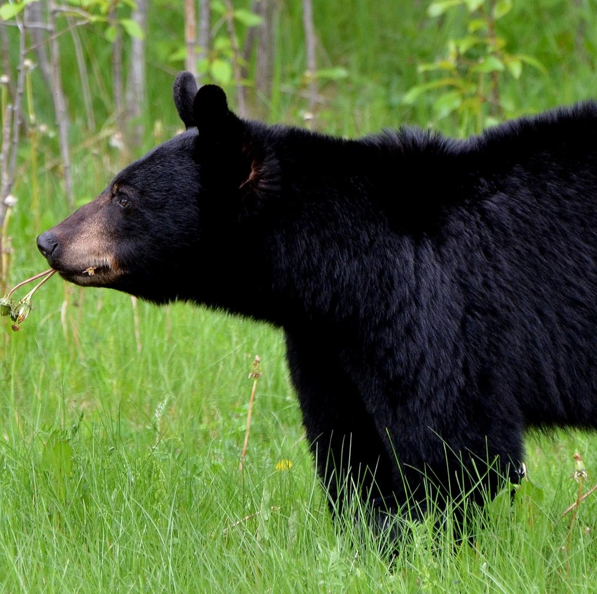
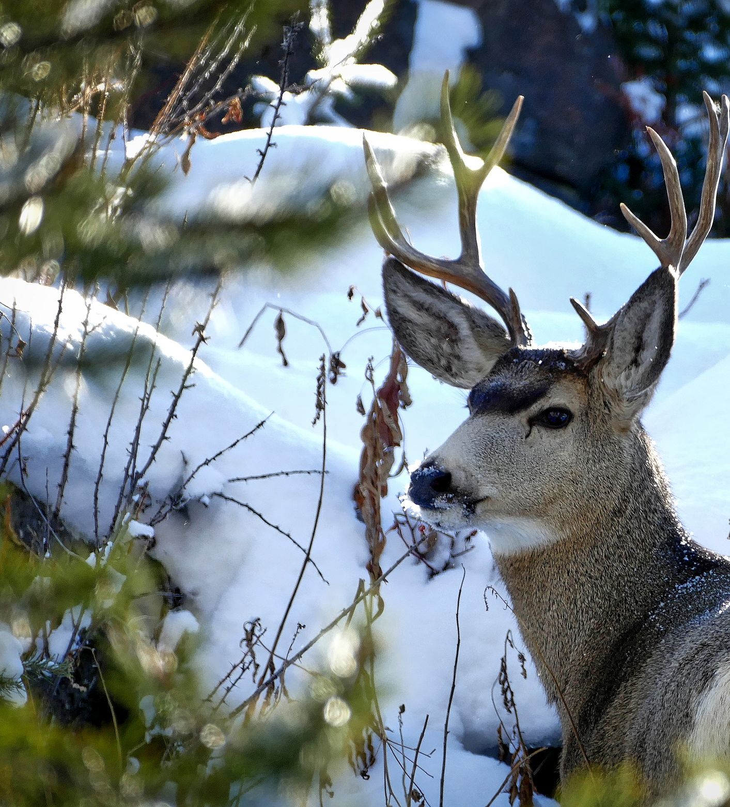
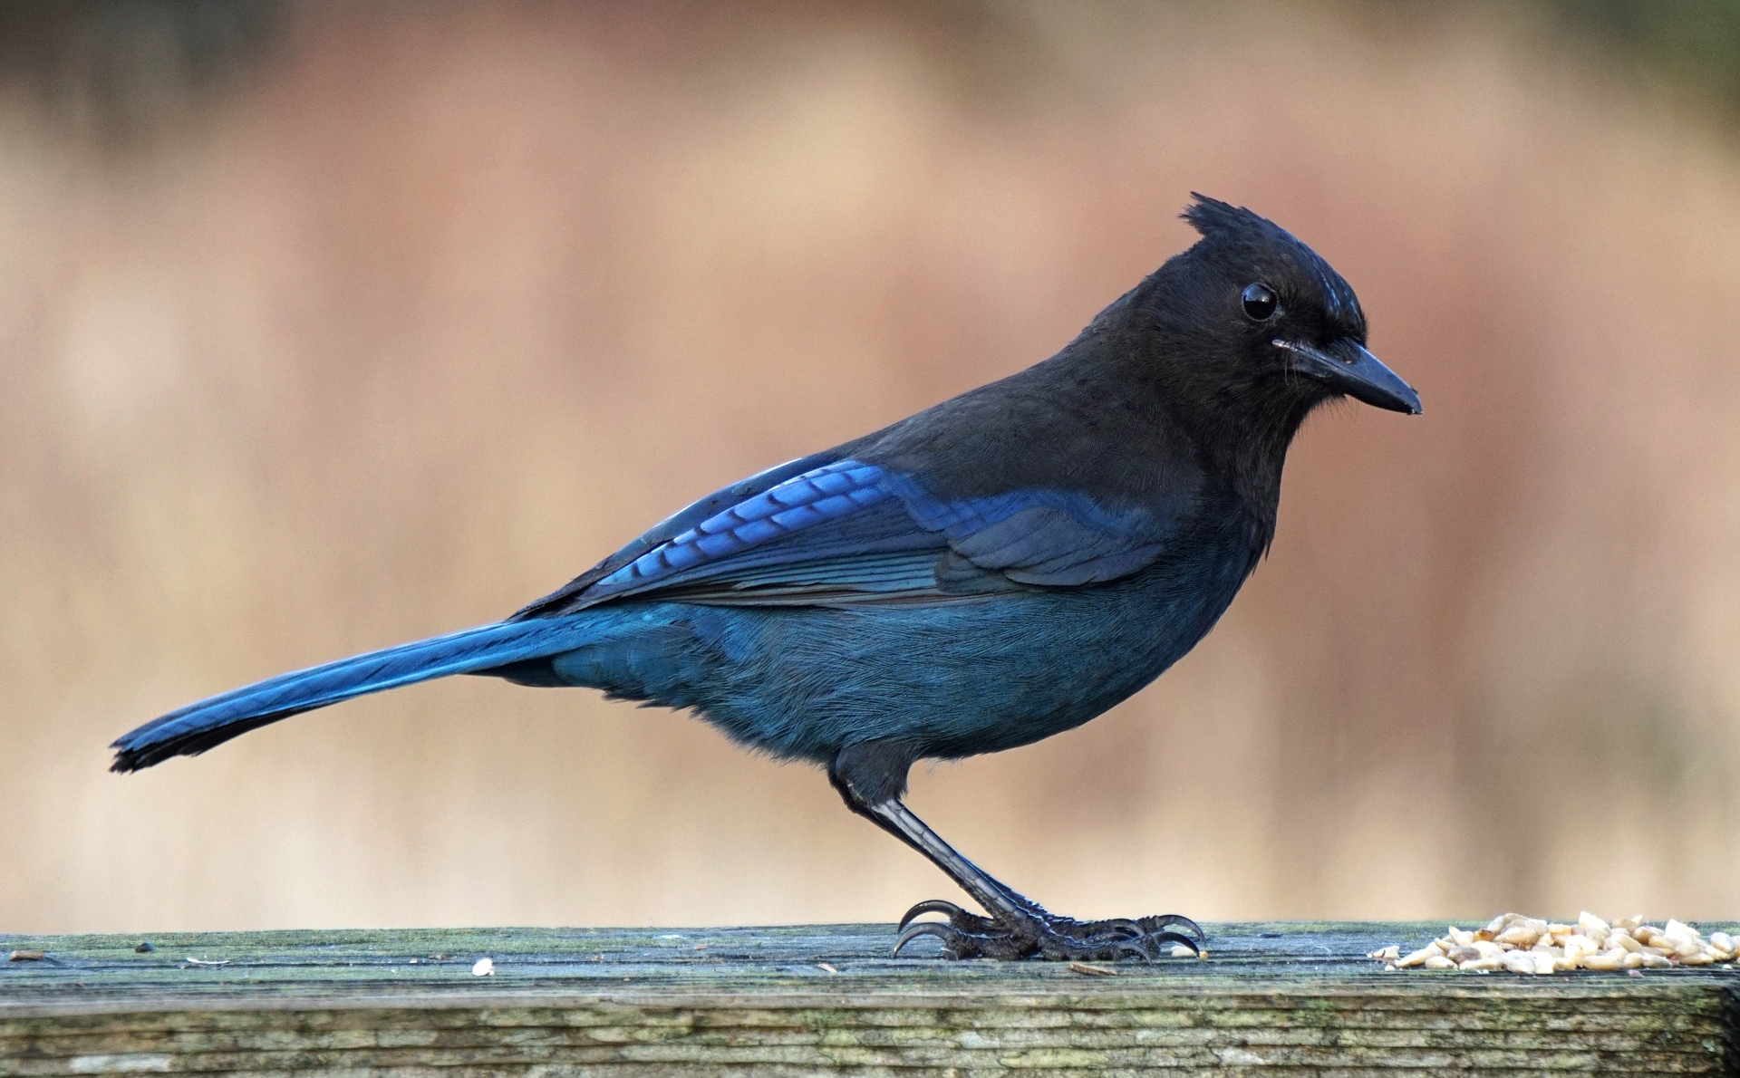
What are some animals that live in the forest?
What adaptations do they have?

Slide 24
Have you ever been to a forest?
Here are some places you can explore forests near Las Vegas . . .

Slide 25
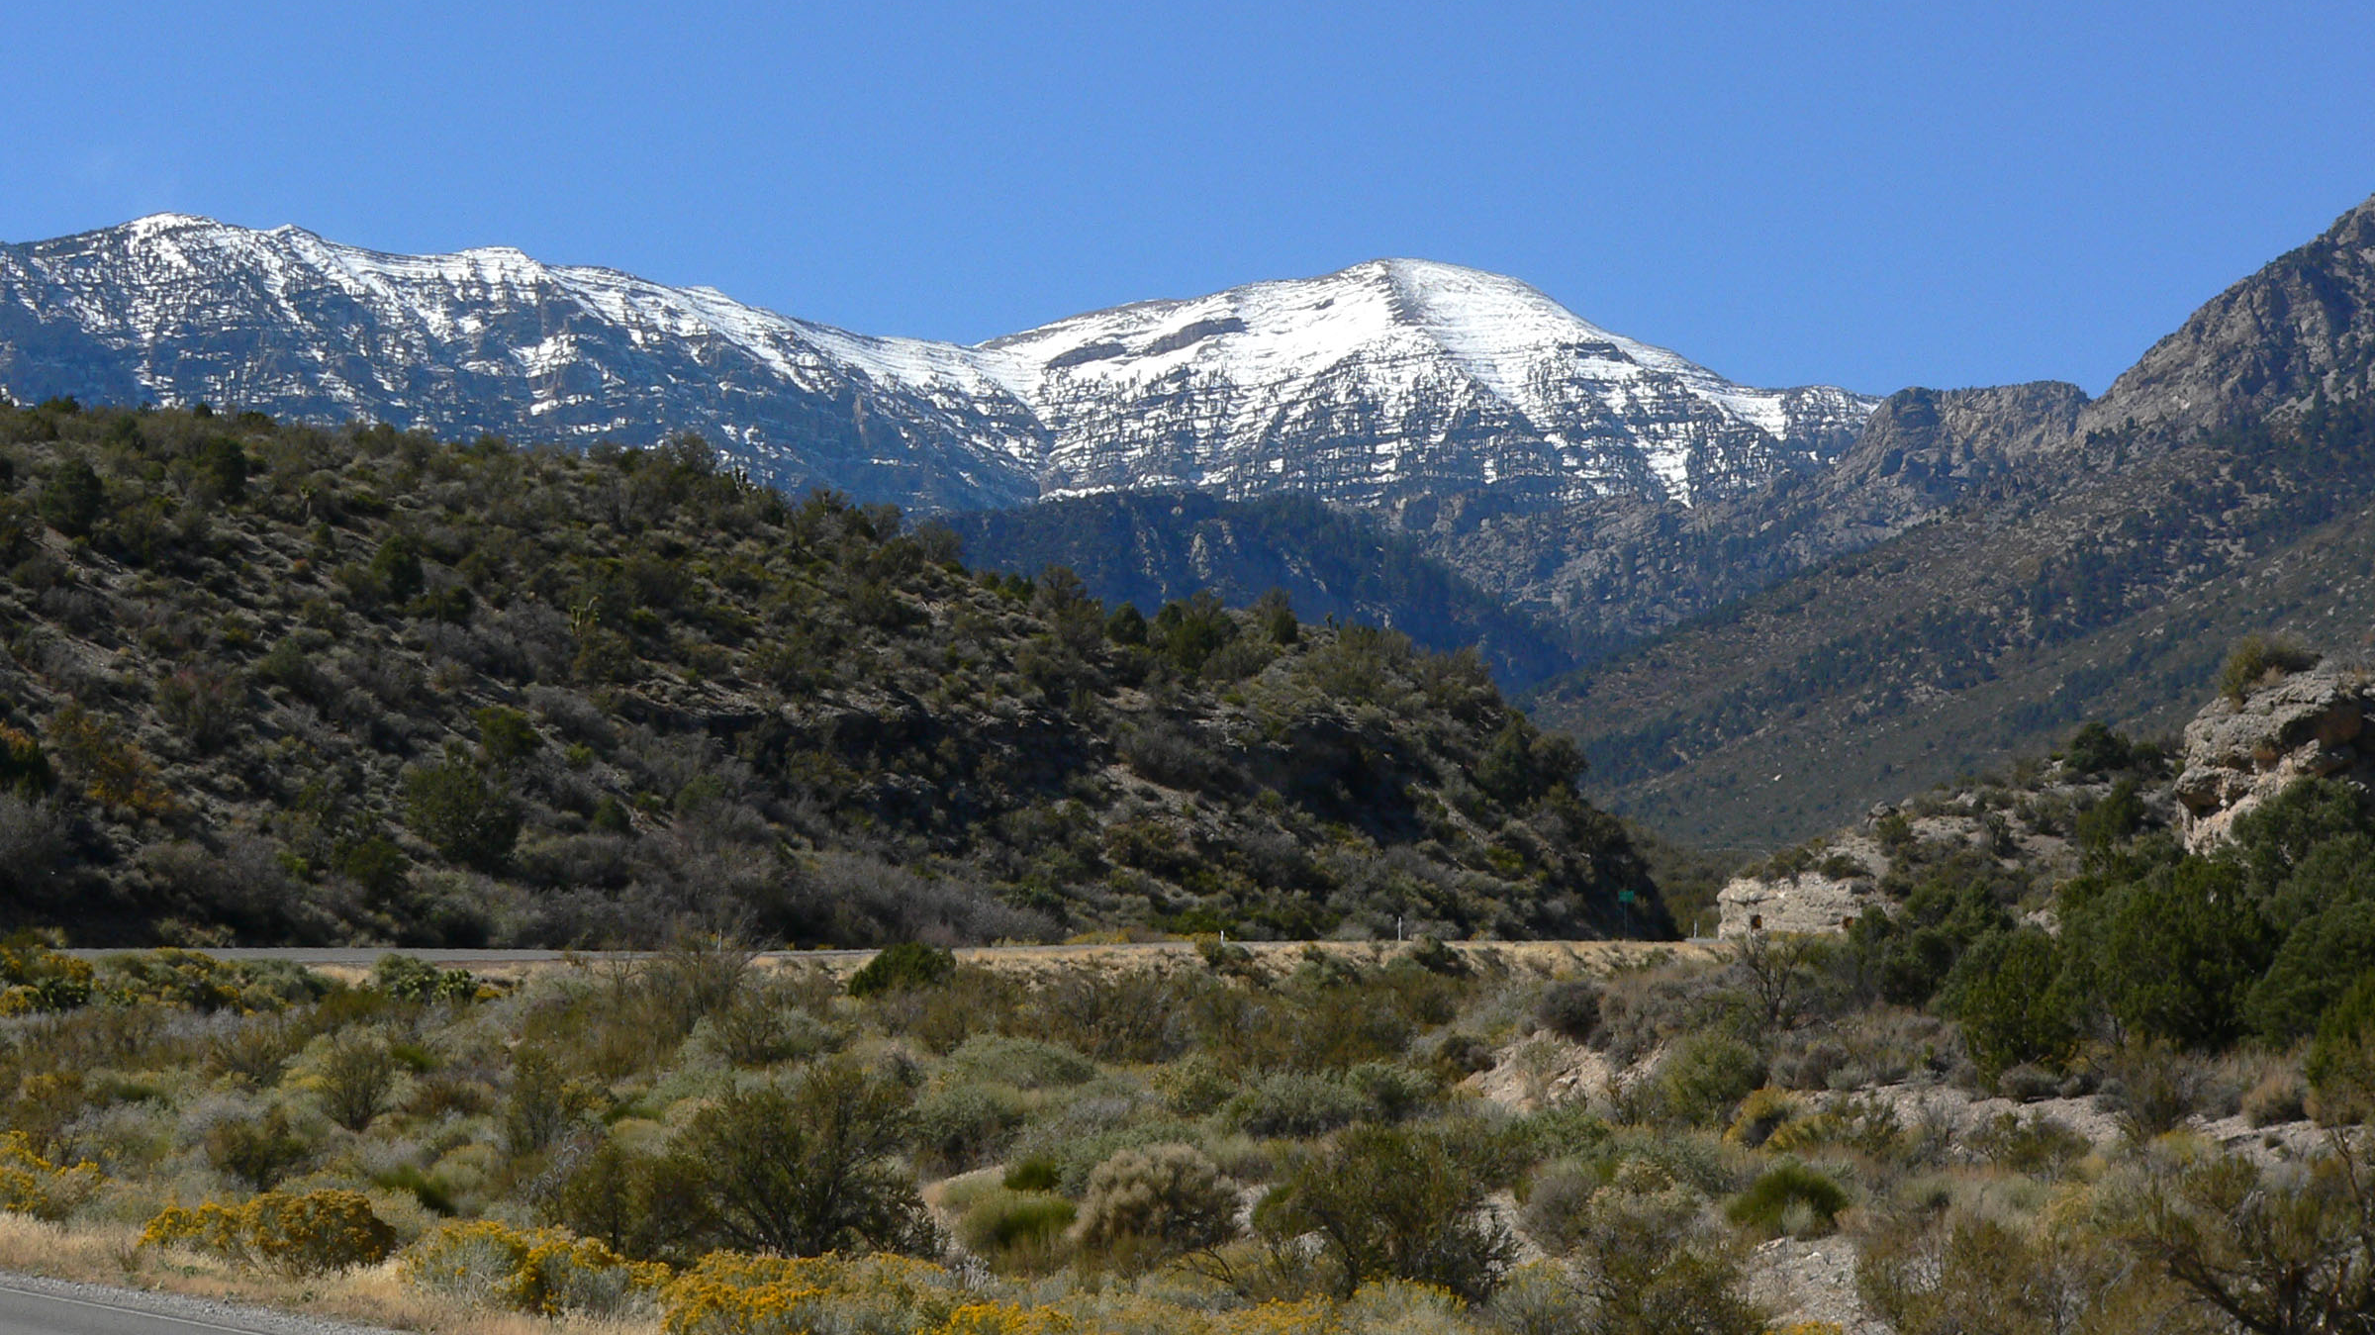
Spring Mountains National Recreation Area

Slide 26
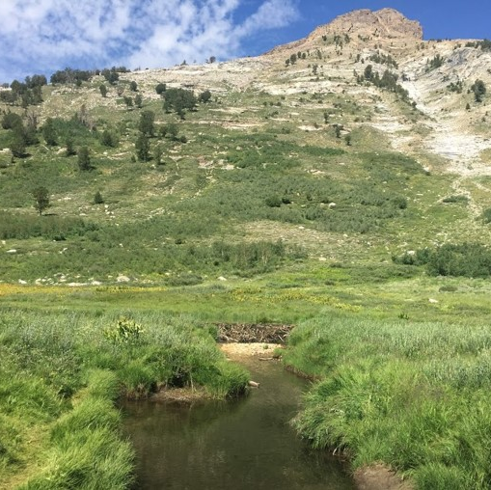
WETLANDS
A habitat where water covers the land.
Wetlands are a biologically diverse type of habitat, which means they have lots of different kinds of plants and animals.
Water in wetlands can come from springs, lakes, rivers, or small streams (also known as rills!).

Slide 27
What are some animals that live in the wetlands?
What adaptations do they have?
What are some animals that live in the wetlands?
What adaptations do they have?

Slide 28
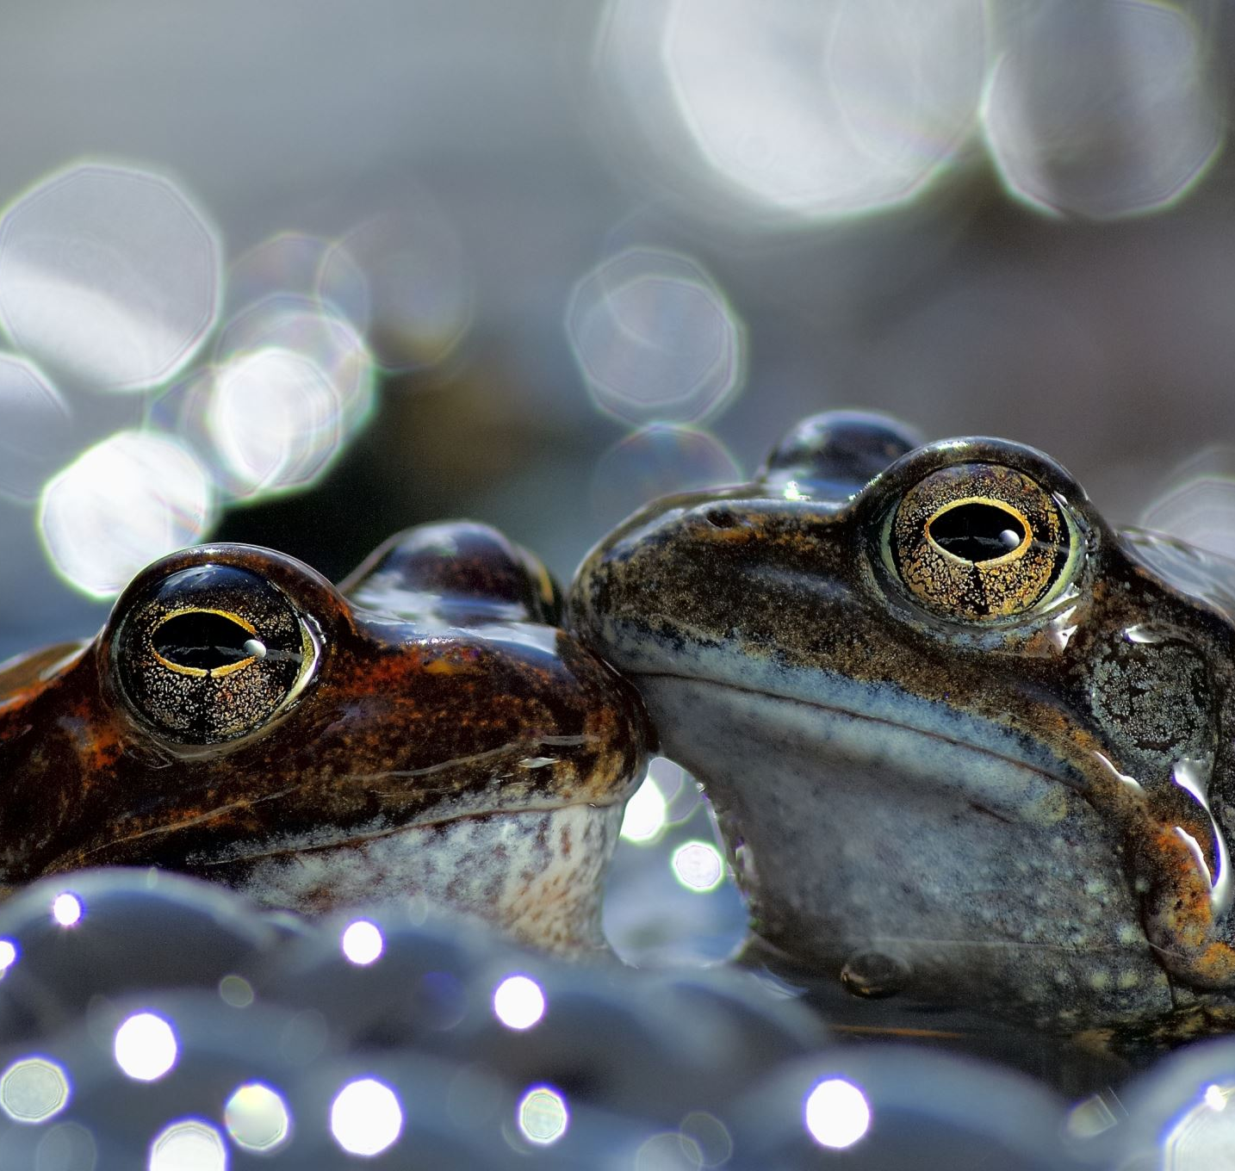
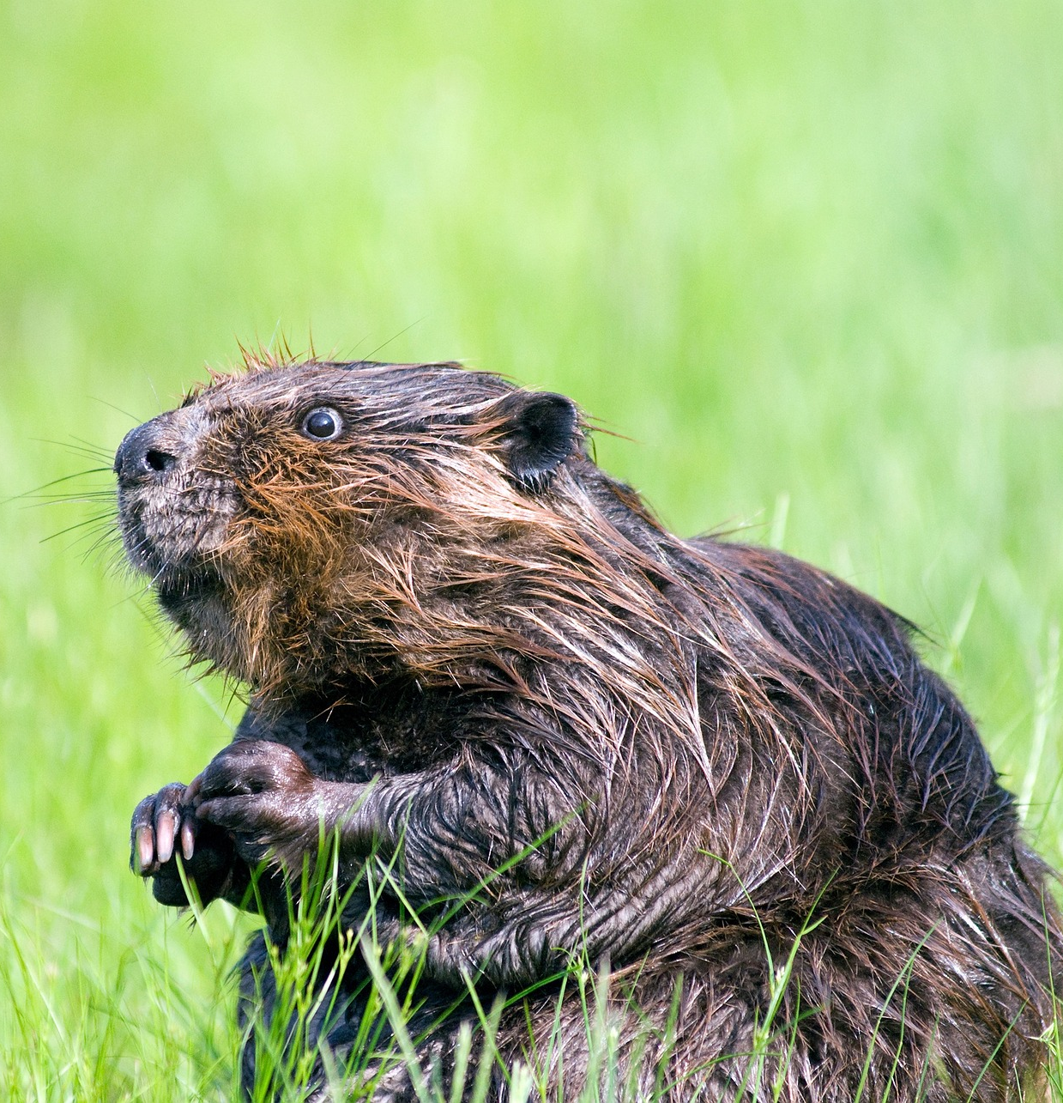
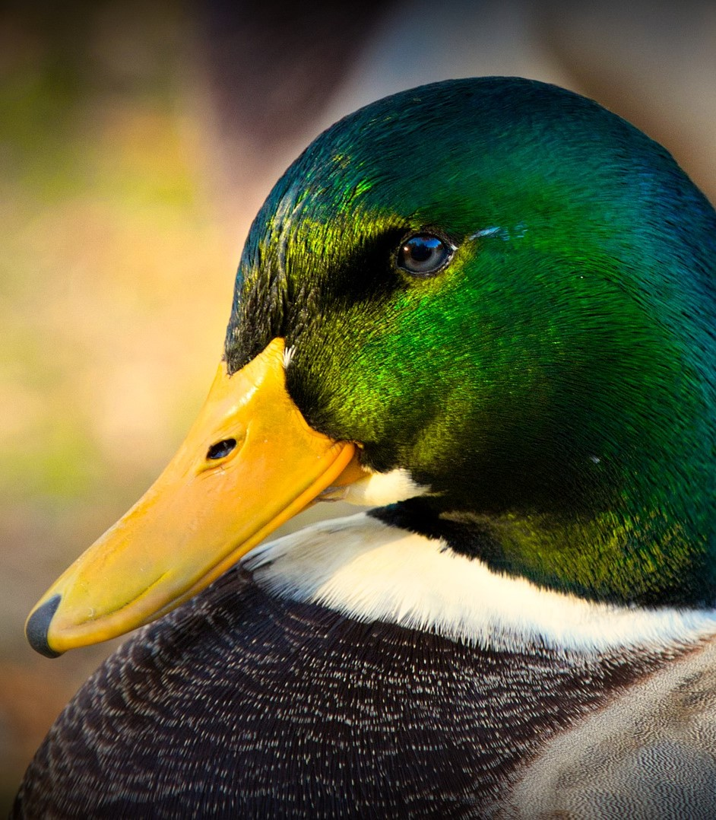
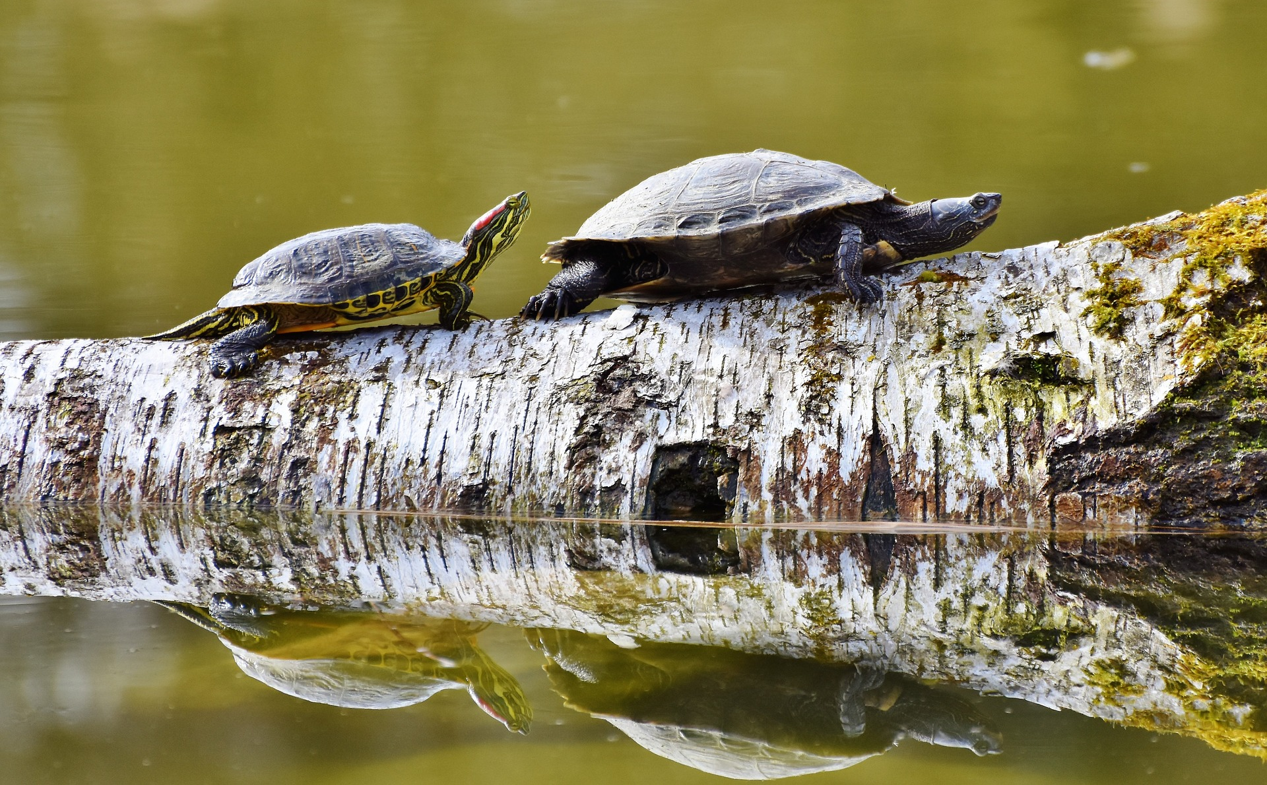
What are some animals that live in the wetlands?
What adaptations do they have?

Slide 29
Have you ever been to a wetland?
Here are some places you can explore wetlands near Las Vegas . . .

Slide 30
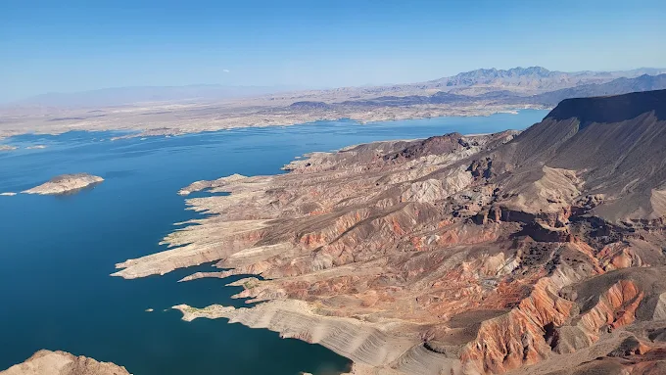
Lake Mead National Recreation Area

Slide 31
Warm Springs Natural Area

Slide 32
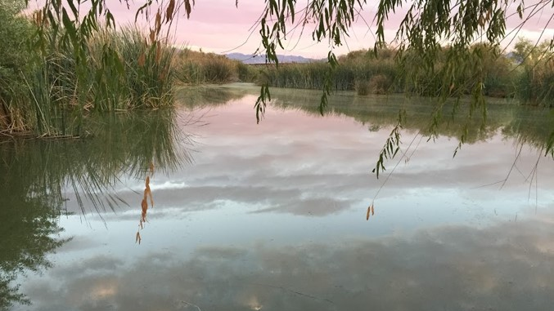
Clark County Wetlands Park

Slide 33
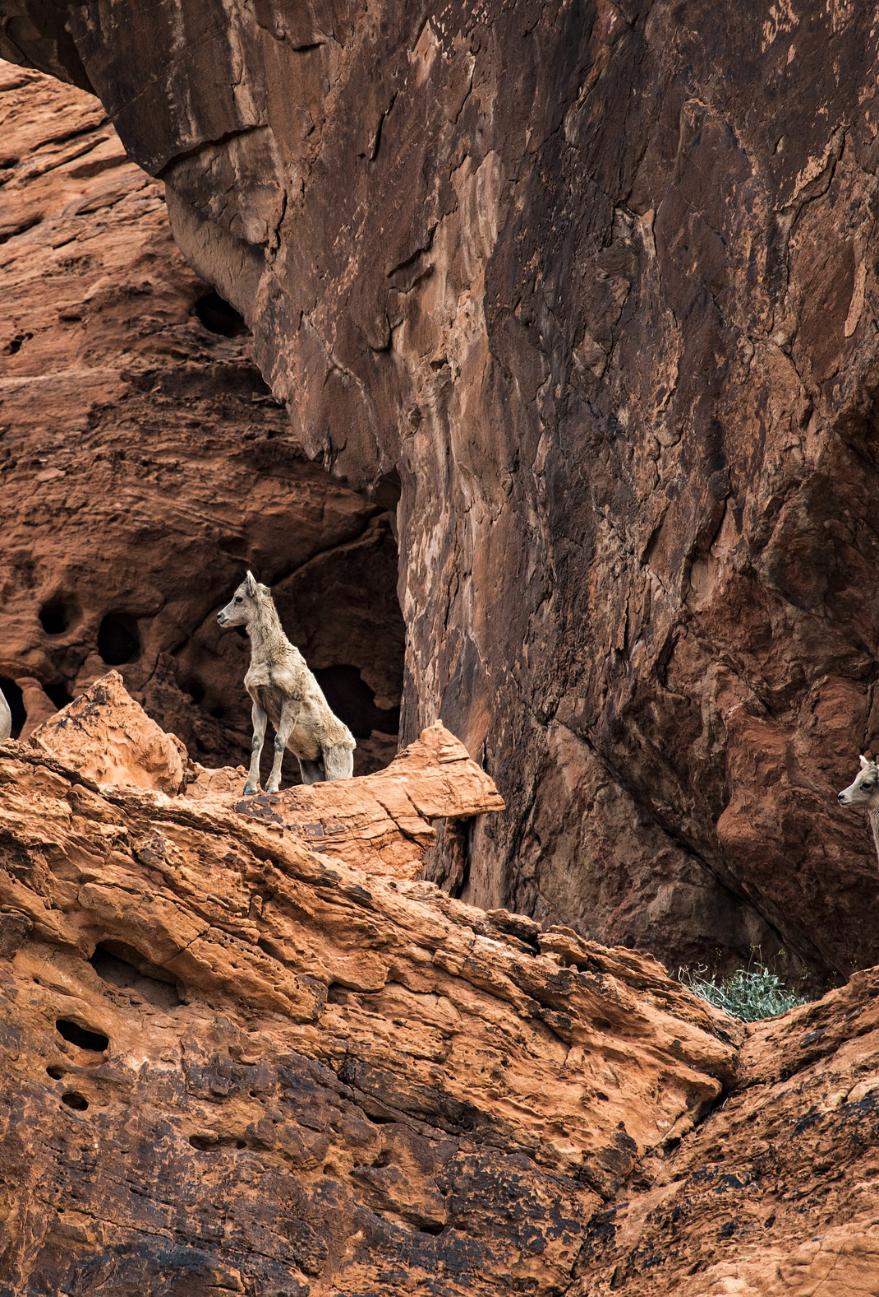
Keep learning!
As you learn about the animals in the trunk, think about their habitats. Where do they live? What is it like there? What adaptations do they need to survive?
Have fun exploring!

Slide 34
Thank you!
Thank you to the Clark County OAG program for providing the funding to create this traveling trunk!
Thank you to the Friends of the Nevada State Museum, Las Vegas for facilitating the development of this trunk!
Photos provided by pixabay.

