Slide 1
Museum in a Box Paleontology and Fossils
Teacher Handbook

Slide 2
Introduction
Safety notes
Contents
State Standards
Activities
Additional Resources
Acknowledgements
Table of Contents

Slide 3
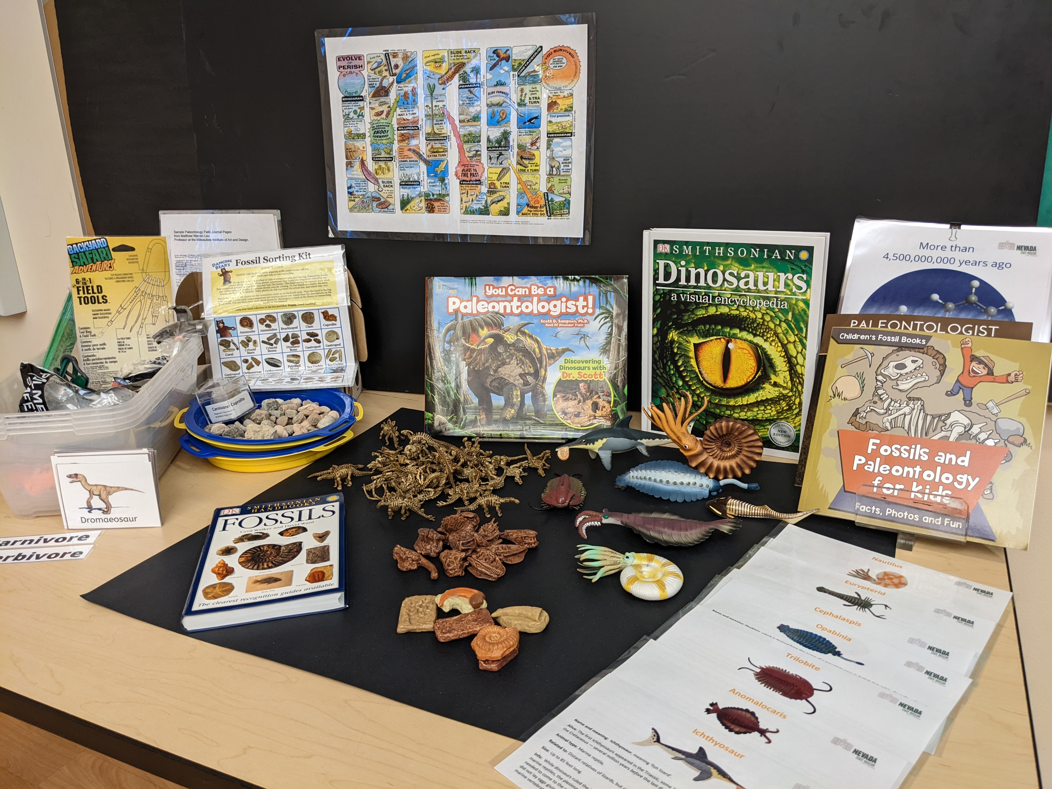
Introduction
Welcome to the Paleontology and Fossils Museum in a Box.
Students will initially question what is the difference between paleontology and archaeology and understand where and how are they interconnected.
This unit leads students to explore evidence of fossils and what is known of the extinct creatures and plants that have been identified this way.
They will discover more about the Nevada state fossil, the ichthyosaur.
Students will be able to research and evaluate the different careers associated with paleontology.

Slide 4
Contents – Paleontology and Fossils
Teacher’s Handbook
Materials for a dig:
Sample laminated field journal pages
5 sieves
5 plastic tubs w/lids that include 5 hammers, 5 screwdrivers, 5 brushes, 5 rulers & 5 protective eyewear and 3 sets of 6-in-1 tools, 2 pictures
Dancing Bear Fossil Identification Kit plus additional bag of fossil pieces also used for above dig work
Carnivore coprolite (poop)
Nevada herbivore / carnivore dinosaur cards
‘Evolve or Perish’ games board, chips and dice
Geologic timeline sheets
Ichthyosaur and other sea creature models (9 in total) plus info / label cards
Dinosaur plastic skeletons (bag)
Safari Toob of 10 fossils
Safari Toob of 11 dinosaur skulls
Fossil rubbing plates
Books:
Dinosaurs, a Visual Encyclopedia
Smithsonian Handbook: Fossils
Paleontologist to Archaeologist
You can be a Paleontologist
Fossils and Paleontology for Kids

Slide 5
Some Safety Notes
Some of trunk contents are real artifacts, please handle with care, and
Some items have sharp edges and / or are breakable. Please examine them carefully and use your judgement as to whether students should handle them.
Accidents do happen, though! Please let us know if anything becomes broken so we can address before the next class receives the trunk. Thank you!

Slide 6
State Standards (1 of 4)
Disciplinary Skills Standards (all grade levels are covered)
Kindergarten, First, Second, Third, Fourth, Fifth, 6-8, 9-12 includes: SS.K.1-K.6, SS.1.1-1.6, SS.2.1-2.6, SS.3.2-3.8, SS.4.1-4, SS.5.1-5.8,, S.S.6-8EUSH.1-.9, SS.9-12-US.1-10
Construct compelling questions, create supporting questions, gather and evaluate sources, compare/contrast, develop claims using evidence and communicate/critique conclusions by participating in academic discussions (STEAM: “to prepare students to communicate and compete as global thinkers within the community using science, technology, engineering, the arts, and math).
(GRADES 3-12: corroboration between sources, identify the differences between primary and secondary sources and explain why both are important to constructing a narrative of the past).
Social Studies:
SS.4.33
Examine jobs related to a career of interest.

Slide 7
State Standards (2 of 4)
FOSS Kit Alignment (K-5): Soil/Rocks/Landforms
6-12: Earth’s Resources
STEAM (all grade levels):Nevada State Definition: “Active teaching and learning centered on relevant experiences, problem solving, and critical thinking processes.”
-Use of integrative and thematic units of instruction to logistically tie in the often neglected of science and technology
-S=A way of learning and discovering about our natural work
-T=the making and use of tools, machines, techniques etc. to achieve a goal or function
-E=science and math to benefit humans
-A=applying creative thinking to STEM projects, igniting students’ imagination and creativity through the arts (liberal, language, social studies, physical, fine arts and music).
-M=study of quantity, structure, space, and change
**Career exploration, focusing on practices, crosscutting concepts, core ideas, planning and carrying out investigations, asking questions and defining problems, using math and computational thinking, analyzing and interpreting data, constructing explanations, engaging in argument from evidence, obtaining/evaluating/and communicating information.

Slide 8
State Standards (3 of 4)
Science:
K-ESS2-2 Earth’s Systems
Construct an argument supported by evidence for how plants and animals (including humans) can change the environment to meet their needs.
K-ESS3-1 K-2 Earth and Human Activity
Use a model to represent the relationship between the needs of different plants and animals (including humans)and the places they live.
1-LS3-1 K-2 Heredity
Make observations to construct an evidence-based account that plants and animals are like, but not exactly like, their parents.
3-LS4-2 3-5 Biological Evolution
-Use evidence to construct an explanation for how the variations in characteristics among individuals of the same species may provide advantages in surviving, finding mates, and reproducing.
-Construct an argument with evidence that in a particular habitat some organisms can survive well, and some cannot survive at all.
-Make a claim about the merit of a solution to a problem caused when the environment changes and the types of plants and animals that live there may change.
4LS1-1 3-5 From Molecules to Organisms
-Construct an argument that plants and animals have internal and external structures that function to support survival, growth, behavior, and reproduction.
MS-LS2-1 Middle School 6-8 Ecosystems/Biological Evolution
-Apply scientific ideas to construct an explanation for the anatomical similarities and differences among modern and fossil organisms to infer evolutionary relationships.

Slide 9
State Standards (4 of 4)
Science (contd.)
-MS-ESS1-4 Middle School 6-8 Earth’s Place/Earth’s Systems
-Construct a scientific explanation based on evidence for rock strata for how the geologic time scale is used to organize Earth’s 4.6 billion year old history.
-Construct an explanation based on evidence for how geoscience processes have changed Earth’s surface at varying time and spatial scales.
-Analyze and interpret data on the distribution of fossils and rocks, continental shapes, and seafloor structures to provide evidence of past plate motions.
HS-LS-1-4 Biological Evolution
-Evaluate the evidence supporting claims that changes in environmental conditions may result in 1) increases in the number of individuals of some species, 2) the emergence of new species over time and 3) the extinction of other species.
HS-ESS1-5, 1-6 Earth’s Place in the Universe
-Apply scientific reasoning and evidence from ancient Earth materials, meteorites, and other planetary surfaces to construct an account of Earth’s formation and early history.

Slide 10
Paleontologists Specialty Areas
Paleontologist definition: a scientist who specializes in the study of life forms that existed in previous geologic periods, as represented by their fossils.
There are 7 key branches of paleontology:
Paleobotany - study of any kind of fossil plants; traditionally includes the study of fossil algae and fungi in addition to land plants
Paleozoology - studies the creatures that come from fossilized remains
Paleoecology – studies extinct organisms' environments and their actions through trace fossils and other discoveries
Paleobiology - study the fossilized remains of any biological life
Micropaleontology - study of generally microscopic fossils, regardless of the group to which they belong
Palynology - study of pollen and spores, both living and fossil, produced by land plants and protists
Iconology - studies visual images and their cultural history

Slide 11
Paleontologists Specialty Areas
However, there are a number of “developing" specialties in paleontology such as:
Taphonomy - study of the processes of decay, preservation, and the formation of fossils in general
Invertebrate paleontology - study of invertebrate animal fossils, such as mollusks, insects, worms, and others
Vertebrate paleontology - study of vertebrate fossils, from primitive fishes to mammals which includes dinosaurs (most popular)
Human paleontology - highly interdisciplinary: to recover, describe, and interpret human fossil remains- they need to have knowledge of cultural anthropology, archaeology, biology, paleontology, and geology study of prehistoric human and proto-human fossils
The recommendation is for Middle School/High School grade levels to have students research the different types of paleontologist’s specialty areas. This lists include some of the key areas, but it is ever evolving.

Slide 12
Famous Paleontologists
William Buckland - British, Megalosaurus
Stephen J. Gould - American, Equilibria
John Ostrom - American, Dinosaurs, Lizards
Alan Walker - British, Lemurs, extinct species
Benjamin Franklin Mudge - American, teacher
Louis Agassiz - Swiss, Glaciers
James Hall - American, Stratigraphy
Charles Darwin - British, Evolution
Xu Xing - Chinese, Jurassic named dinosaurs
Ken Campbell - Australian, fossils
Guntupalli V.R. Prasa - Indian, dinosaur nests
Juan Luis Arsuago - Spanish, fossil guide
Luis Alvarez - Mexican, Meteorite Impact
Mary Anning - British, fossil hunter
Robert H. Bakker - American, Dinosaurs
Barnum Brown - American, fossil hunter
Edwin H. Colbert - American, vertebrates
Edward Drinker Cope - American, “Bone Wars”
Dong Zhiming - Chinese, dinosaur-birds
John “Jack” Horner - American, dinosaur nests
Othniel C. Marsh - American, named 500+ dinosaurs
Richard Owen - British, coined the word “dinosaur”
Paul Sereno - American, fossil hunter, sharks
Famous Nevadan Paleontologist
Margaret "Peg" Wheat - American, Nevada Ichthyosaur
Choose one of these people and find out more about their discoveries...

Slide 13
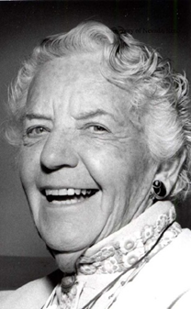
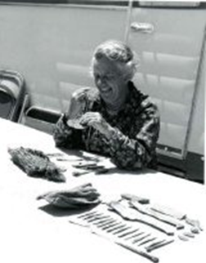
Paleontologists – Margaret Wheat
Margaret Wheat was a self-taught paleontologist, geologist and anthropologist, with a special interest in ichthyosaurs – the Nevada State fossil.
Margaret was born in 1908 to pioneer parents and she received her education in Fallon, NV and at the University of Nevada, Reno. Her second husband, Wendel Wheat, was a mountain man, and together they traveled the desert.
Her field work experiences ranged from working for the U.S. Geological Survey to protecting important cave sites from vandals. In addition to her research about the Northern Paiute American Indians, in 1954 Margaret persuaded paleontologists from the University of California-Berkeley to excavate fossils of ichthyosaurs and she was instrumental in getting the state to acquire and preserve the area now known as the Berlin-Ichthyosaur State Park.
At the first annual Ladies of the Press Luncheon, Margaret was honored as an outstanding Nevada woman writer for 1969. She received the award from the Reno Professional Club and the Nevada Library Association. In 1980, she received an honorary doctorate of science degree from the University of Nevada.
Margaret M Wheat, ca, 1960 examining artifacts found in a cave
during an archaeological excavation by the Desert Research Institute.
Margaret M Wheat ca. 1980

Slide 14
Paleontology Dig Sites in Nevada
The closest to Las Vegas are:
Tule Springs Fossil Beds National Monument, North Las Vegas
Willow Tank Formation in the Valley of Fire State Park
Other dig sites in Nevada include:
Berlin-Ichthyosaur State Park
Ice Age Fossils State Park
Oak Springs Summit Trilobite Area
Choose one of these locations and find out more about what has been discovered there...

Slide 15
Geological Timeline
Included in the Museum in a Box is a set of ten cards which describe the geological timeline of the Earth without the details of the specific era and periods to introduce students to:
the age of the Earth
the time that each step in the Earth’s development
comparatively how little time humans have inhabited the Earth
Students can:
put the stages in order (with the correct order being numbered on the reverse)
work out the years past leading up to the present

Slide 16
Fossils
What is a fossil?
A fossil is physical evidence of a prehistoric plant or animal. This may be their remains preserved as rock or other traces, such as marks they made in the ground while they were alive.
Fossils can be of animals or plants.
They can be divided into two categories:
fossilized body parts, such as bones, shells, claws, teeth, and skin.
fossilized traces, also called ichnofossils, such as footprints, nests, dung, and toothmarks.
Do all living things turn into a fossil once they die?
No!
Very few things do. A specific set of circumstances and conditions are needed for fossilization to occur, so it is actually a very rare event.
Most things that die rot away completely, leaving nothing behind.
Nearly all fossils we find - around 99% - are from marine animals such as shellfish and sharks. This is because they lived in the sea, where sand or mud could bury their remains quickly after they died.
We know less about dinosaurs that lived in jungle or mountain environments. Fossils are very unlikely to form in these habitats.

Slide 17
Fossils
How do animal fossils form?
The most common way an animal such as a dinosaur fossilizes is called petrification. These are the key steps:
1. The animal dies.
2. Soft parts of the animal's body, including skin and muscles, start to rot away. Scavengers may eat some of the remains.
3. Before the body disappears completely, it is buried by sediment - usually mud, sand or silt. Often at this point only the bones and teeth remain.
4. Many more layers of sediment build up on top. This puts a lot of weight and pressure onto the layers below, squashing them. Eventually, they turn into sedimentary rock.
5. While this is happening, water seeps into the bones and teeth, turning them to stone as it leaves behind minerals.
This process can take thousands or even millions of years. Tree fossils, also known as petrified wood, form in the same way. This is why it is possible to count the growth rings of some fossil trees.

Slide 18
Fossils
How do other fossils form?
1. unaltered preservation: humans, animals, or plants trapped in their original form in amber, tar, or ice
Examples: insects in amber, saber tooth tiger in La Brea Tar Pit, mammoth in ice
2. replacement: an organism's hard parts dissolve and are replaced by other minerals, like calcite, silica, pyrite, or iron
Examples: Beecher's Trilobite Bed in New York
3. carbonization or coalification: the carbon remains in the specimen
Examples: some fossil plants, a thin carbon layer is left on a piece of shale
4. recrystallization: the minerals making up the original shell or bone of a fossil change into a different mineral made of the same chemical components.
Examples: some shells

Slide 19
Fossils
What types of fossils are there?
mold fossils: sometimes ground water dissolves the buried bone or shell, leaving behind a bone- or shell-shaped hole or imprint in the sediment. This is a natural mold.
cast fossils: formed when a mold is filled in
trace fossils = ichnofossils: fossilized nests, gastroliths (bones swallowed by bird, reptile etc. to aid in digestion), burrows, footprints, owl pellets etc.). In the box you will find some coprolite (fossilized poop), how might paleontologists use this to find out more about dinosaurs?
true form fossils: fossils of the actual animal/human part like limbs, torsos, skulls, fingers

Slide 20
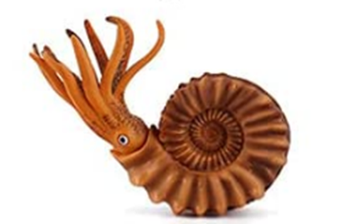
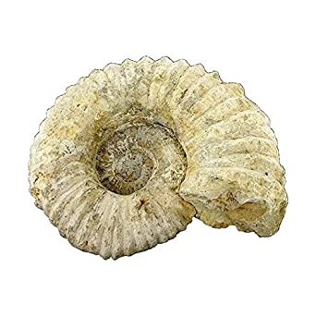
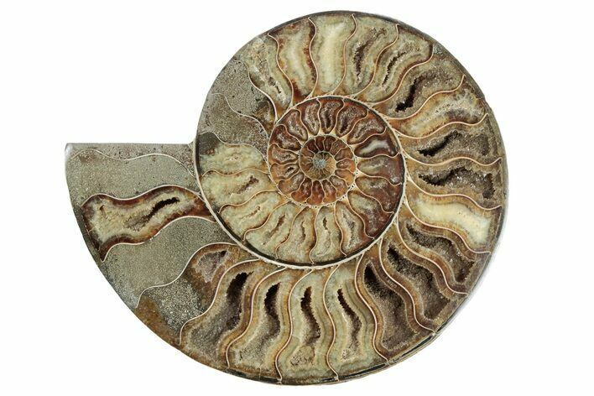
Prehistoric Sea Creatures
There is much fossil evidence of the multitude of varieties of sea creatures that existed in the oceans while dinosaurs dominated the land. The Museum in a Box contains a variety of those creatures with related info cards.
Following on from how fossils form, there is an opportunity to discuss what these animals looked like and what body parts would have fossilized, i.e. their shells or carapaces would have, but it is less likely that the fleshy parts of the animal would have.
Seeing how the creatures looked versus the fossil remains is an interesting exercise. Other exercises are available in the activities section.
Ammonite
Ammonite fossil
Ammonite fossil - polished

Slide 21
Dinosaurs in Nevada
What dinosaurs have been identified in Nevada?
These dinosaurs have been identified by teeth, prints, or small bone fragments at the time this was written.
All of the dinosaurs in Nevada listed can be found in the accompanying book: Dinosaurs, A Visual Encyclopedia by the Smithsonian
Dinosaurs are split in two groups:
Ornithischians (bird hipped)
Saurischians (lizard-hipped).
Activities for further exploration:
alphabetize Nevada dinosaurs
list from small to large, or large to small
graph the sizes (find their “average” height based on class research”
graph or chart: herbivores vs carnivores
graph by types
research how they got their names, who discovered the first one, in what country, when, etc.
draw and color a representation of what they might have looked like based on research
find and illustrate the comparison of animals and/or objects of today that are the same length/height, behave the same, etc.

Slide 22
Dinosaurs in Nevada
Evidence of teeth and other remains in Nevada indicate the following dinosaurs lived here:
Iguanodon (meaning “iguana teeth”) Cretaceous period, 30-35 ft. Ornithopod, bird-hipped, herbivore, walked on two and four legs, used forelimbs to grasp.
Dromaeosaur (meaning “running lizard”) Jurassic to Cretaceous periods, 6-7 ft. Therapod, lizard-hipped, birdlike, feathered, small carnivore “raptor”, claws, arms folded like wings.
Stegosaurus (meaning “roofed lizard”) Jurassic to Cretaceous periods, 20-30 ft. Thyreophoran, bird-hipped, herbivore, walked on all fours, plates, beak, spikes on its tail.
Triceratops (meaning “three horned face”) Cretaceous period, 20-30 ft. Ceratopsian, bird-hipped, herbivore, beaked, walked on all fours, 3 horns, bone frill.
Allosaurus (meaning “different lizard”) Jurassic period, 40-45 ft. Therapod, lizard-hipped, carnivore, walked on two legs, concave vertebrae, holes in skull making it lightweight, killer teeth.

Slide 23
Dinosaurs in Nevada
Evidence of teeth and other remains in Nevada indicate the following dinosaurs lived here (contd.):
Ankylosaur (meaning “fused or stiffened lizard”) Cretaceous period, 5-6 ft. Thyreophoran, bird-hipped, herbivore, walked on all fours, club at the end of its tail, spikes and bony armor plates, beaked, soft belly.
Hadrosaur (meaning “bulky lizard) Cretaceous period, 20-30 ft. Ornithopod, bird-hipped, herbivore, duck-billed beak, walked on two legs, made nesting colonies, ran in herds, most common dinosaur.
Titanosaur (meaning “titanic lizard”) Cretaceous period, 120 ft. Sauropod, lizard-hipped, carnivore, heaviest on earth, last of the dinosaurs, not much known about it.
Hypsilophodon (meaning “hypsilophus-tooth”) Cretaceous period, 6-7 ft. Ornithopod, bird-hipped, herbivore, beak, swift runner on two legs, self sharpening cheek teeth.
Tyrannosauroid (meaning “tyrant lizards”) Jurassic to Cretaceous periods, 8-40ft. Therapod, lizard hipped, carnivore, large skull and jaws, small powerful arms, two or three fingers on each hand, most dominant

Slide 24
Ichthyosaur – the Nevada State Fossil
Naming
The ichthyosaur, and specifically the species Shonisaurus popularis, is designated as the Nevada state fossil as it lived here more than 220 million years ago when Nevada was covered by an open sea.
Ichthyosaur means ‘fish lizard’, and sometimes it is referred to as a ‘sea dragon’.
Shonisaurus means "Lizard from the Shoshone Mountains“ named after the mountains where was found in Nevada in 1928.
Where the fossils were found is now the Berlin Ichthyosaur State Park, it is about 48 feet long and is the second largest in the world. It lived 200-250 million years ago.

Slide 25
Ichthyosaur – the Nevada State Fossil
Location / Habitat
Lived where Nevada is today when the region was covered in a warm sea more than 215 million years ago.
Ichthyosaurs ate fish, squid and shellfish (Cephapods) called ammonites.
The ichthyosaurs sank to the bottom of the sea when they died and then over millions of years the bones were replaced with minerals to create the fossils that have been uncovered now.
Ichthyosaurs are found all across the world and are still being discovered today. They have been found in China, Scotland, England and Germany.
More info: The book: “Smithsonian Dinosaurs, a Visual Encyclopedia.” references the ichthyosaurus on pages 106-111 and can be used as a read aloud or used for individual student research to discover more information.

Slide 26
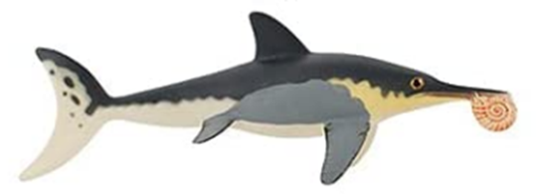
Ichthyosaur – the Nevada State Fossil
Description
The ichthyosaur was a marine reptile. It was not a dinosaur as it lived many millions of years before the dinosaurs.
Ichthyosaurs had the body of a dolphin, with four flippers, and a long tail that moved side to side (not up and down). This allowed it to propel itself forward more quickly in the water. One found in Nevada is about 48 feet long and is the second largest in the world. These were the longest in the world until a slightly longer one was discovered in Canada.
They needed to surface to breathe air as it did not have gills like a fish. They had extremely large eyes in order to see in the water to hunt for their food. The Nevadan ichthyosaurs had teeth, although not all ichthyosaurs across the world did.
Unlike most reptiles, though, they gave birth to well-developed live young. They to where Nevada is today to give birth and that is why we mostly have found female and young ichthyosaurs here. This is similar to how whales behave today, like in Baja, CA.
How the ichthyosaur, Shonisaurus popularis, may have looked like eating an ammonite – a main food source.

Slide 27
Ichthyosaur – the Nevada State Fossil
Extinction
The ichthyosaur, Shonisaurus popularis, lived during the Triassic Period, which was the first period of the Mesozoic Era. This was between 252 and 201 million years ago, after which followed the Jurassic Period. The ichthyosaur became extinct about 95 million years ago, before the great dinosaur extinction which was 66 million years ago. It is believed this was primarily due to climate change and because they evolved too slowly to adapt to these changes.
Ichthyosaur, Shonisaurus popularis, at the Nevada State Museum, Las Vegas (cast)

Slide 28
Activities

Slide 29
Vocabulary Word Game
Fossil Vocabulary Worksheet
fossil
paleontologist
trace
mold
cast
extinct
amber
Fill in the blanks using the words on the left:
1. The replica __________ was made from clay.
2. A scientist that studies fossils is a _______________.
3. Dinosaurs are ________________, or gone forever.
4. ___________ is formed in resin from tree bark.
5. The remains of a prehistoric organism is a _________.
6. Footprints and tracks are ____________fossils.
7. An animal or plant has decayed and left behind an
impression or ____________.

Slide 30
Dinosaur Discovery Group Project
Overview
Have you ever wondered about dinosaurs, plants, and marine creatures that came before us? There are many unsolved mysteries in the world today. With every new paleontological excavation site scientists learn more about life on Earth.
Background to the project:
You are all paleontologists on a dig that has discovered the fossil of a dinosaur in Nevada. It can be a new dinosaur or a known one.
Before you start, as a group you need to decide:
Where in Nevada you discovered your fossil
What fossil you have found
When the animal lived

Slide 31
Dinosaur Discovery Group Project
Your Team Project
Your team is responsible for a poster presentation that explains the following aspects of your find. Don’t forget to add images or photos! Each person should help to create the poster, and each person is responsible for their own section:
1. Write about the fossil – such as what size it is, what position it was found in, how big it is, what type of fossil is it (body fossil, trace fossil, etc.)
2.Write about the animal, such as what might it have looked like, was it a carnivore or herbivore, what did it eat.
3.Write about the environment or habitat that the animal would have lived in, such as the geography of the location, (mountains or valley, lake side or desert), what plants were living in the area, what other animals would have been in the area.
4.Write about the dig site, such as where it is in Nevada, what it would have looked like when the animal was alive, and what it look like today.
Enjoy!

Slide 32
Compare and contrast activity
Paleontology | Archaeology
A paleontologist studies paleontology | An archaeologist studies archaeology
Studying the history of life on Earth as based on fossils | Studying the human past using material remains. These remains can be any objects that people created, modified, or used.
Studying fossils | Studying artifacts
Knowledge and interest in natural sciences, especially biology and geology | Knowledge and interest in human history and conservation

Slide 33
Compare and contrast roles
Paleontologist
Archaeologist

Slide 34
Compare and contrast roles
Paleontologist
Archaeologist
Anthropologist

Slide 35
Match the Tools Needed for a Dig
Review the “Dig Site Tools of the Trade” sheet.
Match the images to the answer sheet describing what they all are and what they are used for.

Slide 36
Field Journal Activity
Questions to ask/answer individually or in a group about how to keep a field journal might include:
What types of observations are being made?
What types of measurements are used? How are they used?
What new words have you learned, and what do they mean?
Choose one of the skeletons from the Museum in a Box and make a drawing of it, labeling each part.
The following pages are actual records from a paleontologist, Matthew Warren Lee, on a real paleontological dig in Montana.

Slide 37
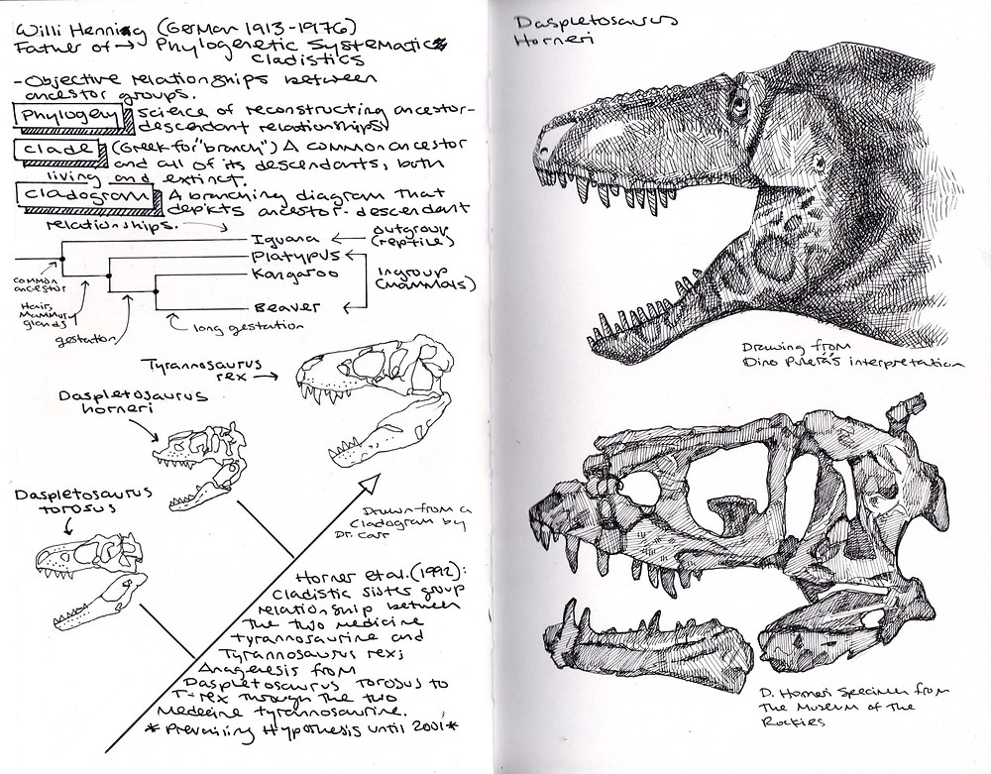
Field Journal Activity
This page shows a ‘cladogram’. A cladogram is a branching diagram that shows the ancestor-descendant relationships.
This one is for the Tyrannosaurus rex. It shows how the newly discovered Daspletosaurus Horneri is related to the T-rex – it was a smaller cousin.
The new dinosaur was named after Jack Horner, the paleontologist who helped on the Jurassic Park films.

Slide 38
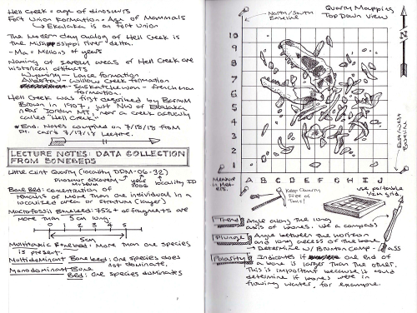
Field Journal Activity
This page documents the correct procedures for the excavation of dinosaur quarries.
Obtaining detailed data from quarries is vitally important for scientific accuracy and the reconstruction of specimens.
Dinosaurs are rarely found with their bones all joined together or as scientists would say ‘articulated’. Typically, they are broken apart, so it is important to record every piece.

Slide 39
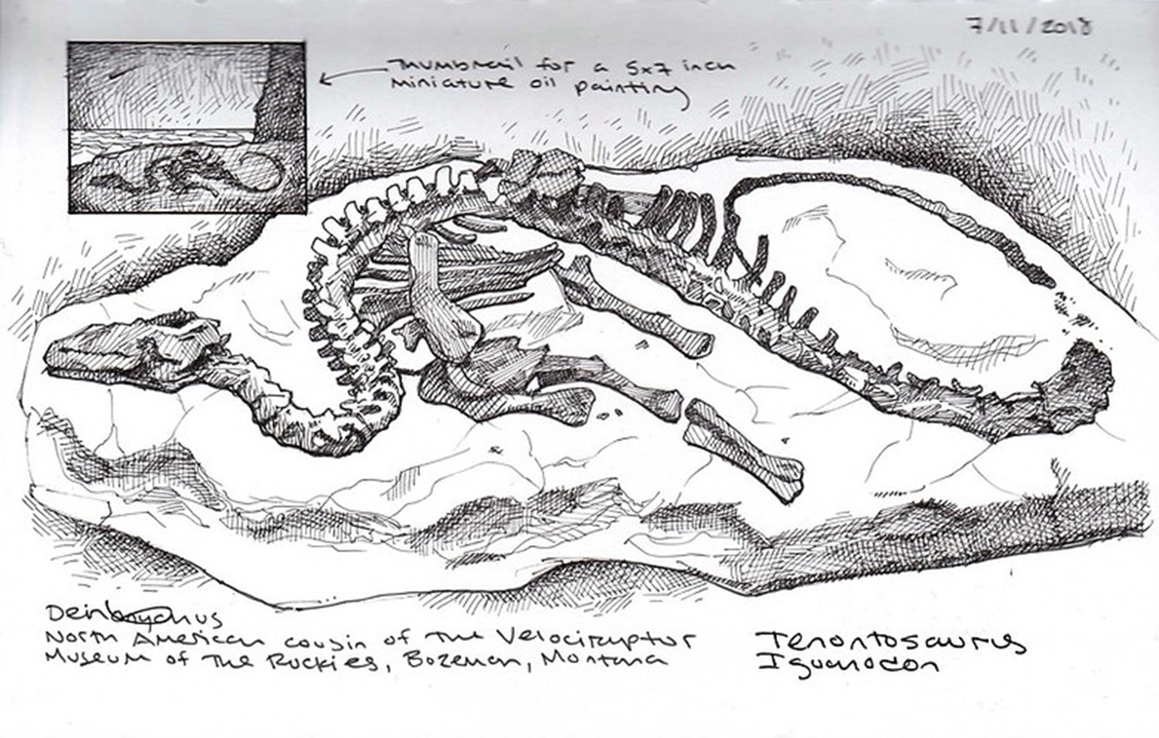
Field Journal Activity
This page is a drawing of the dinosaur find (an iguanodon) as it was found before it was moved.

Slide 40
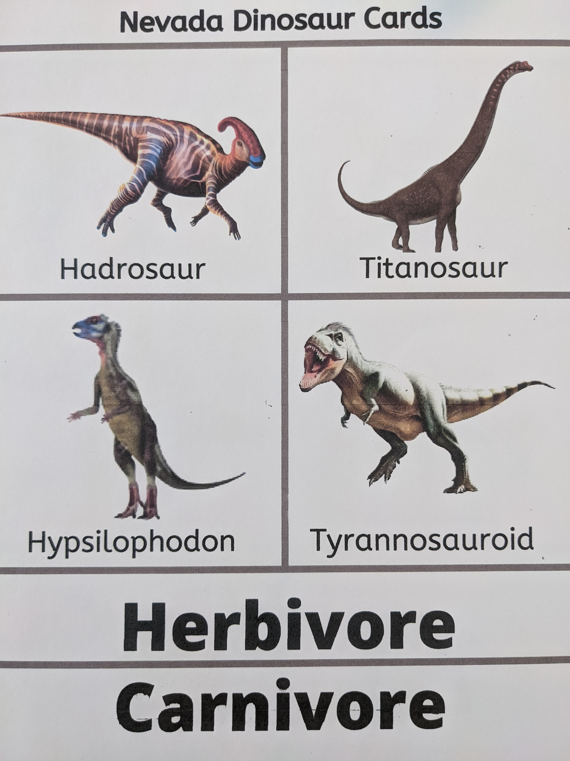
Herbivore or Carnivore?
There is evidence these dinosaurs existed in the area now known as Nevada.
Using the dinosaur cards provided identify which dinosaurs were herbivore and which were carnivores.
How can you tell which ones are which?

Slide 41
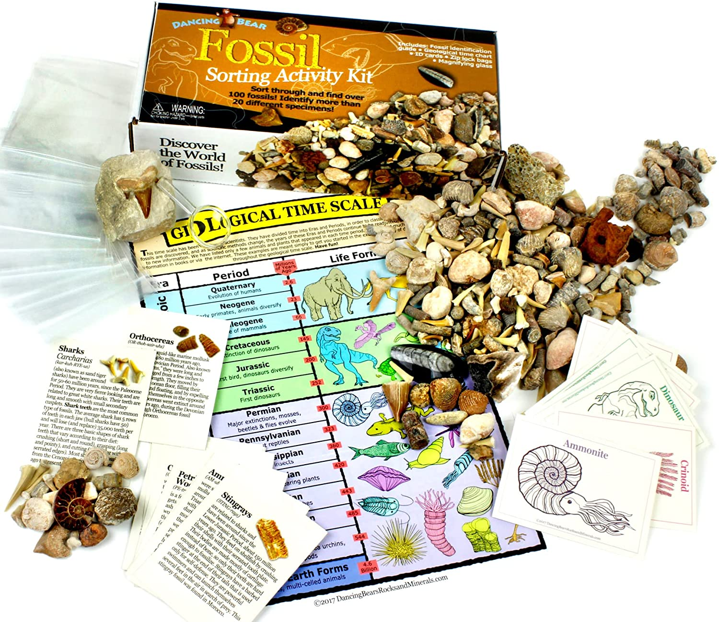
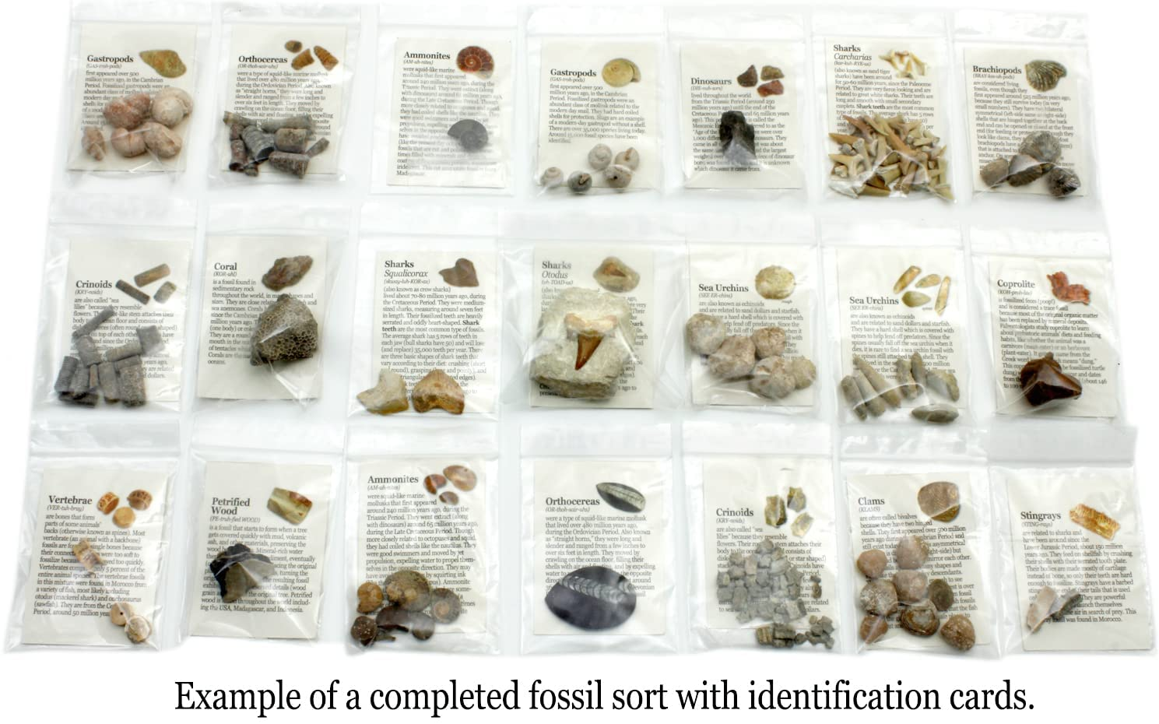
Fossil Sorting Activity
Along with the fossil sorting activity is an additional bag of fossils.
There are 20 small bags into which the students can sort the fossils into the types that are listed on the card.

Slide 42
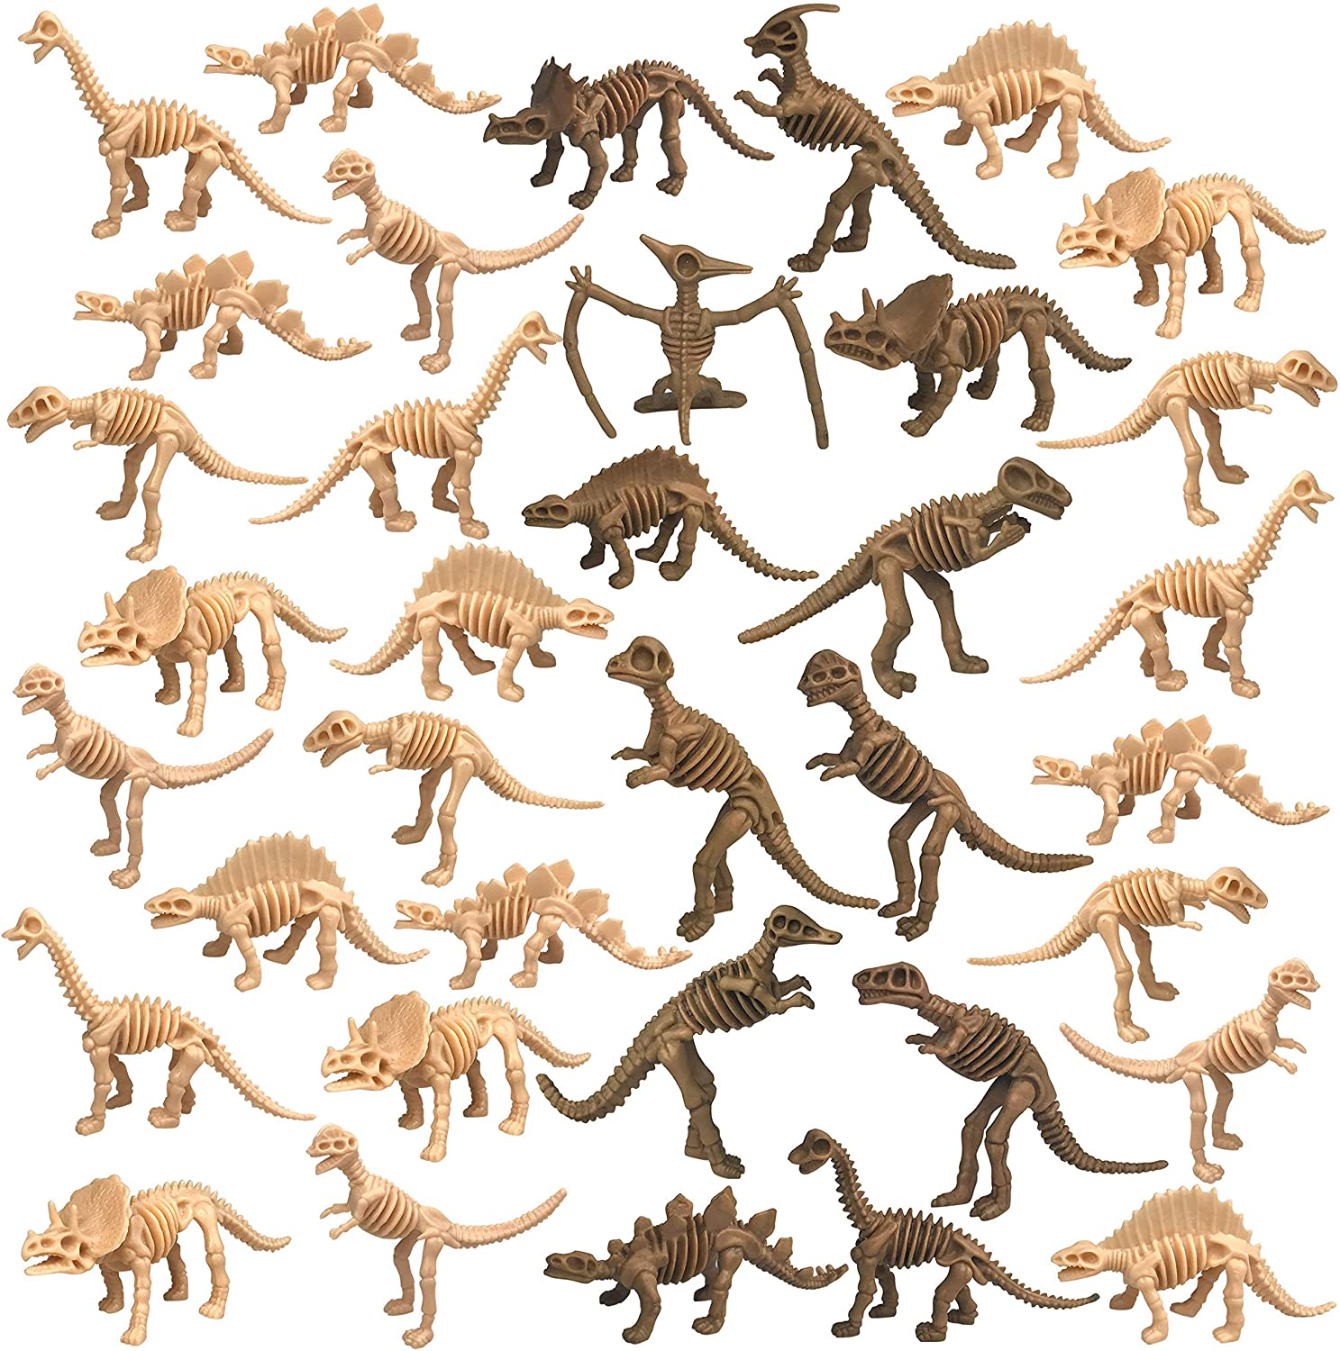
Dinosaur sorting / identification
There are 36 dinosaurs of 8 different types in the sorting/identification activity.
You can use this for a variety of activities, whereby students can:
carry out a simple sorting activity
create a graph of sorting results
use the activity question sheet titled: “Dinosaur Detective” (There are 4 levels for different grades or knowledge levels).
Conduct research to determine what dinosaurs the skeletons represent
Use for a drawing or art exercise
The dinosaurs included are:
Allosaurus - 4
Apatosaurus - 5
Pachycephalosaurus - 5
Parasaurolophus - 4
Pteranodon - 4
Spinosaurus - 4
Stegosaurus - 5
Triceratops - 5

Slide 43
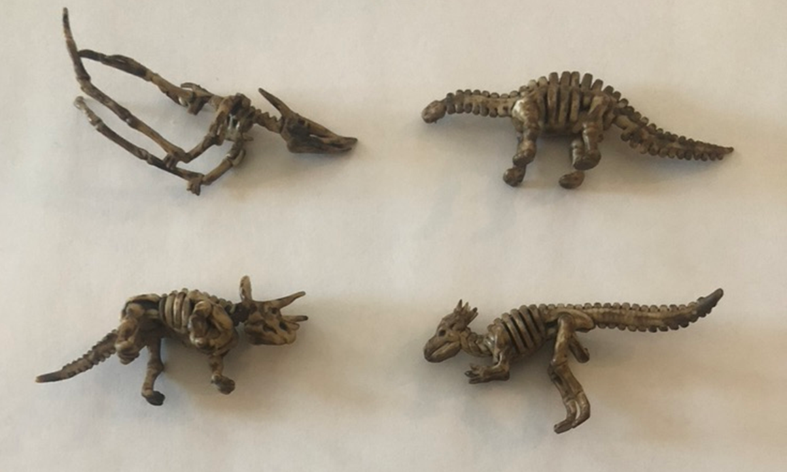
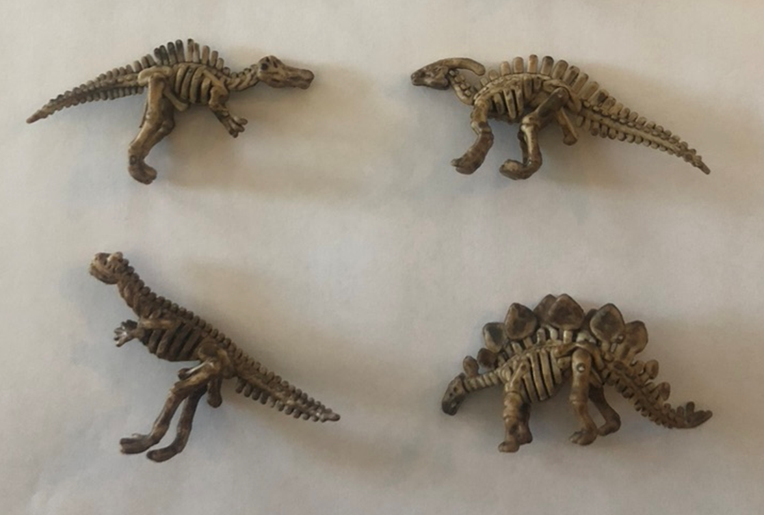
Dinosaur sorting / identification - key
Spinosaurus Parasaurolophus
Allosaurus Stegosaurus
Pteranodon Apatosaurus
Triceratops Pachycephalosaurus

Slide 44
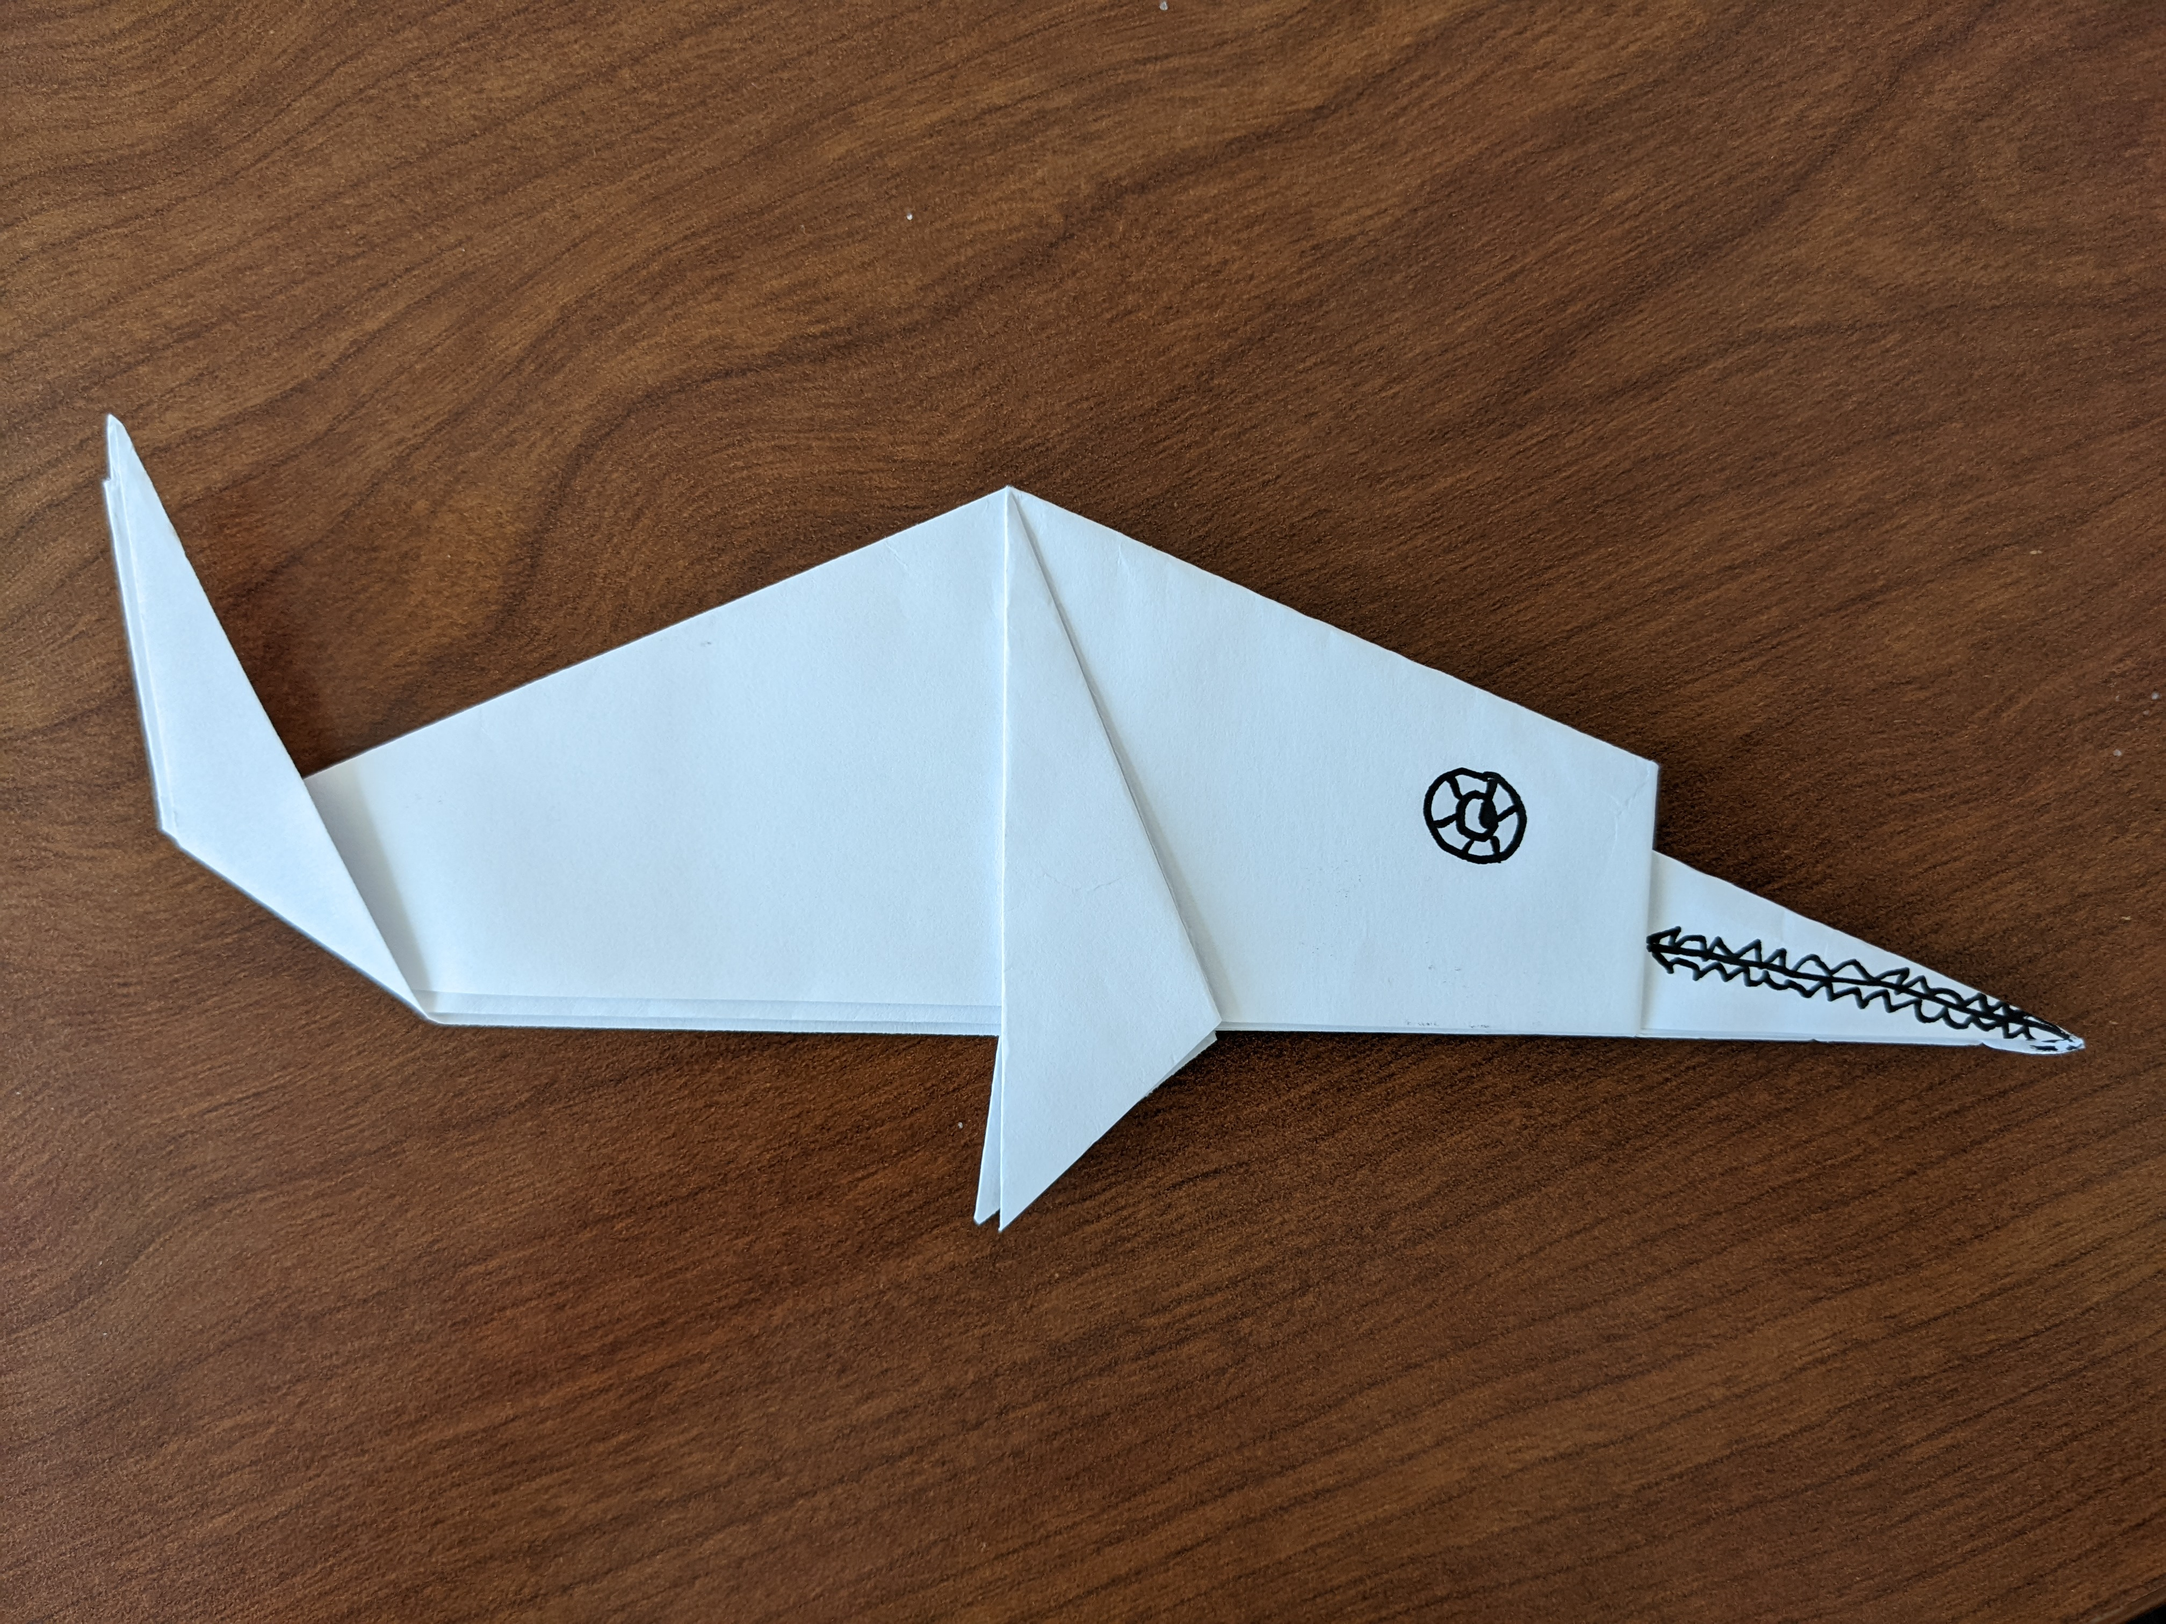
Make an Origami Ichthyosaur
This is an “easy” sample. There are many more complex ones on YouTube for more advanced artists and that include back flippers.
To watch the instructional video, go to: https://www.youtube.com/watch?v=685pVAq7vWo
Materials needed:
Origami paper or precut “squares” of copy paper (your choice of size and color)
Choice of: markers, crayons, colored pencils.
Samples are 7” X 7” and 81/2” X 81/2” squares using white copy paper.

Slide 45
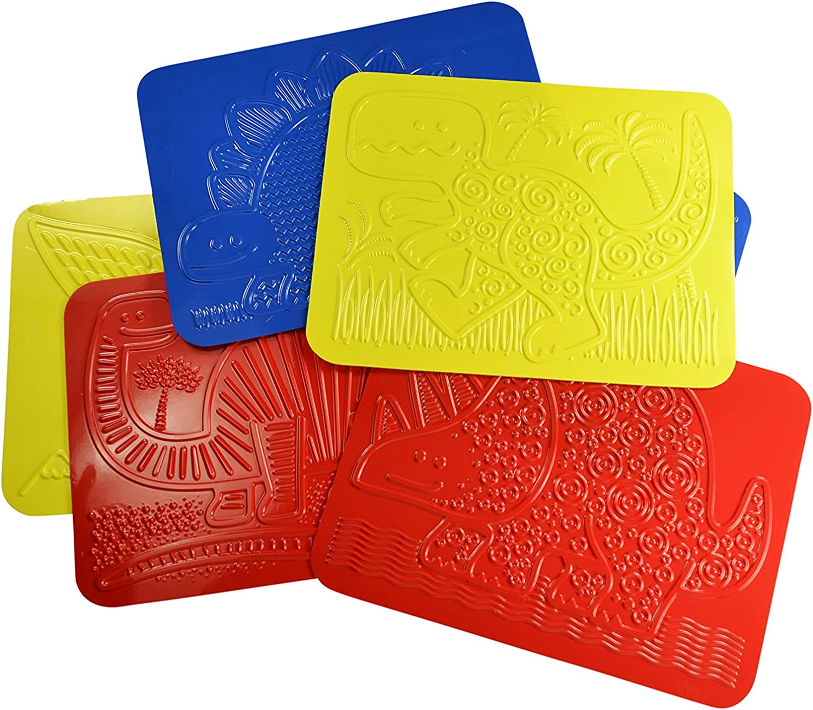
Fossil Rubbings
Directions:
Use 8 1/2 X 11 white copy paper.
Place the paper over the template.
Choose a crayon color (dark colors work best).
Rub back and forth over the template.
Use pressure for a good print.
Cut around print and save.
Identify the dinosaur.
Arrange prints on a 9 X 12 piece of construction paper.
Glue down.
Sign your name at the bottom
Please note, the rubbing plates provided in the Box are transparent.

Slide 46
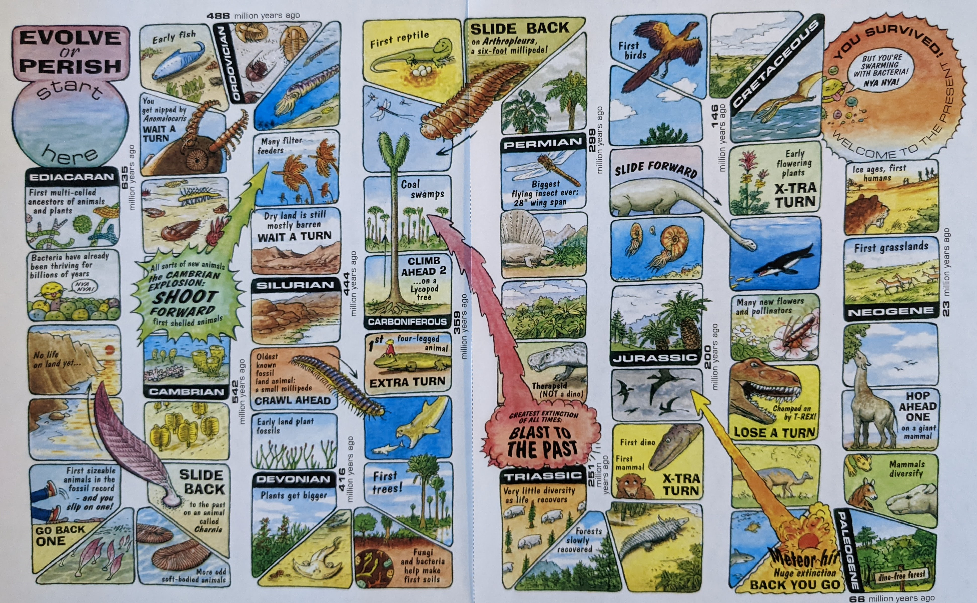
Evolve or Perish Board Game
A fun way to learn about evolution!
The board consists of a track with 63 spaces representing a total of 630 million years. Each player starts with a chip in the starting square and takes turns to roll a single die to move the chip by the number of squares indicated by the die, following the route marked on the gameboard. Several squares take the player a fixed number of years forward or backward in time. Some squares reward the player with an extra turn, such as during the development of early land plants and the first four-legged animal. There are also squares with unfortunate events that force the player to move backwards or lose one or more turns, the most recognizable being the Permian-Triassic extinction.
Winner is the first one to the last square!
See additional sheets for variations of
the game for beginners and advanced students.

Slide 47
Evolve or Perish Board Game
Some help with abbreviations and names…
• mya = millions of years ago
• Meganeuropsis permiana - This is an example of a scientific name of a plant or animal, in this case the giant fossil dragonfly. The first name is the Genus, the second is the species. The proper way to write these names is in italics, so it is clear they are the official Latin names.
• To learn how to pronounce the names, we encourage you to look them up on-line!
Note: The animals and plants depicted in Evolve or Perish are based on actual fossils and information gathered by many generations of paleontologists who have studied them. The artist, Hannah Bonner, remained true to the science but imagined colors and other features for which there is no fossil record.
Below are the names of Geological Time Intervals used in Evolve or Perish (oldest to youngest left to right):
Proterozoic: Ediacaran | Paleozoic: Cambrian Ordovician Silurian Devonian Carboniferous | Mesozoic Triassic Jurassic Cretaceous | Cenozoic Paleogene Neogene

Slide 48
Additional Resources
More places to learn about paleontology and fossils in Nevada:
Ice Age Fossils State Park
http://parks.nv.gov/parks/ice-age-fossils
Berlin-Ichthyosaur State Park
http://parks.nv.gov/parks/berlin-ichthyosaur
Oak Springs Summit Trilobite Area
https://www.blm.gov/visit/oak-springs-trilobite-site
Tule Springs Fossil Beds, NV
https://www.nps.gov/tusk/index.htm
Willow Tank Formation in the Valley of Fire State Park
https://sites.google.com/site/boessepaleo/field-experience/willow-tank-formation-fieldwork--nv
Ichthyosaurs – video
https://education.nationalgeographic.org/resource/prehistory-101-ichthyosaurs

Slide 49
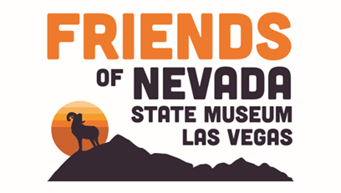
Thank you!
Thank you to our program partners for sponsoring this MIAB about Paleontology and Fossils.
This has been made possible from grants provided by:

