Slide 1
Nevada Animals Traveling Trunk
Trunk Contents

Slide 2
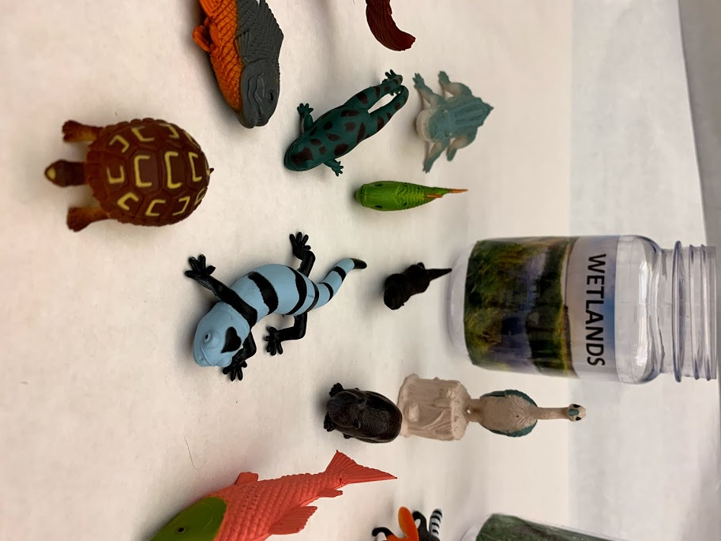
WETLANDS
A habitat that is covered with water.
Some animals found in wetlands around the world are frogs, salamanders, turtles, alligators and crocodiles, fish, birds like herons and ducks, beavers, otters, and fish.
Some examples of adaptations found in wetlands animals:
Beavers have webbed feet that make them excellent swimmers.
Frogs can breathe through their thin skin while underwater.
Fish use gills to breathe underwater.
Some birds have long legs for standing in water.

Slide 3
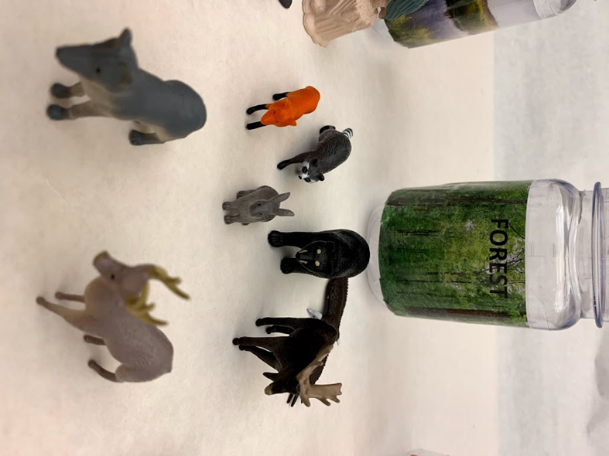
FOREST
A habitat that is covered with trees.
Some animals that are found in forests around the world are snakes, wolves, raccoons, moose, eagles, bears, deer, rabbits, owls, red foxes, and cougars.
Some examples of adaptations found in forest animals:
Black bears hibernate through cold winters.
Some birds migrate to warmer areas in winter.
Chipmunks gather food and store it for winter.
Baby deer (called fawns) have spots that blend in with the forest floor and help them hide from predators.

Slide 4
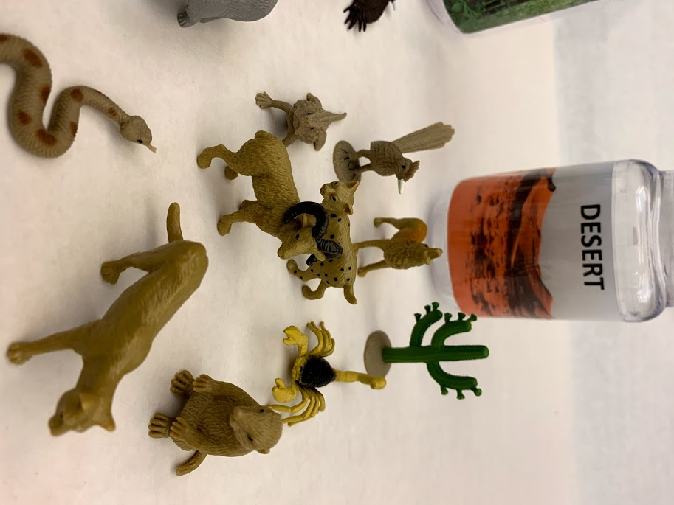
DESERT
A habitat that gets very little rain.
Some animals that are found in deserts around the world are bighorn sheep, bobcats, horned lizards, mountain lions, coyotes, roadrunners, rattlesnakes, and scorpions.
Some examples of adaptations found in desert animals:
Snakes and other reptiles are covered in scales that keep them from losing water.
Desert tortoises can store water in their bladders.
Ground squirrels use their tails to shade themselves from the sun.
Many desert animals are nocturnal, meaning they’re active at night when it’s cooler.

Slide 5
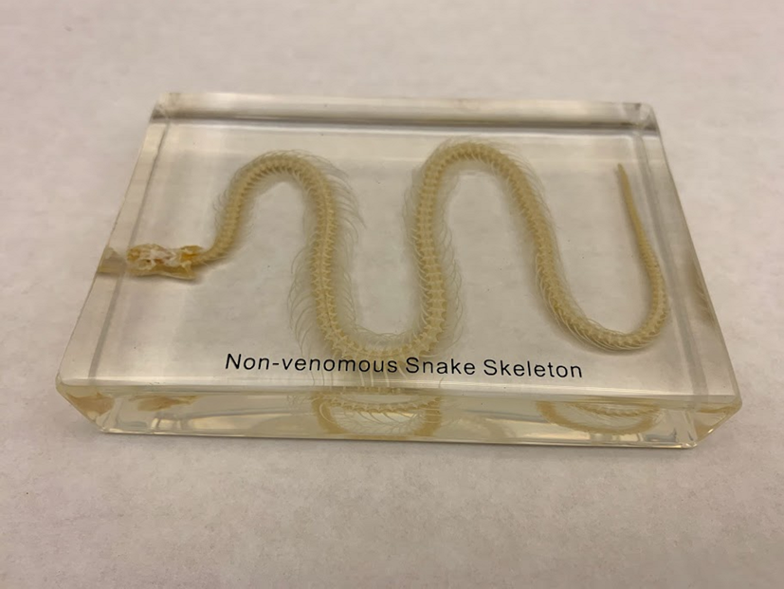
SNAKE SKELETON
Snakes can live in deserts, forests, and wetlands. A snake’s coloring can give you a clue about its habitat. Many snakes blend into their environments.
Snakes are carnivores. They eat small animals.
A snake’s shape lets it slither quietly through grass or rocks so that it can sneak up on its prey.
Like all reptiles, snakes are covered in tough scales that protect them and keep them from losing too much water from their bodies.

Slide 6
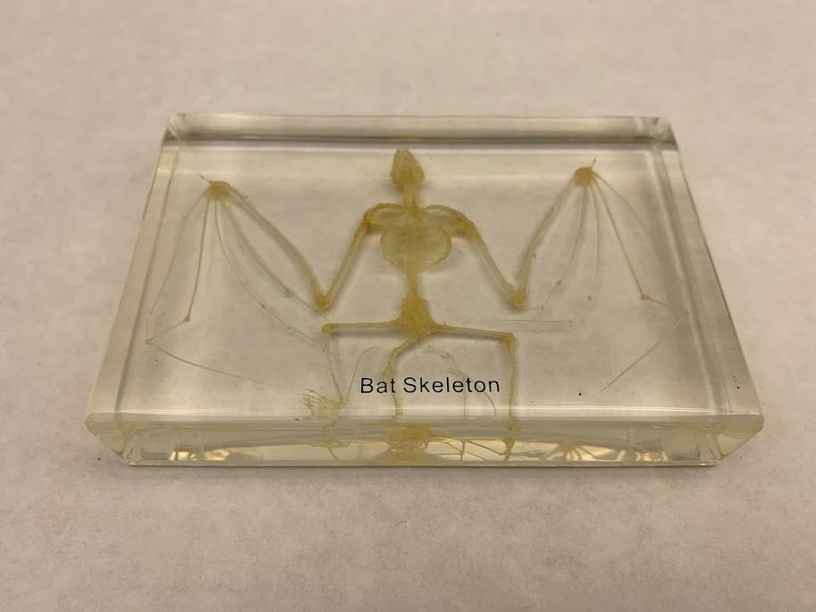
BAT SKELETON
Bats can live in deserts, forests, and wetlands.
Bats can be carnivores or herbivores. Different kinds of bats eat insects, nectar, or even animal blood!
Bats are the only mammal that can fly.
Look closely at the bat’s wing. It is made up of bones very similar to your fingers. The thumb is not part of the wing and is used to cling to surfaces.
Bats find shelter in buildings, caves, and mines.
Bats are nocturnal. This helps them avoid the heat of the day, have less competition for food, and avoid predators.

Slide 7
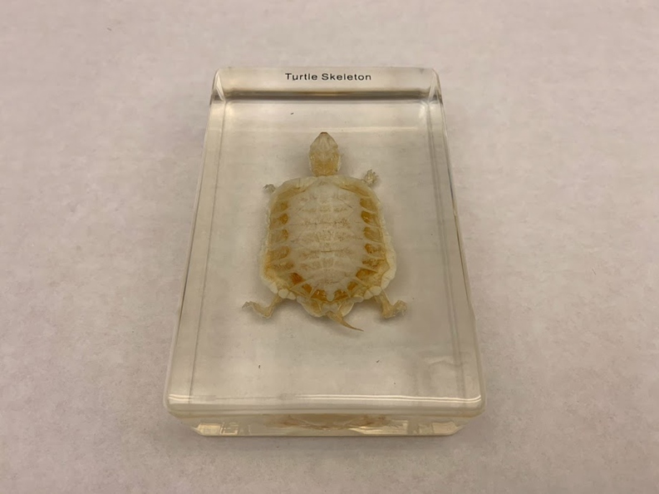
TURTLE SKELETON
Most turtles live in wetlands. Turtles that live on dry land are called tortoises.
Turtles are carnivores. They eat insects, worms, snails, and fish.
Turtles are protected by a hard shell. The shell is made of bone and is part of their skeleton.
Turtles have webbed feet for swimming.

Slide 8
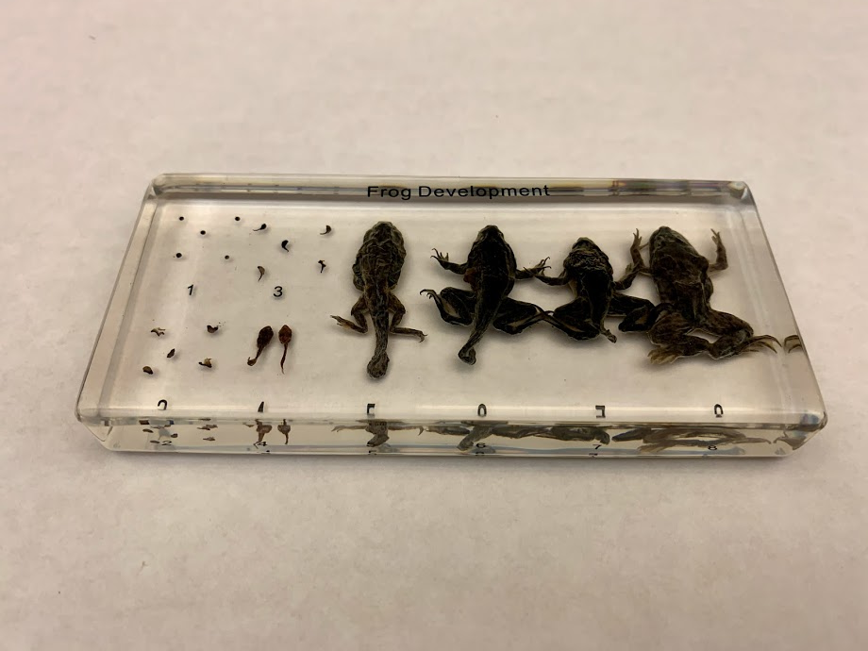
FROG LIFE CYCLE
Most frogs live in wetlands.
Adult frogs are carnivores. They eat insects and worms.
Frogs can breathe underwater by absorbing oxygen through their thin skin.
Frogs have strong legs for jumping.
Frogs change from tadpoles into adult frogs through a process called metamorphosis.

Slide 9
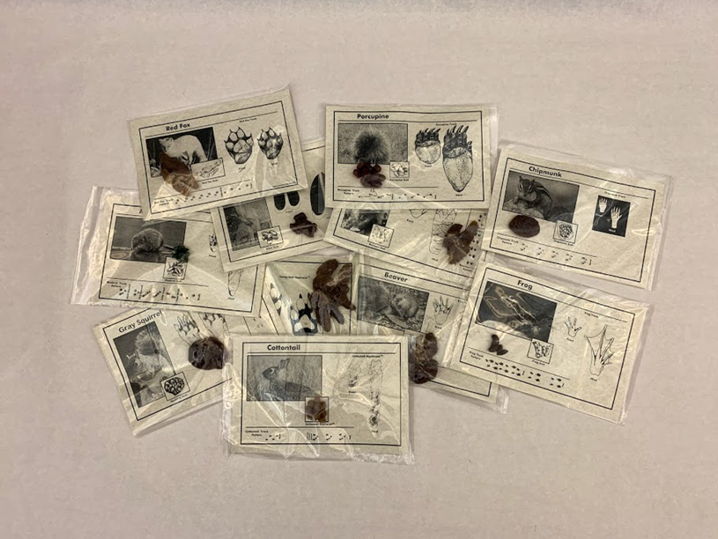
SCAT
(replicas)
Scat is what scientists call animal poop.
Looking at the size, shape, and color of scat can tell you what kind of animal it came from.
Examining scat can give you some clues about what an animal has been eating.

Slide 10
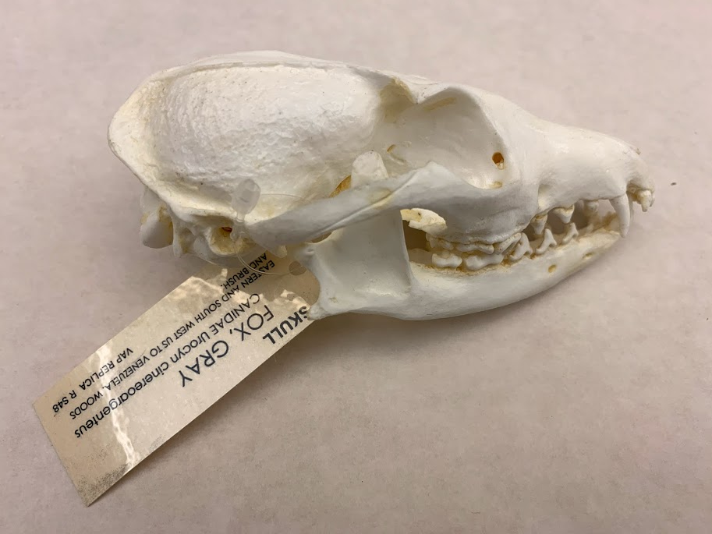
GRAY FOX SKULL
(cast)
Gray foxes can live in deserts, forests, or wetlands.
Gray foxes are omnivores. They eat small animals, fruit, and seeds. They have sharp teeth in the front for tearing flesh, and flat teeth in the back for chewing plants.
Scientists can identify gray foxes by the U-shaped ridge of bone on top of their skulls. Can you find it?
Gray foxes are in the dog family. They are one of only a few kinds of dogs that can climb trees.

Slide 11
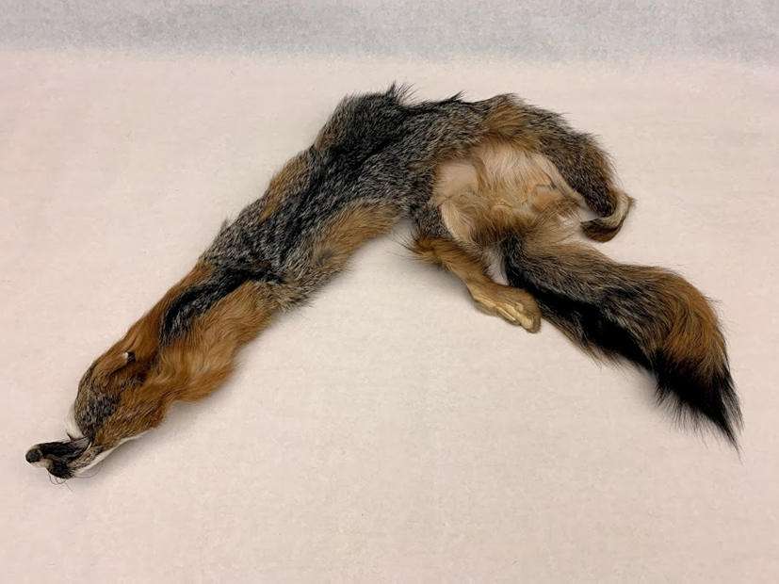
GRAY FOX PELT
Gray foxes can live in deserts, forests, or wetlands.
Gray foxes are omnivores. They eat small animals, fruit, and seeds. They have sharp teeth in the front for tearing flesh, and flat teeth in the back for chewing plants.
Gray foxes are gray on top and reddish on their sides and legs. They have a black strip on their tails.

Slide 12
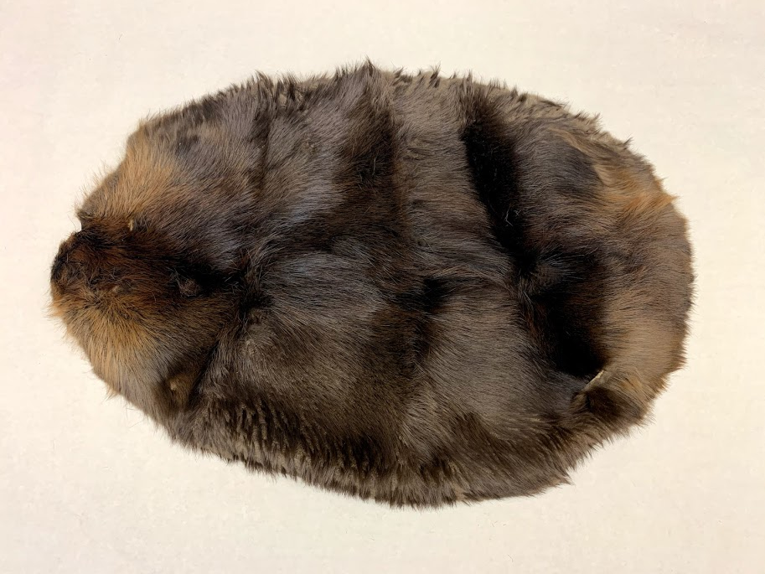
BEAVER PELT
Beavers live in wetlands.
Beavers are herbivores. They eat tree bark and plants.
Beavers have water repellent fur that keeps them warm and dry. Their coats have two layers with coarse fur on top and soft, downy fur underneath. See if you can find the two layers.
Beavers have webbed back feet for swimming.

Slide 13
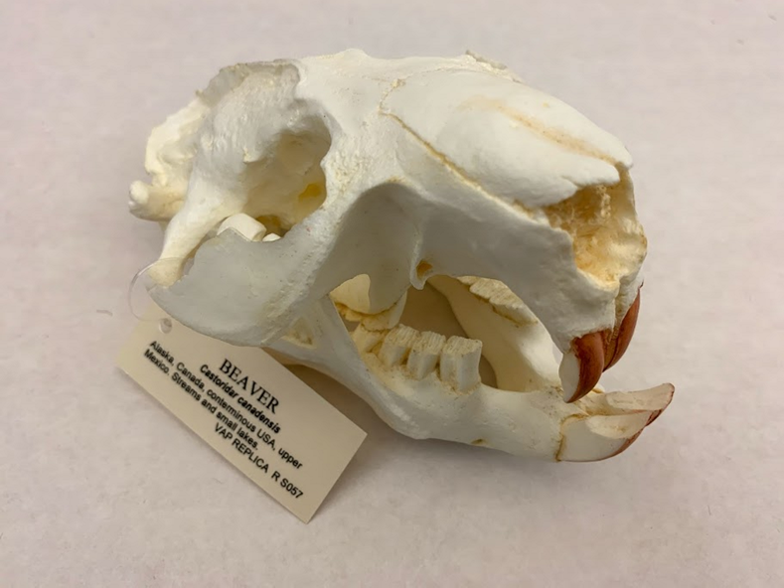
BEAVER SKULL
(cast)
Beavers live in wetlands.
Beavers are herbivores. They eat tree bark and plants.
Beavers use their strong front teeth to chew down trees to build dams. Their teeth have iron in them to make them extra strong. The iron gives them an orangish color.

Slide 14
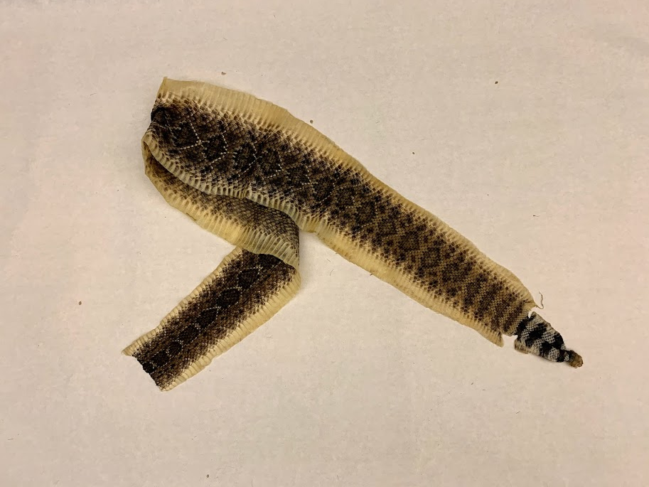
RATTLESNAKE SKIN
Snakes can live in deserts, forests, or wetlands.
All kinds of snakes are carnivores. They eat small animals.
Rattlesnake rattles are made of segments made of keratin, just like your fingernails. Snakes can scare away their predators by using special muscles in their tails to shake their rattles.
Snake skin is covered with tough scales.

Slide 15
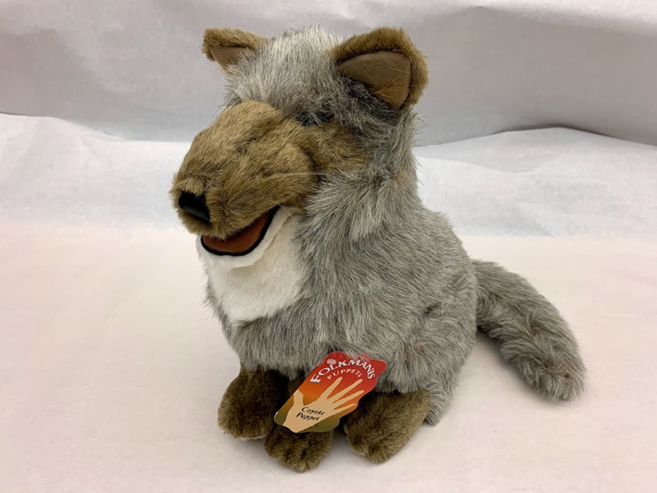
COYOTE PUPPET
Coyotes can live in deserts, forests, or wetlands.
Coyotes are omnivores. They eat smaller animals, seeds, and fruits. In urban areas they’ll even eat your garbage!
Coyotes are sometimes eaten by larger animals like wolves and mountain lions.
The coyote’s scientific name, Canis latrans, means “barking dog.” They make lots of different sounds to communicate with each other.

Slide 16
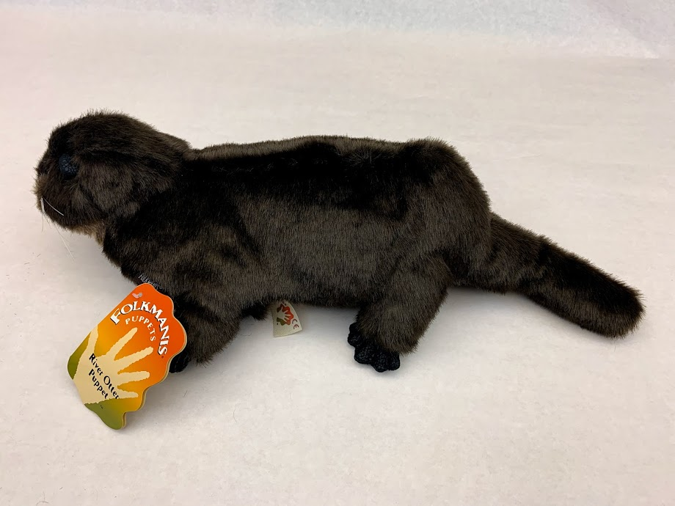
RIVER OTTER PUPPET
River otters live in wetlands.
River otters are carnivores. They eat fish, crabs, frogs, reptiles, birds and bird eggs, and small mammals.
Bobcats, coyotes, and large birds are some of the animals that might eat river otters.
River otters have lots of traits that make it easy for them to live in water, including thick fur, webbed feet, and nostrils they can close when they go underwater.

Slide 17
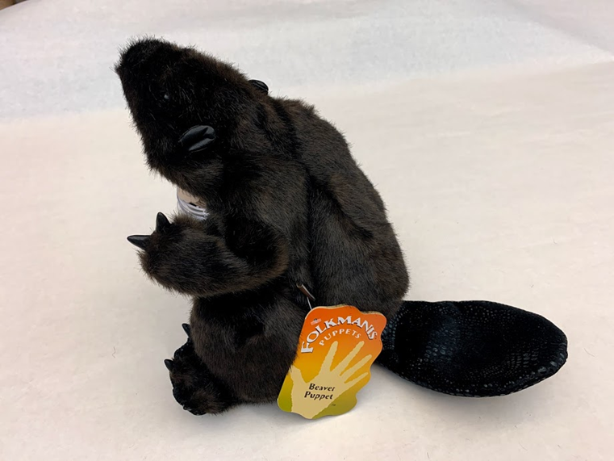
BEAVER PUPPET
Beavers live in wetlands.
Beavers are herbivores. They eat tree bark and plants.
Predators like coyotes, bears, and foxes will eat beavers.
Beavers use their flat tails to slap the water to make a loud sound that warns other beavers of danger.

Slide 18
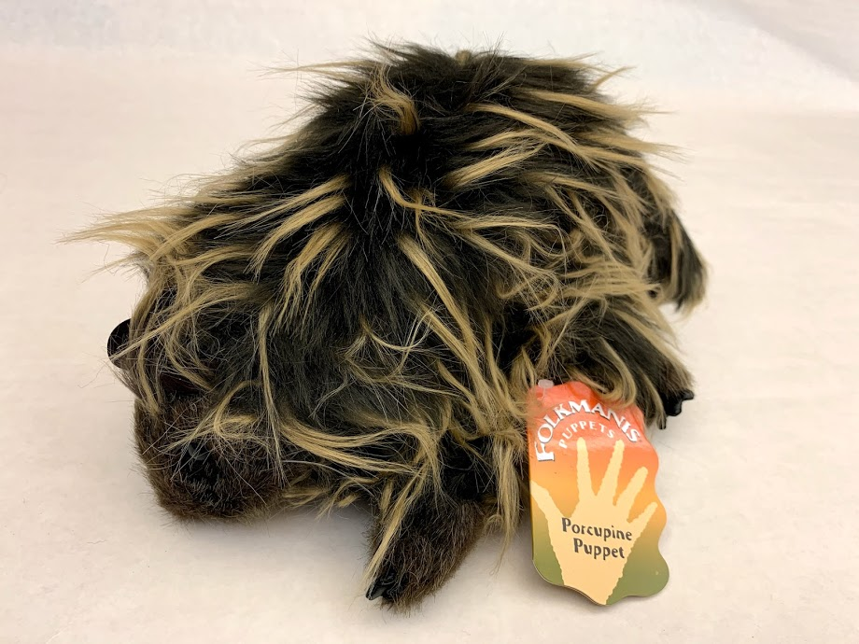
PORCUPINE PUPPET
Porcupines live in forests.
Porcupines are herbivores. They eat pine needles, tree bark, and other plant parts.
Porcupines are protected by over 30,000 sharp quills!
Some predators can flip porcupines over to attack their unprotected stomachs.
Porcupines have long claws that help them climb.

Slide 19
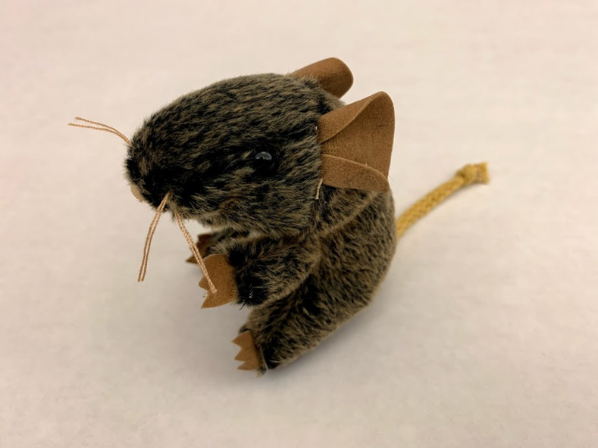
MOUSE PUPPET
Mice can live in deserts, forests, or wetlands.
Mice are omnivores. They eat seeds, grains, fruit, insects, and snails.
Larger animals like coyotes, foxes, bobcats, snakes, and birds will eat mice.
Mice have good eyesight and hearing to detect predators.

Slide 20
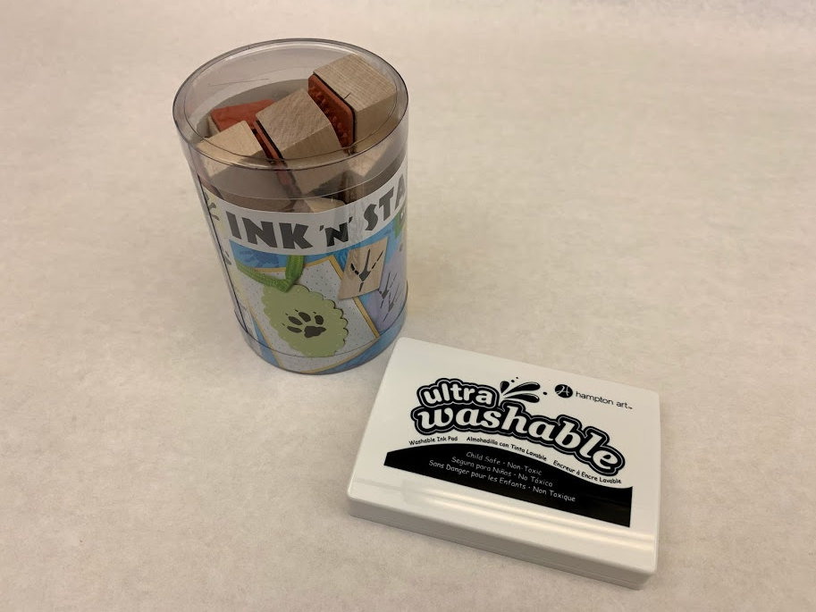
ANIMAL TRACK STAMPS
Animal footprints are called tracks.
Tracks are easiest to see on snow, mud, soft dirt, or sand.
Each animal’s track has a distinctive shape and size.
You can even tell how fast an animal was moving from its tracks. See if you can tell how your footprints change when you’re walking versus running.

Slide 21
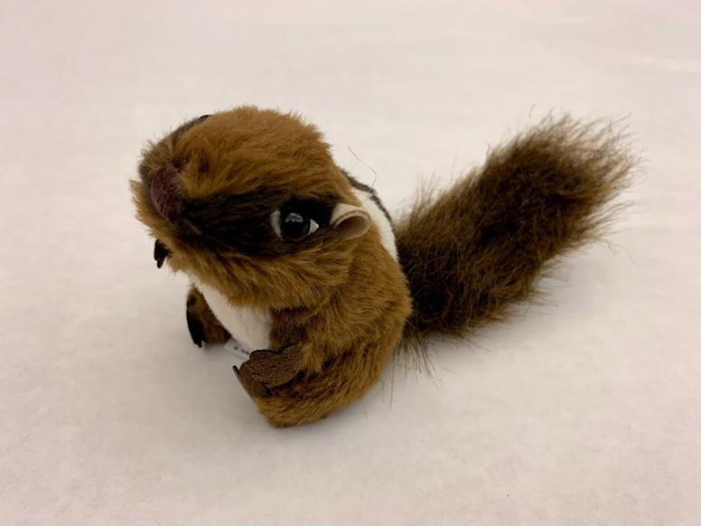
CHIPMUNK PUPPET
Chipmunks can live in deserts, forests, or wetlands.
Chipmunks are omnivores. They eat seeds, fruits, plants, and insects.
Larger animals like coyotes, foxes, bobcats, snakes, and birds will eat chipmunks.
Chipmunks are good climbers and fast runners, traits that help them avoid predators.

Slide 22
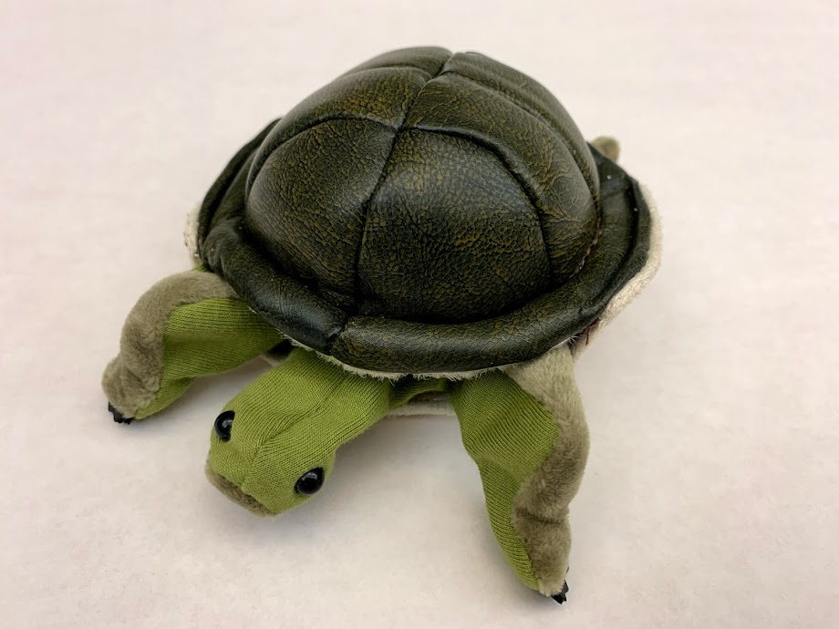
TURTLE PUPPET
Most turtles live in wetlands. Turtles that live on dry land are called tortoises.
Turtles are carnivores. They eat insects, worms, snails, and fish.
Turtles can be eaten by mammals, reptiles, and birds, especially when they’re young and their shells are still soft. Some birds fly into the air and drop turtles onto the ground to break their shells.
Turtles are protected by a hard shell. The shell is made of bone and is part of their skeleton.
Turtles have webbed feet for swimming.

