Slide 1
Children Past & Present
EARLY SCHOOL DAYS IN LAS VEGAS
Activities sponsored by:
Our special thanks to
University of Nevada, Las Vegas
Special Collections and Archives

Slide 2
The first Las Vegas School, at 2nd and Lewis Street
Description of photograph: “A teacher and school children posing next to a wooden school building. Handwritten note on back of photo: ‘Located at 2nd & Lewis Street. Originally at 1st & Main. I do not know what year this picture was taken -- probably before 1910 as the old 5th Street School was built in 1910.’”

Slide 3
5th and 6th graders at the Las Vegas School, 1905 - 1906
Fifth and sixth grade students at a school located on Second and Lewis Streets, 1905-1906. For several years prior to 1905, school was held in a tent.

Slide 4
A temporary location after fire destroys the school
Photograph of schoolchildren and teachers, Las Vegas, Nevada, circa 1910. The Las Vegas School was held in the Methodist Church after the school at 2nd Street and Lewis burned to the ground. A group of schoolchildren and their teacher Florence Squires (later Boyer) are pictured in the front of the building.

Slide 5
Waiting for the new school …
Schoolgirls on stairs outside of Methodist Church where school was held in Las Vegas, Nevada, in 1910. The young woman holding a book is identified as teacher Florence Doherty.

Slide 6
Students at the new Las Vegas School
Photograph of children at Las Vegas School, circa 1912. The school had opened the year before. The building had eight rooms.

Slide 7
The one-room schoolhouse in Paradise Valley
Black and white image of several school children in front of a school house in Paradise Valley near Las Vegas, Nevada, 1916. Handwritten text on image reads: "My first school in Paradise." Note: Image is from a family photo album that was loaned to UNLV Libraries Special Collections and returned to the family on July 17, 1984.

Slide 8
5th Street Grammar School, 1920s
Photograph of grammar school, Las Vegas, Nevada, circa 1920s. A new high school had opened a few years earlier.

Slide 9
Time out for a snowman
Photograph of school children making a snowman, Las Vegas, January 10, 1930. School children making a snowman outside of the Fifth Street School. Handwritten note on photo sleeve: "Making our snowman- boy on left standing alone is Rulon Ostenson. I believe Rulon is an officer in the First State Bank in Las Vegas now (1975)."

Slide 10
Boulder City Elementary School, October 1932
Photograph of Boulder City Elementary School, Boulder City, Nevada, October 5, 1932. Black and white image of school children in front of the Boulder City Elementary School, now the home of City Hall, located at 401 California Avenue in Boulder City. Four hundred of the 550 enrolled pupils are seen in front of the school.

Slide 11
A rare Las Vegas snowfall
Photograph of school children in the snow, Las Vegas, January 10, 1930 Close-up of children playing in the snow at the Fifth Street School. Handwritten note on photo sleeve: "Her first snow! I think this is a darling picture. Kathleen Meyers is so cunningly & unconsciously posed. Most of the children had never seen snow before. It's been a real treat."

Slide 12
St. Thomas, before Lake Mead rose to cover it
Black and white photographic image of school children in St. Thomas, Nevada, in the early 1930s. St. Thomas is a part of Clark County and was abandoned when the water from Lake Mead submerged the town. It is now a Ghost Town protected by Lake Mead National Recreation Area.

Slide 13
A one-room schoolhouse
This is the Sandy Valley School, in Lincoln County. The photograph dates from 1938.

Slide 14
Las Vegas School students, circa 1910

Slide 15
El Dorado Grammar School, south of Las Vegas, 1938

Slide 16
Gold Point School, Esmeralda County, 1938
Gold Point was another Nevada mining town. It is now considered to be a ghost town.

Slide 17
Lincoln County High School, Panaca. This photograph was taken in the 1930s.

Slide 18
Las Vegas School students, November 1928

Slide 19
Ready for basketball
This appears to be the girls’ basketball team, or perhaps the girls’ physical education class. The photograph is dated November, 1916.

Slide 20
Ready for basketball
The men’s basketball team at Clark County High School, during the 1920-1921 school year.

Slide 21
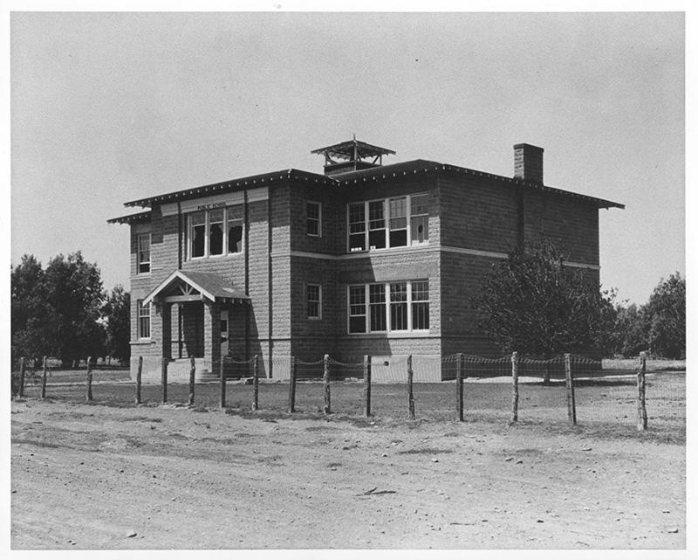
St. Thomas, Nevada, schoolhouse
Residents had already abandoned St. Thomas, Nevada, as Lake Mead began to fill behind the Hoover Dam. Someone has already broken all of the windows in the upper story classrooms. National Park Service photo.

Slide 22
At play, Fifth Street Grammar School, 1930s

Slide 23
A crowded Boulder City High School classroom, 1945

Slide 24
Patriotic pageantry in Boulder City
Boulder City, Nevada children dressed up for a Fourth of July parade, wearing historic costumes. They are in front of City Hall. Photograph dates from between the 1930s to the 1950s.

Slide 25
Costumes all around
Children in costume, possibly for a Fourth of July parade, in front of Boulder City Hall. Photograph dates from sometime between the 1930s to the 1950s.

