Slide 1
Museum in a Box Mining in Nevada
Artifacts

Slide 2
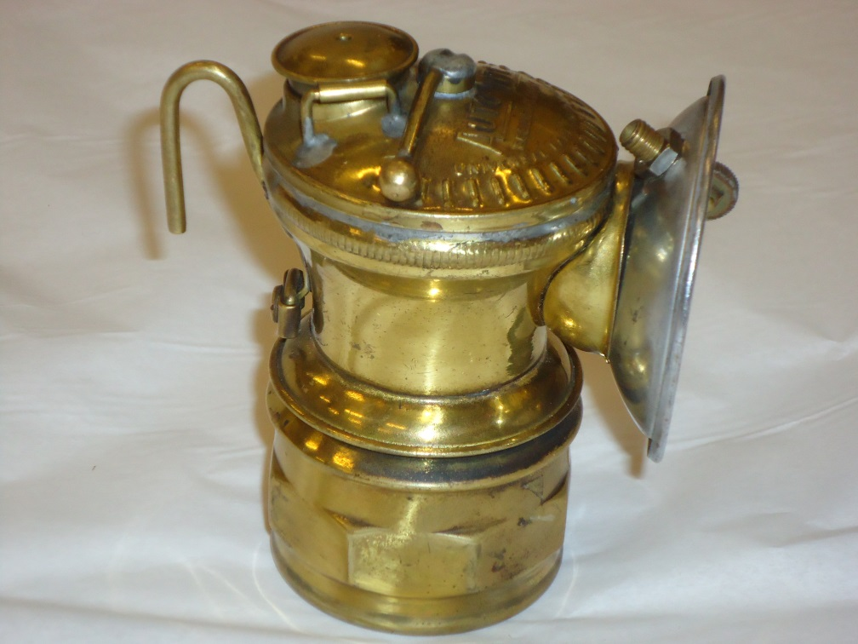
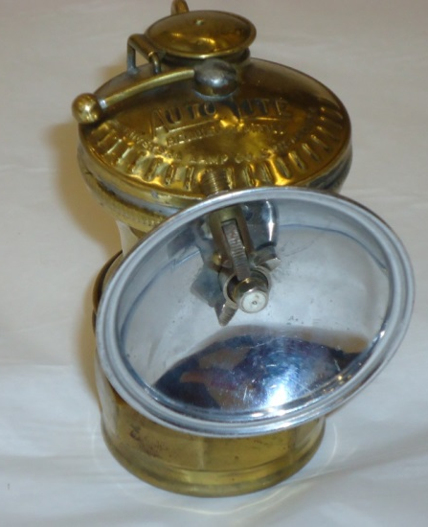
Mining in Nevada - Artifacts
The miner’s carbide lamp, developed in the 1890s, consisted of a container made of brass, with a top that screwed onto the base. The top had a nozzle with a shiny reflector behind it. The reflective surface directed the light outward. The flame came out the nozzle and could be ignited with a flint striker – something like today’s matches.
The lamps used calcium carbide lumps as fuel. These were placed in the lower chamber of the lamp, and water was placed in the upper chamber. Water would drip into the chamber below slowly, creating acetylene gas which was ignited to produce a flame – and light for the miner.
Miners wearing the lamps attached to their caps.
Credit: Smithsonian Institution, The National Museum of American History

Slide 3
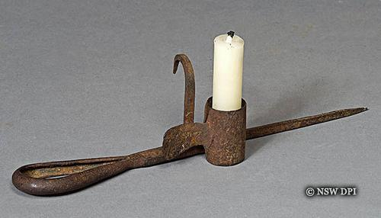
Mining in Nevada - Artifacts
A miner’s candlestick or candle holder. The candle was placed in the circular holder and the point was pushed or hammered into a crack in the wall of the tunnel or mine shaft.
Since the candle would be the miner’s only source of light, the miner would place the candlestick above his eye level, out of his way.

Slide 4
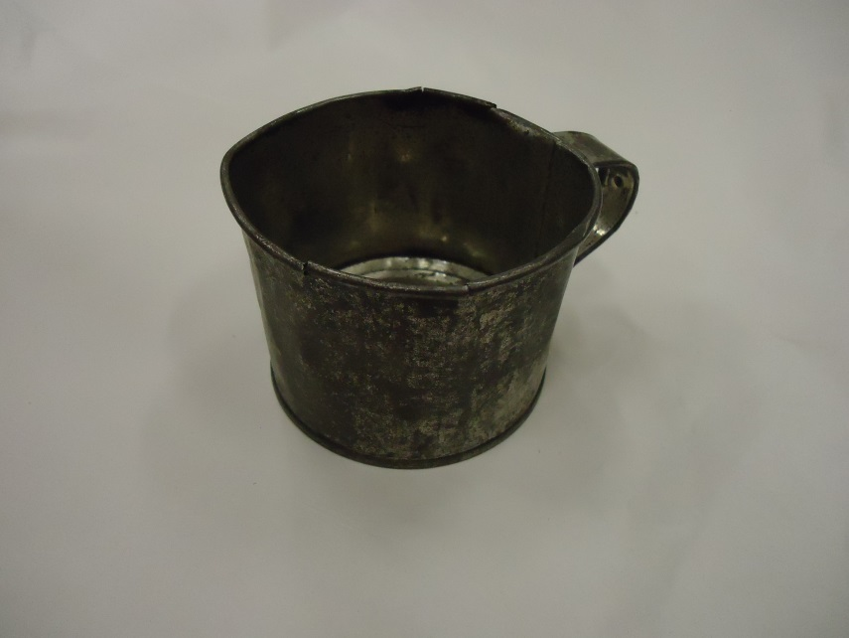
Mining in Nevada - Artifacts
Tin cups and coffee pots were used by miners as they were light weight and would not break the way that china or glassware would.

Slide 5
Mining in Nevada - Artifacts
A tobacco tin kept tobacco dry.
This Prince Albert brand was introduced in 1907, and was produced by the R. J. Reynolds company. Many prospectors and miners used tobacco products that came in tins like this one.
Once the tobacco tin was empty, it served as a dry, safe place to store the miner’s claim.
Please note some tobacco tins in the trunk may look and be branded differently.

Slide 6
Mining in Nevada - Artifacts
Prospectors would mark their mining claims by placing a copy of the claim in a tin like this one, and then building a monument of stones to cover it.
Mining claims were filed with the Clerk of the county where the claim was located. A claim included a physical description of the mineral area as well as the prospector's name. The mining claim was a legal document protecting the prospector’s land and was proof of their ownership.

Slide 7
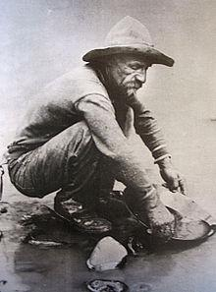
Mining in Nevada - Artifacts
A prospector’s pan was essential for a ‘placer miner’ or a prospector. The miner would mix sand, which might contain gold flakes, with water, and then move the pan in a circular motion to rinse the sand and separate the heavier gold flakes, which would settle to the bottom. This was called panning.

Slide 8
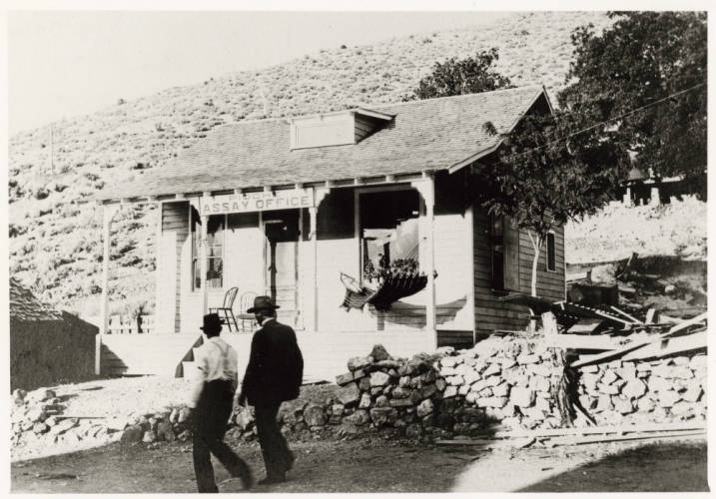
Mining in Nevada - Artifacts
Gold scales, found in an assayer’s office, measured the weight of the gold brought in by a prospector. An assayer was an important person in town. Assayers had to understand how to measure the amount of precious metals, and how to extract them as well. It was a complex job.
Credit: UNLV Special Collections

Slide 9
Mining in Nevada - Artifacts
A crucible was used in the process of assaying metals like gold and silver. They could come in different sizes.
A crucible is a pottery cup or small bowl that can be heated to very high temperatures – temperatures hot enough to melt ore and separate the different metals present in a rock sample.
To assay the metals a measured amount of powdered ore was placed in a crucible and melted. The ore formed a button shape in the bottom of the crucible. The ‘button’ of metal was then weighed so the assayer could calculate the quality of the ore.

Slide 10
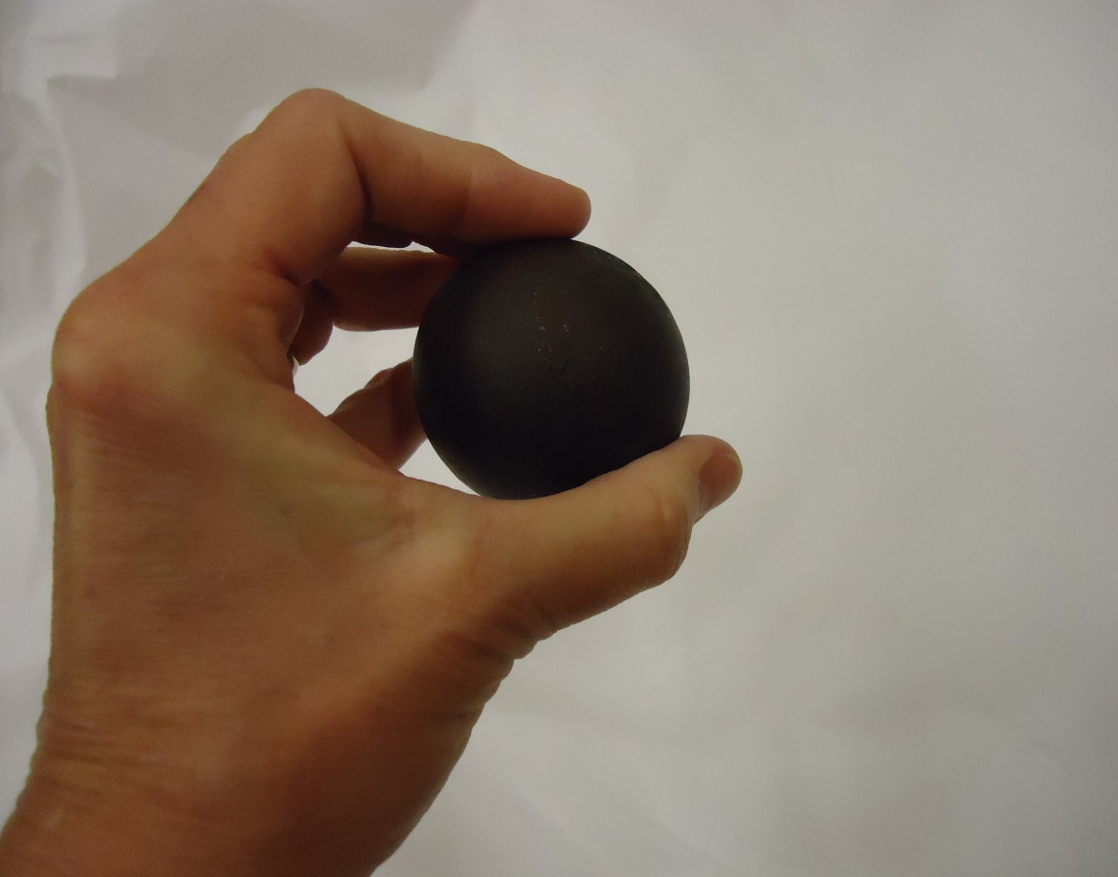
Mining in Nevada - Artifacts
There were many steps to process ore. This iron mill ball played an important part in the third step.
1. The ore went into a crusher, where it would be reduced to pea-size pieces.
2. The crushed ore would go to a stamp mill and be ground to the consistency of sand.
3. The ball mill – using different size iron mill balls – reduced the ore to a powdery consistency.
4. The chemical cyanide was used to remove the precious gold and silver.

Slide 11
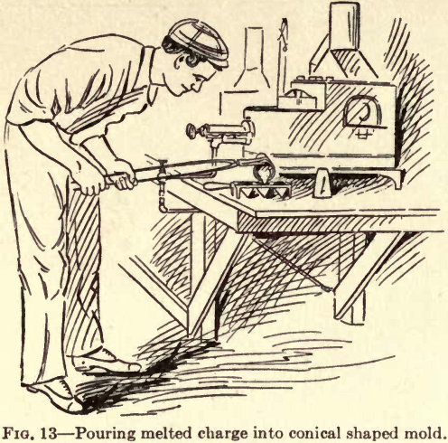
Mining in Nevada - Artifacts
Gold and silver was placed into the cup of an iron ladle which was then inserted into an oven with the long handle sticking out, making it easier to pick up.
The metals would melt and then could be poured into ingots (long, narrow rectangular shapes), or other molds.
Below, a ‘metallurgist’ pours molten metal into molds.

