Slide 1
Children Past & Present
Content
Activities sponsored by:

Slide 2
Cast iron pigg bank?
A ‘trick dog’ cast iron mechanical bank. Place a coin in the dog’s mouth and push the lever. The dog jumps through a hoop held by the clown (missing on this one). Toy banks were popular in the 19th century. The purpose was to teach children to save money. Banks were designed to make saving money attractive by rewarding children with the dog’s ‘trick’ as they saved their pennies.

Slide 3
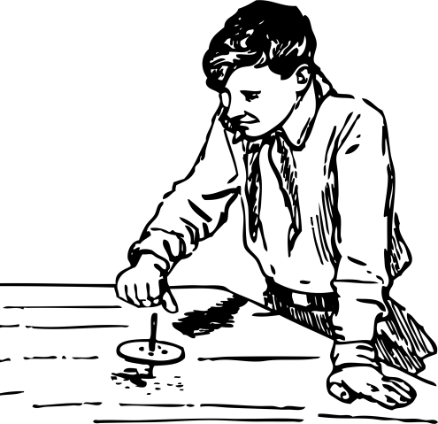
Spindle top
The spindle top is the easiest top to spin. Insert the spindle of the top through the small holes of the handle. Put the tip of the shoelace into the smaller hole of the spindle (but don’t pull it through). Turn the top to wind the lace on the spindle. Hold the handle over a table or the floor, and pull the wooden end of the lace. The top will drop out spinning!

Slide 4
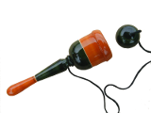
Ball and Cup Game?
There are many variations on this ball-and-cup game found around the world. This version is an early-American style. Putting the ball into the cup is possible with a small wrist action. Keep your eye on the ball!

Slide 5
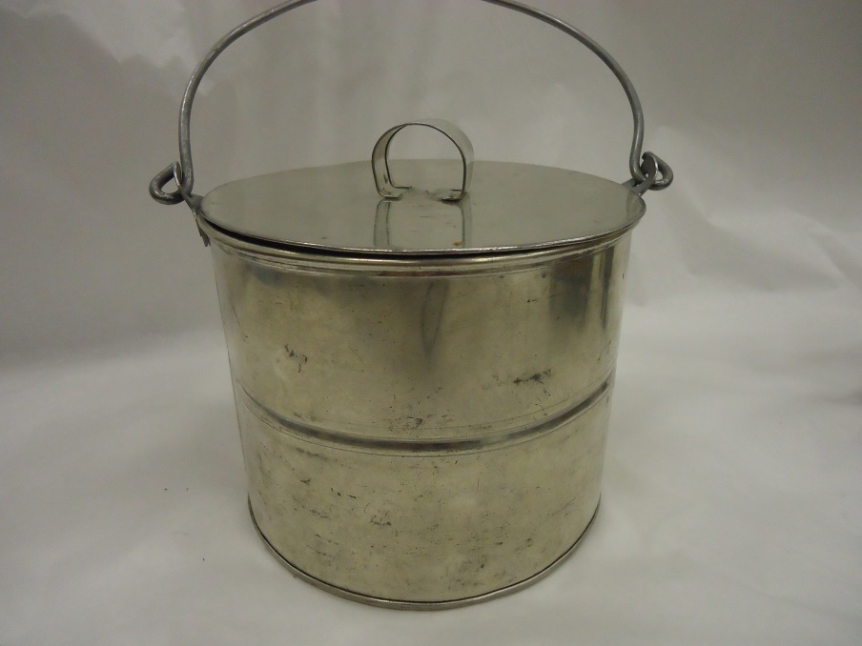
Lunch pail
Children often took their lunches to school in tin lunch pails. They could be shiny and new, like this one, or even a recycled large tin can. If no pails were available, a piece of cloth served as a lunch sack.

Slide 6
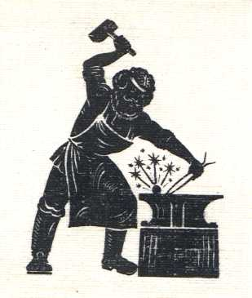
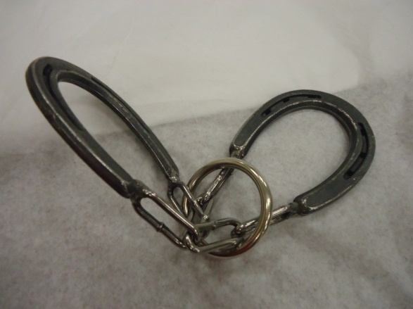
Blacksmith puzzle
The Blacksmith puzzles in this trunk are based on originals made out of iron by a blacksmith in the late 19th century. These puzzles ere made by a blacksmith at the Sturhr Museum of the Prairie Pioneer, in Grand Island, Nebraska.

Slide 7
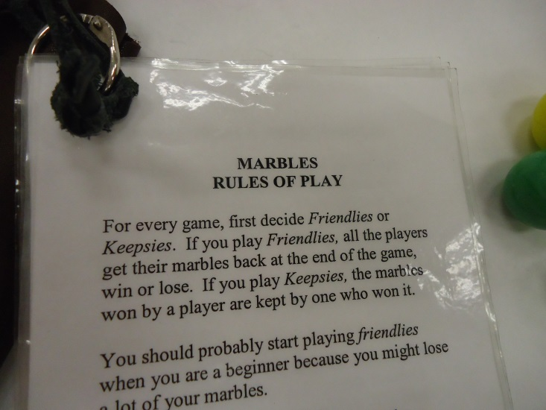
Marbles
Marble games have been around for more than 3,000 years! Clay marble have been found in ancient Egyptian tombs. And they played marbles in Ancient Rome.
Think about this: Why are marbles called marbles? Like so much of our language, the word marble comes from the Latin word, marmor, meaning “to gleam or sparkle.”
In North America, archaeologists have found marbles in what is now Mexico, as well as in parts of the United States, dating back to 100 B. C. In Europe, a 1560 Brueghel painting shows children playing marbles. By the 1800s, marbles were being mass-produced. Over the centuries, marbles have been made of clay, bone, polished nuts, stones, and – indeed – marble! Now, most marbles are made of glass.

Slide 8
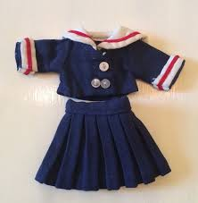
Wooden penny dolls
One hundred years ago, a penny could buy many different things. Small wooden penny dolls like this one could be bought in a general store for just a penny. Making clothes for the doll was the owner’s ‘job’ – and a good way to learn sewing skills.

Slide 9
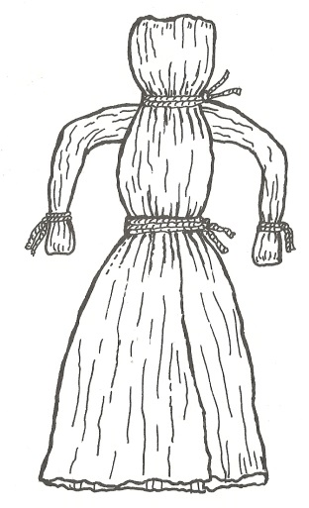
Corn husk doll
A popular doll was the corn husk doll, made from the outer leaves on ears of corn. Our corn husk dolls are simple. Heavy string is used to hold the doll together. Such string might have been hard to find for some children, depending on how far from a town they lived.

Slide 10
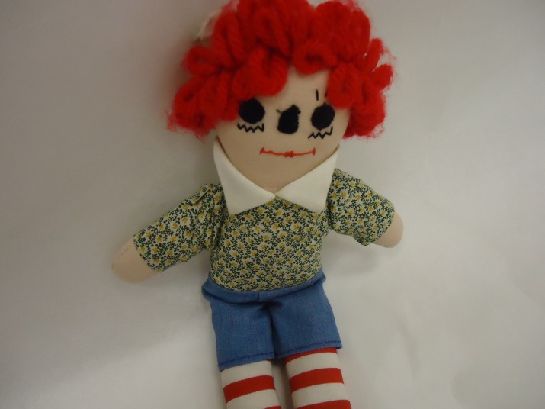
Rag doll
A Rag doll was a favorite toy, especially for pioneer children. The doll was usually made of scraps of material the child’s mother had saved and stuffed with scraps of old cloth. These reproductions look like the original dolls, although the stuffing is now cotton. The fabric used for their clothes are reproductions of late 19th century printed fabric.

Slide 11
Pull toy
A horse pull toy would be a fun activity for any young child!

Slide 12
Wooden donkey cart
This wooden donkey cart is an example of another pull toy, intended for a young child. If the donkey cut-outs had life-like decorations, they were applied by the color lithography process. Milton Bradley used this process on the toys and games he began manufacturing – making or building -- in the 1860s.

Slide 13
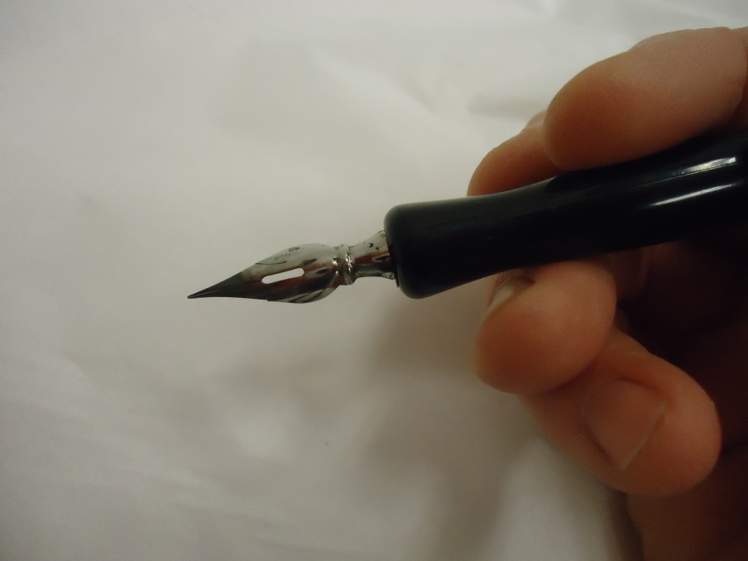
Ink and ink pens
Ink well, pens, nibs, ink and blotting paper were once very familiar to schoolchildren! Goose or turkey quill pens were used in the 1700s. Steel quills (or nibs) and holders were invented in the 1800s. The ink well is a glass container for ink and sat in a special hole in a student's desk in the late 1800s and early 1900s. The nibs are the pen points that are used by pushing them into the pen holder. These pens were used for cursive writing only, not for printing. The Montgomery Ward catalog has rubber pen holders and other ink pens. Special blotting paper is used to soak up the extra ink that comes out of the pen when you write.

Slide 14
Cube puzzle
Cube puzzles offered six puzzles in one, and provided hours of fun for children. The accompanying pictures show each finished puzzle. The pictures on this reproduction puzzle are not 19th century in style, but the puzzle type is!

Slide 15
Parlor games
The “parlor” was the room in a home where a family could gather after the day’s work was done, or when friends visited. Indoor activities that took place in that room became known as parlor games. Faces cards were a popular parlor pastime, just like the enclosed Changeable Portraits.

Slide 16
Changeable portraits
Changeable Portraits was a fun game for all ages. Changeable Portraits were usually a book of pictures of people, houses, or outdoor scenes. The pages of the book were cut in three even sections. The pictures changed by flipping through and selecting mismatched sections. Here there are six pictures of boys and six pictures of girls in 19th century clothing styles. You can try to put together the real picture – or, have fun and create your own.

Slide 17
Pull toy
This pull toy replicates an old circus wagon. Pictures like the one on this toy were applied using a color lithography process. This process was used in the 1860s by Milton Bradley on the toys and games the company manufactured. Milton Bradley, located in East Longmeadow, Massachusetts, continued to make toys and games until 2009.

Slide 18
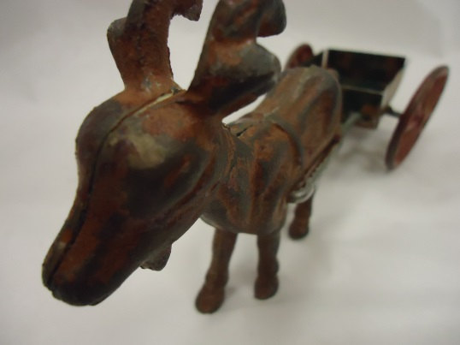
Cast iron toy
Cast iron toys like this goat cart were popular in the 19th century. They were cast using molds. Cast iron is a durable material, meaning is can last a long time. Cast iron is an alloy – or special mixture -- of carbon, iron, and silicon. Cast iron toys can break and cannot be repaired. You probably will also notice that they are quite heavy! Reproductions – or copies – of the old toys have been made for the past fifty years.

Slide 19
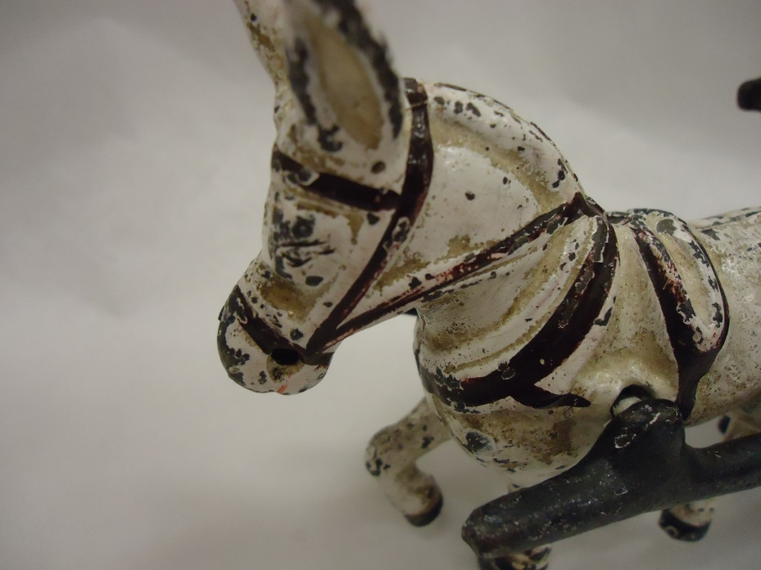
Donkey cart
This donkey cart is another example of a cast iron toy, popular in the 19th century. They were made using molds. Cast iron is a durable – and heavy – material. It is an alloy of carbon, iron, and silicon. Cast iron toys can break, and they cannot be repaired. This is a reproduction of the original.

Slide 20
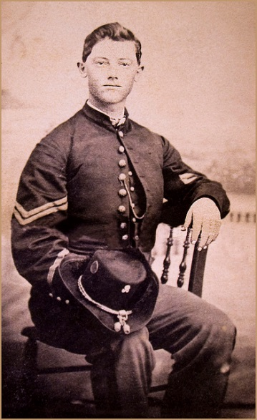
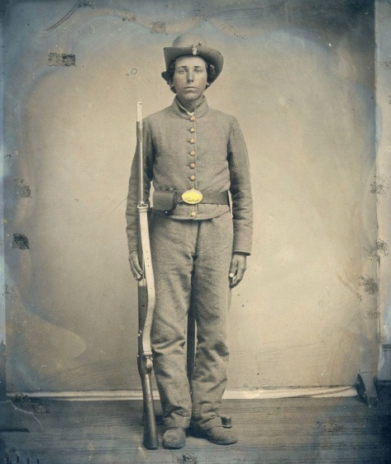
Lead toy soldiers
After the Civil War (1861-1865), lead soldiers were a popular toy for children. These reproductions are similar to the toys from over 100 years ago.

Slide 21
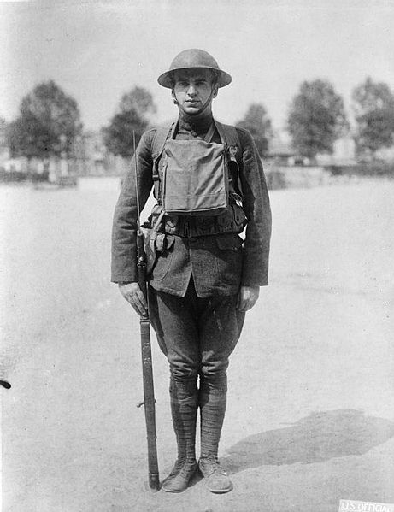
Lead toy soldiers
Toy soldiers were popular at the end of the 19th century. These World War I soldiers could be British or American. In some of the trunks, the WWI soldiers may have horses. Horses were used to bring wagons of supplies to the armies. Motor vehicles – trucks, automobiles – were available, but could not get everywhere.
World War I began in 1914, and ended in November of 1918. It was fought in Europe. The United States entered the war in April of 1917. Veterans’ Day, on November 11 each year, originally honored the men who fought in the First World War.
These toys are made of lead. Do not put them in your mouth.

Slide 22
Valentines
Valentines were very popular during the Victorian Age. We call it the Victorian Age after Queen Victoria, who reigned in Great Britain from 1837 to 1901.
The styles here are reproductions of late 19th century valentines. Animation made these valentines special with the pull-out, and the turning wheels.

Slide 23
Jumping jacks
Brightly-colored jumping jacks were animated puppet toys whose arms and legs moved when a string was pulled. Hold the jumping jack by the string at the top of his head, and pull down on the string that comes out below to make him dance!
Jumping Jack is the doll name used in England. They were called hampelmann in Germany, and pantin in France, where they first became popular.

Slide 24
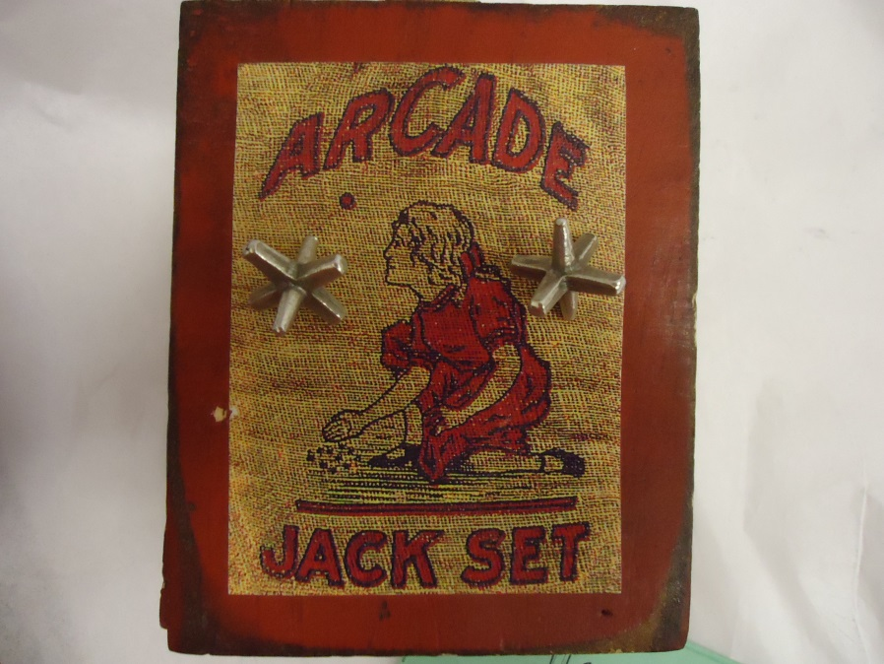
Jacks
Jacks is an ancient game with many different names. It can be played many ways. Throughout history, seeds, stones, and animal bones have been used to play. The game has been called knucklebones, jackstones, fivestones, checkstones, and dibs.
Long ago in England, the word Jack was a nickname for a young boy. It came to be associated with the game. A century ago, stones cubes of different colors , but about the size of dice, were used for the game. In many countries, pebbles and stones are still used.
Today, the game is played with a small rubber ball and 5 six-legged jacks. The jacks are either metal or plastic.

Slide 25
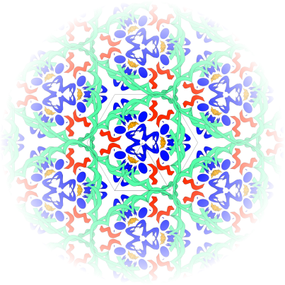
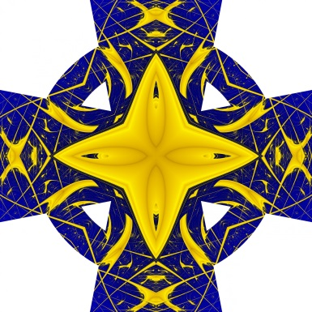
Kaleidoscope
The kaleidoscope was invented in 1816 by Sir David Brewster of Scotland. He created a tube-like instrument with mirrors set inside at different angles and loose pieces of glass at one closed end of the tube. He called the instrument the kaleidoscope, from the Greek words meaning “beautiful-form-to-see.” In 1870, Charles G. Bush developed and sold kaleidoscopes in the United States and they have been popular here ever since.
The parlor was the room where a family gathered after the day’s work was done, or when friends visited. Indoor activities like playing with the kaleidoscope took place there.

Slide 26
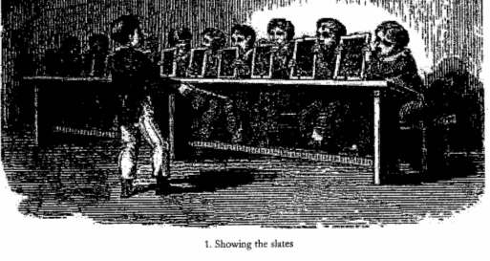
Chalkboard
A slate was a lap chalkboard used in school. Children used a slate pencil to scratch their assignment on the slate board. In the 20th century, large slates called blackboards were fastened to the school room wall and chalk became the writing tool. Slate is a type of rock, and is breakable. The illustration is called, “Showing the Slates.”

Slide 27
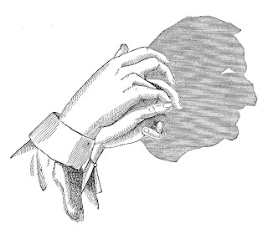
Hand shadow game
Another popular parlor game was “Hand Shadows.” Most of us know how to make bunny ears – that’s easy. But using this Hand Shadows flip book, can you try the more difficult ones?

Slide 28
Cast iron car
Another example of a cast iron toy. This is, of course, a model of an early automobile.

